Slide 1

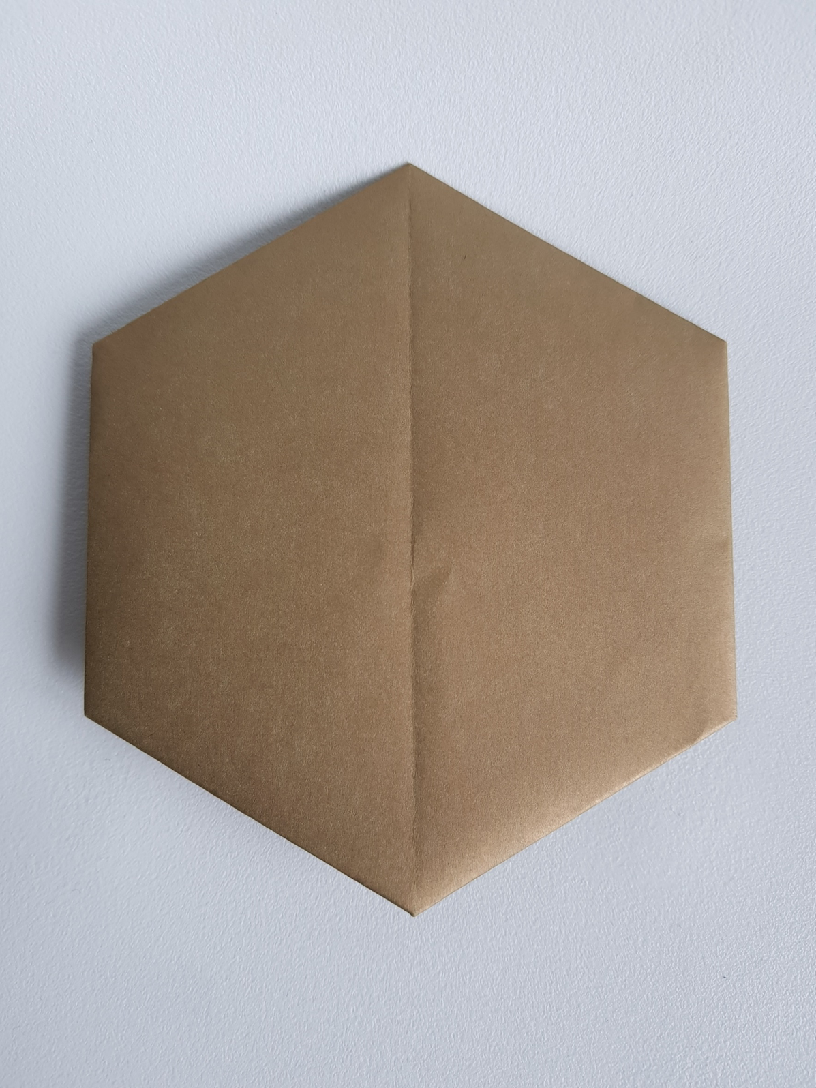
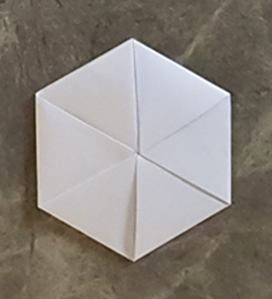
James Webb Space Telescope
Primary Mirror Origami Challenge

Slide 2
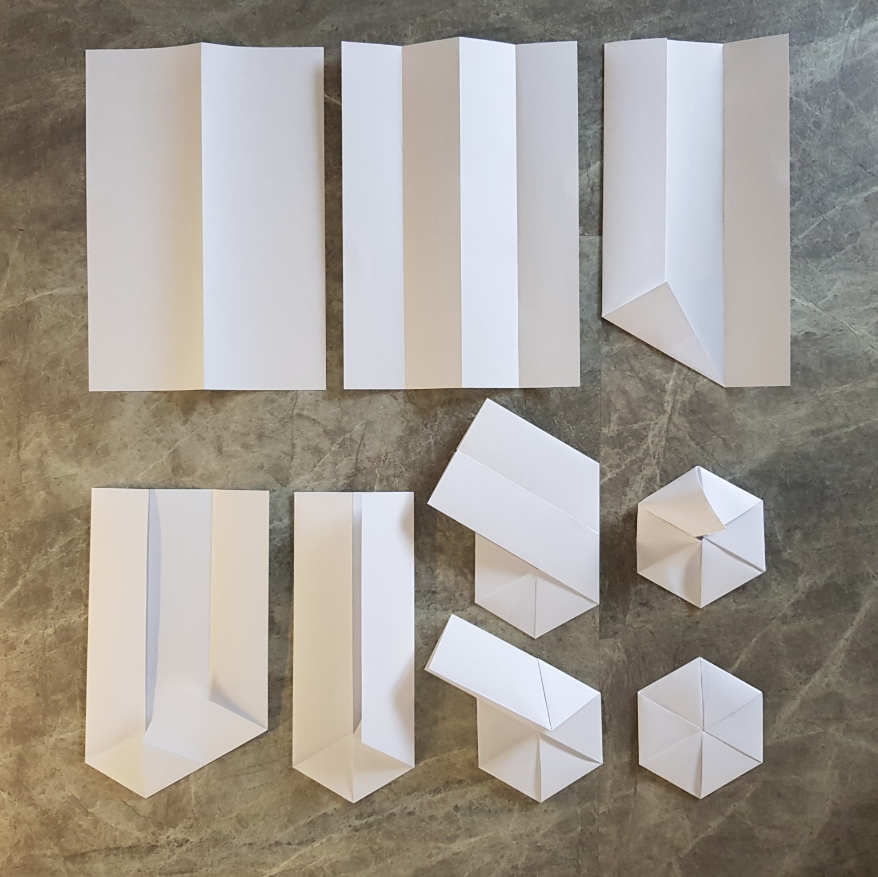

Slide 3

Main Mirror folding steps
1. Start with A4 paper size.
2. Fold the paper into half along the longest side.
3. Unfold and turn the paper over.
4. Now, fold each longest edge towards the central fold you just made.

Slide 4
Main Mirror folding steps
5. Open all the folds and rotate the paper to have the shortest edge towards you.
6. Fold the longest edge from the left to the central crease.
7. Now, hold your right index finger on the longest crease on the left, and lift and stretch the bottom left corner up to the central crease. The fold should start at the bottom left crease and end at the central crease.
8. Fold the lower right corner of the paper section up in parallel with the crease you just made.

Slide 5
Main Mirror folding steps
7. Now, hold your right index finger on the longest crease on the left, and lift and stretch the bottom left corner up to the central crease. The fold should start at the bottom left crease and end at the central crease.
8. Fold the lower right corner of the paper section up in parallel with the crease you just made.

Slide 6
Main Mirror folding steps
9. Re-fold the right edge of the paper over to the left to meet the central crease.
10. Fold the whole long section from the top lower section up, along the sloping edge of the lower left section.
11. Unfold.
12. Keep rotating the paper and fold the top section down, aligning the edge with the crease you just made.

Slide 7
Main Mirror folding steps
13. Fold the top left section down to the right.
14. Fold the remaining strip down to the right, aligning with the lower left edge.
15. If you open out some of the folds, you will be able to see a pocket that was formed right at the start.
16. Insert the remaining strip of paper into the pocket. You may need to bend the hexagon backward in half a little, making it easier to slot it in.

Slide 8

