Slide 1
The effects of compounding
Interest and depreciation

Slide 2
Task 1
If, at the start of the year, I have £100 in a bank account, which of the following offers do you think gives me the largest balance at the end of the year?
20% annual interest applied annually (a single one-off interest payment)
19% annual interest applied monthly (12 compounded interest payments)
18% annual interest applied weekly (52 compounded interest payments)
Set up a spreadsheet to analyse which is the best offer.
Notes:
Make sure that students understand exactly how this works.
For example, for the option of 19% compounded as 12 monthly payments, divide 19% by 12 to find the ‘monthly interest’ (about 1.58%), and use this to produce a ‘monthly multiplier’ of 1.0158.
Enter the initial balance of £100 in a spreadsheet cell.
In the next cell, enter a formula that multiplies the initial amount by 1.0158 – the result will be the balance at the end of month 1.
Copy this formula across (or down, depending on how the spreadsheet is set up) to 11 further cells, and the value in the final cell is the balance after 12 months.

Slide 3
Task 1 results
Interest intervals | Final balance | AER
Annual | 120.00 | 20.0%
Monthly | 120.75 | 20.75%
Weekly | 119.68 | 19.68%
AER stands for Annual Equivalent Rate and represents the realised annual percentage interest due to compounding.
Notes:
Show these values, and check that students have obtained the correct answers.

Slide 4
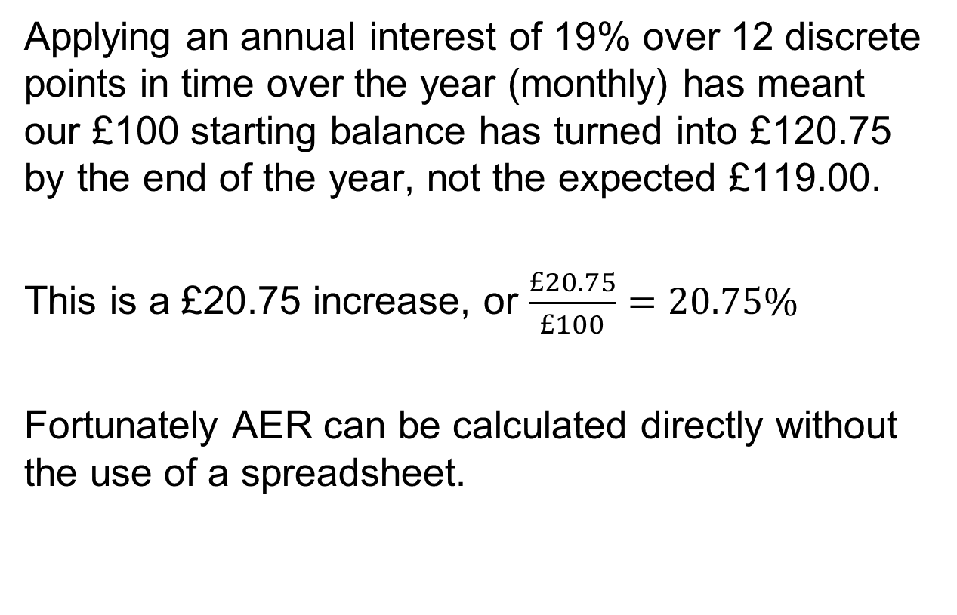
Annual Equivalent Rate
Applying an annual interest of 19% over 12 discrete points in time over the year (monthly) has meant our £100 starting balance has turned into £120.75 by the end of the year, not the expected £119.00.
This is a £20.75 increase, or $\frac{£20.75}{£100}=20.75\%$
Fortunately AER can be calculated directly without the use of a spreadsheet.
Notes:
Make the point that we do not want to have to enter (or copy) a long string of formulas in order to calculate the AER. There is a quicker way…

Slide 5

Annual Equivalent Rate
The annual equivalent interest rate (AER), r, is given by
… where i is the nominal interest rate, and n the number of compounding periods per year.
Note: the values of i and r should be expressed as decimals.
For monthly payments: r = (1 + 0.19/12)¹² – 1 = 0.2075 = 20.75%
Use the formula to check your results for weekly compounding.
What AER would expect for 17% nominal interest compounded as daily payments?
Notes:
The formula shown can be used to calculate the AER directly.
This formula is available as a built-in function called EFFECT() in spreadsheets like Excel or Numbers.
As an example of how to use this:
Enter text ‘Nominal Annual Rate’, ‘Number of Periods per Year’, and ‘AER’ into cells A1, B1 and C1. Adjust the width of columns A to C to fit the text.
Enter 19 in A2 and 12 in B2
In C2, enter the formula = EFFECT(A2, B2)
You can now make changes to the values in A2 and B2 to solve all of the problems on the next slide.

Slide 6
Annual Equivalent Rate
Calculate the following AERs:
An annual 13% interest compounded monthly
An annual 2.4% interest compounded weekly
An annual 0.9% interest compounded quarterly
An annual 100% interest compounded daily
13.80%
2.428%
0.903%
171.5%
Notes:
See previous slide for instructions on calculating these values using a spreadsheet.

Slide 7
Task 2
A Cash Individual Savings Account or ISA is an account which benefits from higher interest rates due to tax exemptions, although how much you can put into the account each year is limited.
Different banks offer different Annual Equivalent Rates (AERs).
Next are some example ISAs, along with an opening balance that will be put into the account and left untouched.
Notes:
Note that in this task we are back to considering interest paid annually.

Slide 8
Comparing savings accounts
ISA A
Initial deposit £980
0.75% AER
ISA B
Initial deposit £920
1.7% AER
ISA C
Initial deposit £940
1.25% AER
Option D: Under the mattress
Initial deposit £1000
0% AER
Notes:
Options A, B and C represent offers by various banks, building societies, etc.
Option D is ‘do nothing’ – i.e. keeping the money under the proverbial mattress!
Ask students to compare the performance of the four options over a period of 10 years.
They should use a spreadsheet for this. A good solution would be a single graph showing how all of the investments vary over the time period stated.

Slide 9
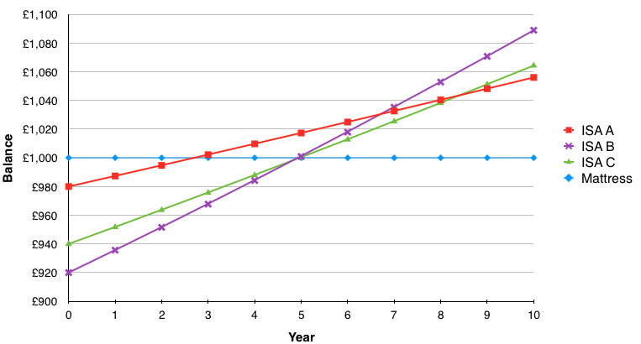
ISA interest
Notes:
This shows one possible solution. Ask students to compare their results to this one. Although their graphs may be formatted very differently, the data should be the same!

Slide 10
Task 3
Depreciation is the decrease in value of an asset (or valued object).
Companies have to apply a percentage decrease to their assets for financial recording purposes (although it isn’t an exact science).
Following are details of four new cars, along with depreciation rates that have been applied to them.
Notes:
Finally, we are going to look at what happens when things go down in value – i.e. depreciation.

Slide 11
Comparing cars
Car A
Initial value
£19 000
Annual depreciation
14%
Car B
Initial value
£15 000
Annual depreciation
9.9%
Car C
Initial value
£12 000
Annual depreciation
6.5%
Car D
Initial value
£9 500
Annual depreciation
5.2%
Notes:
Again, the task here is to compare the depreciation of the four cars shown over a period of 10 years.
Students may be able to adapt their previous solution, rather than starting from scratch.

Slide 12
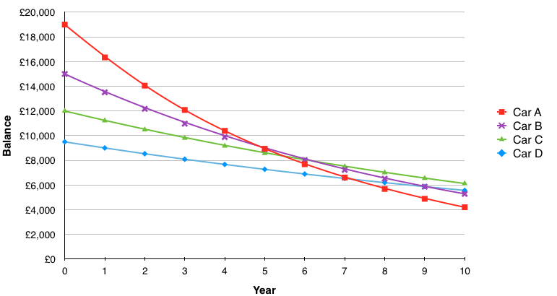
Car depreciation
Notes:
Here is one solution. It might be worth asking how realistic this model is; would we really expect a car to lose a constant percentage of its value each year in this way?
As an extension, students could investigate the validity of this model, by getting values of second-hand cars (the same model, but different ages) and seeing how well they fit this picture of ‘exponential decay’ of value.

