Slide 1
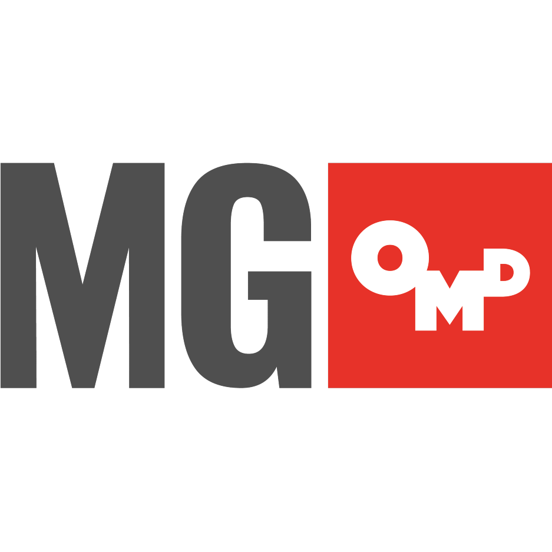
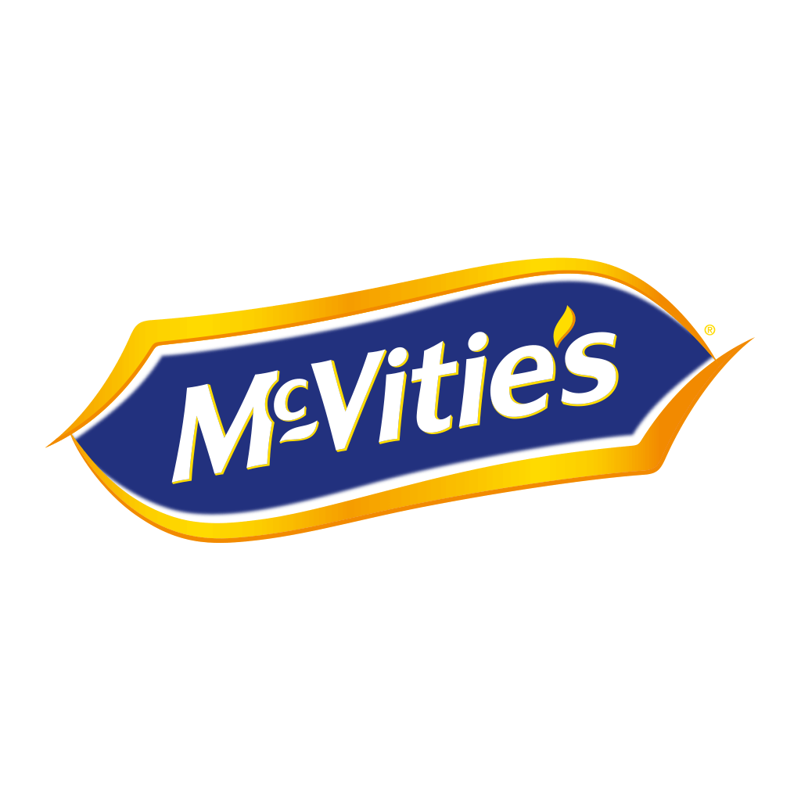
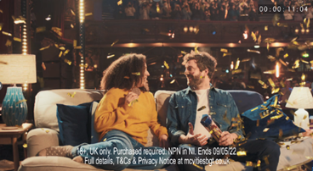
Biscuit’s Got Talent: How Britian’s Got Talent Sweetened Mcvitie’s
The Challenge:
McVitie’s while still well-loved wasn’t being talked about in the same way. They needed a campaign that would set them apart from other brands and showcase their unique place in British society.
The Solution:
Sponsorship with entertainment institution, Britain’s Got Talent to reach 7.5 million individuals on linear alone and a programme licence to bring the IP into the real world across in store, on packets and more.
The Results:
Social activity reached 43.7 million individuals, 73% of viewers recalled the sponsorship, 82% of viewers remembered seeing at least one more campaign execution. Brand Talkability was 17% higher with those who recognised the campaign. Purchase intent rose by 5% over the sponsorship period. And finally it established McVitie’s as the UKs number 1 Biscuit brand.
Notes:
The Challenge
McVitie’s vision is to be Britain’s best loved snacking brand. The brand while still well-known, research showed that while there was a huge amount of love the brand, no one was talking about it or recognising it. McVitie’s needed a campaign that would awaken the love for the brand and get people talking about them.
McVitie’s, as a result, had clear of objectives of changing perceptions and driving awareness for the brand. But the campaign needed to set McVitie’s apart from other biscuits, it needed to be a premium brand that customers would pay more for. Consumer research showed that people saw McVitie’s as part of British true fabric and a national brand. The campaign needed to make McVitie’s feel like a British Icon while still driving sales for the brand.
The TV Solution
Armed with clear objectives, MGOMD got to work in finding the best way to hit these goals and ambitions. While TV had always worked well for McVitie’s but with small budgets than the competition, they weren’t getting the right cut through. Having seen the power of sponsorship with other clients, MG went into the market looking for the right property that would deliver the Britishness needed to cut through. At that moment the perfect property landed on the market, ITV’s Britian’s Got Talent. With 7.5 million adults watching each episode and the last series being the second most watched entertainment show for 16-34-year-olds. With an ambition to tap into shared moments, BGT also fitted the bill, with 44% of the series viewed as a co-viewed with 2 or more people watching together. The high frequency of idents would also allow McVitie’s to showcase the full range on offer from the digestive to the newly relaunched BN.
The Plan
Inspired by Britian’s Got Talent’s display of skills from singing to dancing, Comedy to sword swallowing, McVitie’s idents showcased the original, unique and golden ways people can share a McVitie’s biscuit. To build on the partnership beyond the idents, McVitie’s created a BGT first, contextual ads that sat in airtime around the shows to maximise conversation, create a stand out and a point of difference. When the iconic golden buzzer was pressed during the show, the contextual ads would play directly in the next break to the buzzer press. The contextual ads would encourage the viewer to pick up a pack of McVitie’s and enter a competition to win ‘money can’t buy prizes.’ In the eyes of MG, it was the perfect way to bridge the gap between advertising and in store sales.
To intergrate the campaign with wider activity, McVitie’s took the campaign to social media with a plan that ran across Meta and TikTok and was aligned to the golden moments of a buzzer press. When the buzzer was pressed, a give away was deployed in real time so that viewers could play along with the show. Taking this one step further, MG also created a competition called ‘BixTrix’ across TikTok that would see users vote for their favourite content creator, who’d used biscuits to display their own talents. In a TV first, this content was then brought to TV and used to bookend the ad breaks of the BGT final live on air with the winner revealed and all the talents showcased.
In terms of in store activations, MG were able to secure over 700,000 Touchpoints via licensing, this allowed McVitie’s to use BGT IP in supermarkets and independent stores nationwide. The McVitie’s retail team were also able to leverage the IP and secured eye-catching units around stores that would build excitement and interest in the competition and the all-important sales they needed.
Results
The campaign was a massive success for McVitie’s. From a media standpoint, the sponsorship of BGT proved fruitful totalling 1,371 TVRs with owned and earned social activity reaching 43.7 million people. The sponsorship also stood out and set McVitie’s apart from the category. 73% of viewers recalled the sponsorship against a norm of 53%. 82% of BGT viewers remembered seeing at least one other campaign execution beyond the idents.
The campaign also got people talking about the brand, brand talkability was 17% higher for those who recognised the campaign. The sponsorship also re-established McVitie’s as a loved British icon. 9 out of 10 people said it was a perfect brand match. Perceptions of McVitie’s being ‘a brand I love’ rose from 46% to 51% among viewers who recognised the campaign.
Finally, purchase intent increased 5% over the course of the sponsorship. 87% of viewers said the partnership made them want to buy some McVitie’s the next time they went shopping. And finally, the campaign helped to establish McVitie’s as the number 1 biscuit brand in the country.

