Slide 1
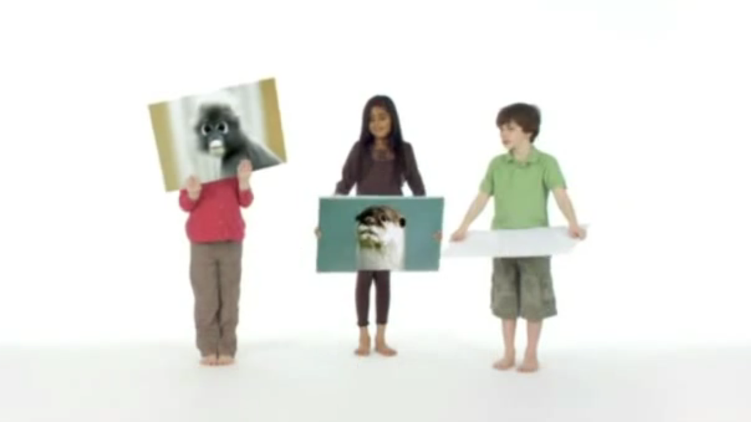
Twycross Zoo tries TV for the first time
Challenge
Twycross Zoo wanted to showcase what the zoo had to offer, raise its profile following advancement of their facilities and increase visitor numbers
Solution
They bought a tightly targeted campaign with ITV Central East, enabling the activity to be focused on a specific catchment area
They had 85 spots over three weeks in family programming, timed to align with the Easter holiday
Results
Visitor numbers rose by 132% over the Easter week
74,000 searches for Twycross Zoo over advertised period
Notes:
The Challenge
Twycross Zoo is a large zoo in Leicestershire, founded in 1963. In 2009, Twycross Zoo had undergone a revamp which included a new visitor centre and main entrance.
Twycross needed a new marketing strategy to promote these new developments and to ensure the success of future fundraising for the zoo. In addition, they wanted to raise the profile of the zoo, increase overall visitor numbers, retain existing loyal visitors and encourage repeat visits
Previously the zoo had been a heavy user of local press and PR. It had featured in local guides and coach publications, but it needed something extra to increase awareness.
The ideal plan would be to have a media campaign that could be built upon and developed, as footfall and budgets increased over the coming years. The campaign would start small but grow with the zoo. They also wanted the campaign to generate impact and talkability. This meant only one thing – a TV campaign showcasing what the zoo had to offer.
The Solution
The TV campaign gave Twycross Zoo the ability to showcase the various animals and the new features including the adventure playground and the train.
Twycross produced creative that appealed to both parents and children and featured three children showcasing all the things to do at the zoo. The ad was kept simple and the children held up pictures of the zoo and the numerous animals. It was accompanied by the soundtrack “Going to the zoo” and the strapline “Spend the day at Twycross Zoo and bring out the animal in you”. This tagline was to be used as the basis for a wider integrated campaign.
The campaign was broadcast across the ITV1 Central East region which enabled Twycross to focus its activity on a small and specific catchment area in a powerful and impactful way.
They bought 85 spots across three weeks in April 2009, focusing on the key period before, during and after Easter. The airtime was targeted in programmes watched by the family including Primeval and Coronation Street as well as films such as Charlie & the Chocolate Factory and Jurassic Park III.
Across the 17 days the campaign was active, over 845,000 adults saw the campaign at least once and whilst they spent a great deal less than their competitors, because the campaign bought a good selection of programming in a relatively small area, it worked wonderfully well for them.
The TV campaign was supported by a radio campaign.
Results
Visitor numbers were up 28% for the full month of April
Visitor numbers were up 132% over the Easter week
Searches were up over 130% in April
74,000 searches for Twycross Zoo over advertised period
97% of those who had seen the advertising agreed it would be a ‘fun and enjoyable day out for the family’
90% of those who had seen the advertising agreed it ‘provides a wide range of things for children to do’
79% of those who had seen the advertising claimed they were likely to visit the zoo in the future
Twycross came back on air with an increased budget and a larger area
To read the full case study and access the creative visit: https://www.thinkbox.tv/Case-studies/Twycross-Zoo

