Slide 1


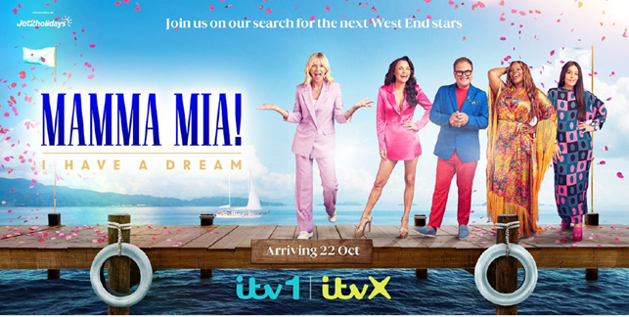
Jet2holidays: Welcome aboard sponsorship airways
The Challenge:
Price inflation, a cost-of-living crisis and wild weather had many considering a staycation rather than their yearly dose of sun and sand. For Jet2holidays to succeed they would need to reinforce their position as experts in travel.
The Solution:
Partnering with new ITV commission, Mamma Mia: I Have a Dream, Jet2holidays would be able to showcase their brand purpose and convince viewers of their expertise while improving perception, consideration and purchase intent.
The Results:
Creative testing showed the partnership as improving statements like ‘telling me something new about the brand’ and ‘making me want to find out more about Jet2holidays’. Along with this, those that recalled seeing the campaign saw strong improvements in consideration for the brand, with uplifts in likelihood to book with Jet2 in the next 12 months. Showing the movement from awareness to consideration to conversion.
Notes:
The Challenge
With 55% of Brits saying they look forward to their yearly dose of sun and sand over any other event in the year, Jet2holidays, the UK’s largest tour operator, should have been sitting back and enjoying the sun themselves. But against a backdrop of price inflation and a cost of living crisis had lead to questions around the affordability of European travel. Coupled with this was widespread media coverage of oppressive heatwaves, raging wildfires and mass evacuations which had prompted many holidaymakers to consider a staycation.
With the quality of the holiday being the main thing consumers look for when booking, Jet2holidays along with media agency Wavemaker, knew that any activity would need to build trust and convince users of the value of the package holidays on offer. Jet2Holidays would need to reinforce their position as experts in travel, moving the needle from awareness to consideration.
The TV Solution
With clear objectives, Wavemaker got to work in understanding the problem at hand. It was clear to them that a partnership would be the best way to strengthen brand associations. Research highlighted that the right partnership would deliver improvements in perception, consideration and purchase intent. Partnering with the right host would also see improvements in brand stature and improvements in trust.
Wavemaker knew that only one channel would deliver the required cut through with the target audience of families, TV. With more than a third of families saying they booked a holiday because they saw the destination on a TV show. TV would be the perfect environment and they just needed a TV show that would deliver on the brand purpose of Jet2holidays.
The Plan
Having landed on the idea of a TV partnership, Wavemaker went to work in seeking out the right partnership. In October 2023, Jet2holidays found the ideal brand partner. Enter the new ITV commission, Mamma Mia: I Have a Dream. The talent show format would see 14 of the best young performers in the UK compete for a starring role in the West End’s iconic production of Mamma Mia, set against the backdrop of a beautiful Greek island of Corfu. The show due to start in October would be perfect as it was outside of the traditional category window for marketing and would hopefully prime the audience ahead of the key first quarter booking period. The Sponsorship was designed in a way that would allow Jet2holidays to showcase their fun, family friendly credentials to the audience of 3 million a week across linear, BVOD and social channels to build favourability with the viewers across as many touchpoints as possible.
Wavemaker, working closely with Jet2holidays and partners Thames (production), Fremantle (distribution), ITV (broadcast) and IMA-HOME (creative), were able to devise a fully activated marketing campaign that would amplify the association with Mamma Mia: I have a Dream! Across all owned, paid, earned and performance channels. The linear sponsorship would provide the backbone to the campaign. Reaching 13 million adults in a relaxed state at the peak of their happiness and positivity, early on Sunday evenings. IMA-HOME produced bespoke idents and a commercial competition for each episode across the 8 week period showing the full scope of the offering and expertise in travel. Contextual creative would call out the previous week’s winner of the competition, which was designed to enhance engagement and maximise traffic to the site, where the consumer could find destination guides, travel info, family offers and behind the scenes content.
Branding was integrated into the show through passive placement to showcase the complete Jet2holiday experience, from end to end. Talent from the show were shown flying with the airline, transport was facilitated by the ‘red team’ resort helpers and mentoring and performances were set against the backdrop of Jet2’s exclusive resorts and hotels.
The launch of the show was supported with a series of events across all offices, bases and retail centres. ITV sponsored a Greek themed experience complete with an ABBA tribute band. Airports used the licence to rebrand check in decks and trade and contact centres gave away tickets to the live final. Long term partnerships with publishers were leveraged to amplify the partnership with exclusive imagery weaved into native articles, newsletters, competitions and advertorials. Some of this activity was lined up to match with promotional coverage including the front cover of the Daily Mail’s weekend supplement. This amplification continued when the campaign was live with Jet2holidays social team engaged with audience between episodes with reactive show messaging. Social content included licensed video, where audiences could watch talent being transformed from their everyday selves into sun kissed singers they see on TV.
Results
Jet2holidays partnership with Mamma Mia: I Have a Dream was a roaring success for the brand. The sponsorship allowed Jet2holidays to showcase their brand purpose and improve the key image metrics. Creative testing showed that the sponsorship out performed benchmarks for both ‘telling me something new about the brand’ and ‘making me want to find out more about Jet2holidays’. Key to fitting with the objective of moving awareness to consideration.
Independent research showed the partnership had shown growth in all the key consumer metrics. Of those aware of the sponsorship, there were strong uplifts in terms of future consideration of the brand and likelihood to book in the next 12 months. Prompted awareness increased amongst those who recalled seeing the activity. And 57% of those aware of the sponsorship saying that Jet2holidays ‘provides a better experience than other travel brands’. Truly positioning Jet2holidays as leaders and experts in travel.

