Slide 1


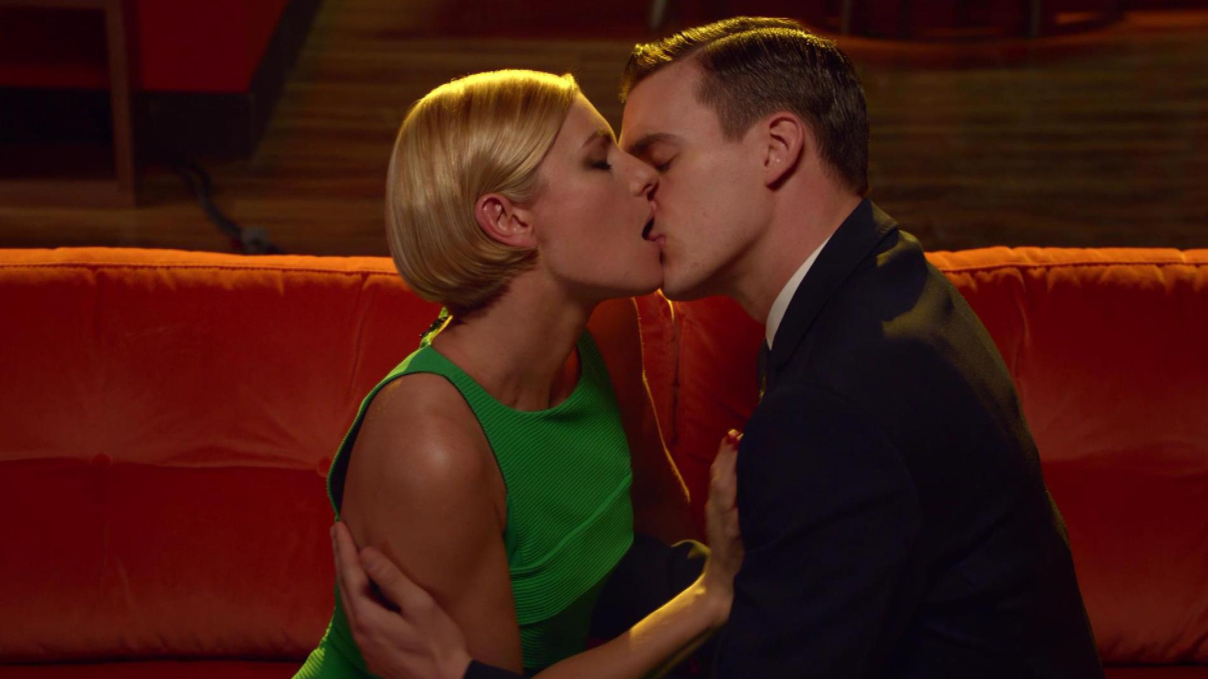
Habitat use TV for the first time
Challenge
Habitat wanted to build brand awareness and drive sales by educating people about their offering of high quality, well priced, fashionable furniture
Solution
They used TV for the first time using two stylish ads to focus on their upmarket audience within “voyeuristic” programming on Channel 4
Results
Brand consideration increased by 100%
40% of those who saw the ad talked about Habitat
Notes:
The Challenge
Despite Habitat’s heritage of 51 years, they unfortunately went through administration in 2011, which removed all but three of their stores from the high street. In 2015, the challenge was to educate their target audience that Habitat offers high quality, well priced, fashionable furniture.
Habitat’s furniture is available nationally via their website and in-store. However, as the three remaining stores are all in London, this skewed the target audience to London and the south east. Whilst there had been growth for the brand over recent years, they needed to accelerate the growth.
They had three core objectives:
Build brand awareness within the core target audience
Increase search for the brand
Drive sales of the advertised products
The Solution
Habitat worked with their agencies Portas and the7stars to create an insight and framework for the campaign, which was centred on the fact that consumers choose their home furnishings based on seeing furniture in other people’s homes or ‘through the keyhole’ type of programmes where they peek into other people’s lives for inspiration. The idea is that everyone is a voyeur but a Habitat voyeur is instinctively drawn to the design, no matter what else is happening in the room. The strapline they came up with was “We all look, but only some of us see”.
They chose to use TV for the campaign because TV delivers the greatest profit per pound, higher than any other media. In addition, they considered research from the IPA that showed that the most successful campaigns are those that build fame through emotional campaigns.
They created two stylish TV ads – “The Kiss” and “Dancing”. Both had a strong voyeuristic feel, as the viewer peeked in through the window to a living room and saw either a couple kissing or a semi-naked man dancing. However, the Habitat audience would see beyond this to the stylish furniture. Each ad championed a different product – the Oricco table or the Hendricks sofa.
Results
The launch campaign reached over 6 million ABC1 women
66% of those who saw the advert thought Habitat had good design – an 18% increase
Other key metrics were also improved eg. Habitat is forward thinking – up 10%, Habitat offers a wide range – up 30%, Habitat is affordable – up 50%
The activity got people talking. 40% of those who saw the ad, talked about Habitat
226% increase in sales of the Oricco table featured in the ad
Brand consideration – 100% increase
To read the full case study and access the creative visit: https://www.thinkbox.tv/Case-studies/Habitat

