Slide 1


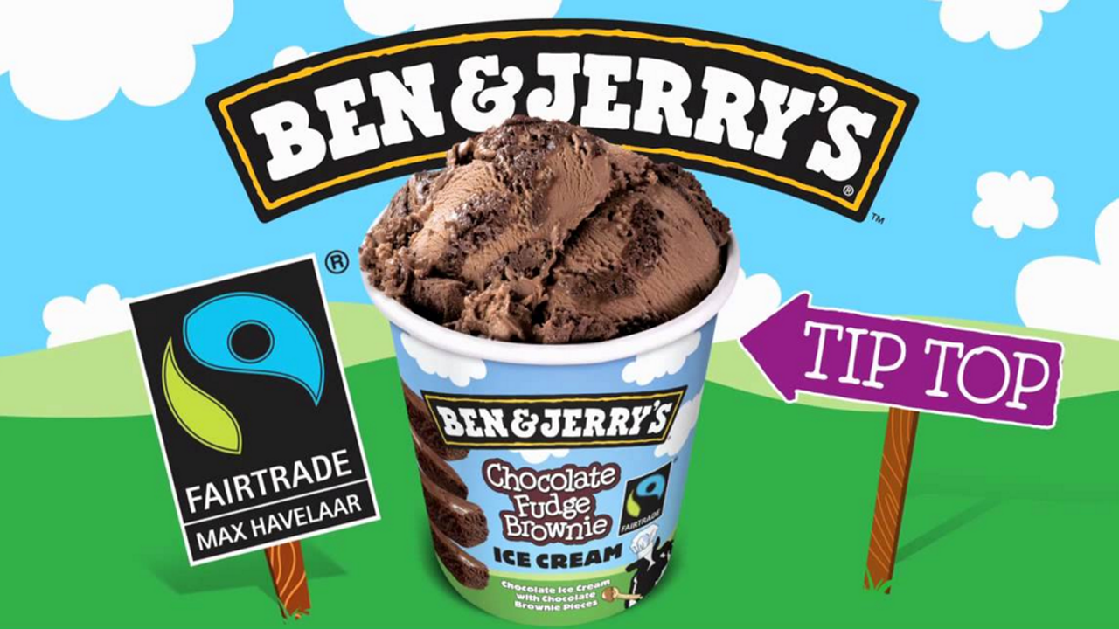
Ben & Jerry’s show the proof of TV’s effectiveness is in the pudding
Challenge
Ben & Jerry’s wanted to improve perceptions of their environmental credentials
Solution
They identified specific programmes more likely to be watched by people with an interest in Fairtrade and the environment
Ran the campaign on Channel 4 as their programmes were the most relevant
Results
Sales of the advertised product increased by 27% with overall sales increasing 6% year on year
Public perception that the brand is environmentally responsible grew from 16% to 27%
Notes:
Challenge
In a heavily commoditised marketplace full of brands focusing on price and promotional strategies, Ben & Jerry’s ice-cream needed a big idea. The brand shifted its focus to Fairtrade, in keeping with the nature of the brand and with the increasing consumer desire to understand what the brands they choose stand for.
The challenge for Ben & Jerry’s was that only 16% of people know that they have ethical credentials (source: Millward Brown). With a majority of consumers, Fairtrade alone is not a big driver in choice of ice-cream, with ‘flavour’ then ‘offers’ (source: Mintel) at the top of the consumer decision-making hierarchy in this category. Ben & Jerry’s needed to drive the high quality ingredients credentials through communicating the 100% Fairtrade message – but as this message only really has benefit within their core consumers, they had to be smart in the way they targeted them.
The Solution
Traditionally, Ben & Jerry’s have employed a multimedia, multi-touchpoint approach to their communications using cinema, print and digital in highly targeted ways. This time however they needed a different approach. They wanted to build awareness and drive responses to their website where there was a compelling story detailing their extraordinary ethical credentials. To do this they used TV – the broadest of all broadcast channels in a targeted, narrowcast way.
Mindshare worked closely with Ben & Jerry’s to identify a bespoke audience that went beyond demographics and targeted those who may be more likely to have an interest in the environment and Fairtrade. By creating a bespoke audience, they were then able to identify specific programming environments when these people would be most likely to be watching TV. The plan did not focus on the highest rating shows but the highest indexing. The Channel 4 portfolio was used for the campaign as this had the most relevant programme content across the period.
Results
Two thirds of the bespoke audience saw the TV advert an average of 5.5 times
Across the whole campaign an additional 11% points of cover were delivered on top of what total reach would have been using 2009’s multimedia (excluding TV) laydown with similar budgets
Some top line Millward Brown tracking results:
Brands that are responsible for the environment moved from 16% to 27%
Brands that you trust moved from 49% to 62%
Brands that appeal more moved from 42% to 55%
Brands that you would recommend to others moved from 47% to 57%
Most importantly sales of the advertised variant increased 27% and overall sales increased by 6% year on year
Ben & Jerry’s increased their investment in TV by 150% year on year as they were so impressed with TV’s effectiveness.
To read the full case study and access the creative visit: https://www.thinkbox.tv/Case-studies/Ben-and-Jerrys

