Slide 1


Monthly TV viewing report
December 2025
Waitrose – The Perfect Gift

Slide 2
December linear TV facts & figures
Total TV weekly reach %
Total TV viewed per day
Commercial TV viewed per day
Impacts
Individuals
74.2 | 52.6bn | 2h 13m | 1h 29m
77.0 | 51.1bn | 2h 31m | 1h 41m
75.8 | 20.2bn | 1h 58m | 1h 13m
56.0 | 3.3bn | 38m | 27m
75.7 | 23.2bn | 2h 27m | 1h 39m
78.2 | 27.9bn | 2h 35m | 1h 43m
75.1 | 3.2bn | 1h 13m | 50m
Adults
ABC1 adults
16-34
Men
Women
Housepersons with children
Source: Barb, December 2025, industry standard TV viewing in-home on a TV set. Reach 3min+. 30” equivalent impacts.
Notes:
December linear TV figures for weekly reach, impacts, total TV viewing hours and commercial TV viewing hours

Slide 3


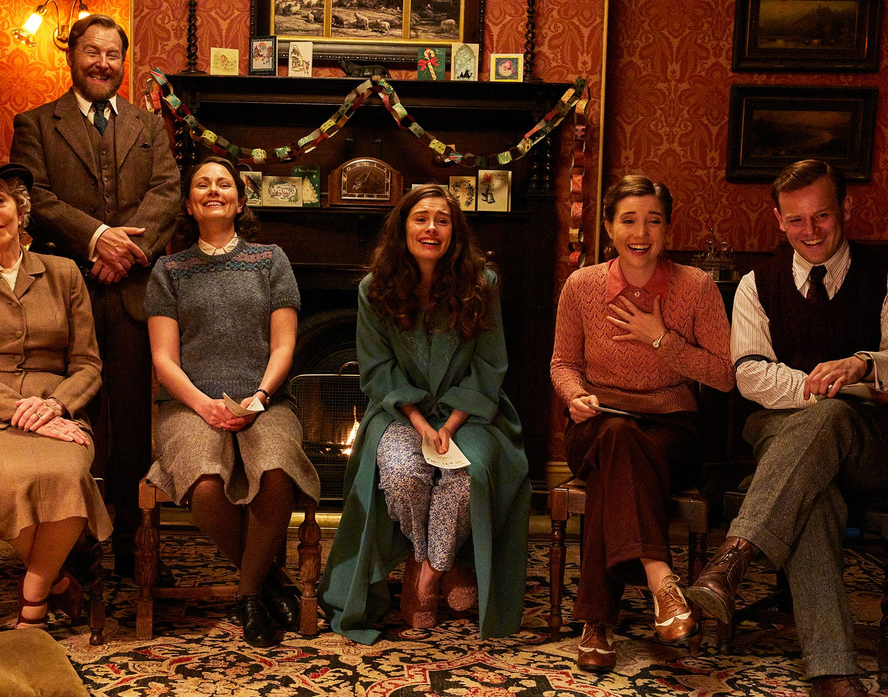

Some notable TV moments in December
On 21 December, ITV1 aired The Royal Variety Performance to an audience of 4.08m.
On 25 December, Channel 4 hosted The Great British Bake Off: Festive Special to an average audience of 3.59m.
On 24 December, Channel 5 aired Christmas special All Creatures Great and Small to an average audience of 2.99m.
On 12 December, Sky Atlantic aired All Her Fault to a pre-broadcast audience of 1.20m, time-shifted audience of 80k and a live audience of 18k.
Source: Barb, December 2025, individuals. Average audience figures, TV set and devices viewing 1-7 days (includes pre-broadcast figures, if applicable).

Slide 4

Top 5 ITV1 programmes
I'm a Celebrity... Get Me Out of Here! (7 December) 8.27 million viewers
Coronation Street (29 December) 4.35 million viewers
The Royal Variety Performance (21 December) 4.08 million viewers
The 1% Club (25 December) 3.79 million viewers
Emmerdale (29 December) 3.78 million viewers
I’m a Celebrity Get Me Out of Here, ITV1
Source: Barb, December 2025, individuals. Average audience figures, TV set and devices viewing 1-7 days (includes pre-broadcast figures, if applicable)
Notes:
Top 5 programmes - ITV

Slide 5

Top 5 Channel 4 programmes
The Great British Bake Off: Festive Special (25 December) 3.59 million viewers
Big Fat Quiz (26 December) 3.13 million viewers
24 Hours In Police Custody (9 December) 2.99 million viewers
Taskmaster: Champion of Champions (22 December) 2.30 million viewers
Gogglebox (5 December) 2.27 million viewers
Taskmaster: Champion of Champions, Channel 4
Source: Barb, December 2025, individuals. Average audience figures, TV set and devices viewing 1-7 days (includes pre-broadcast figures, if applicable)
Notes:
Top 5 programmes – Channel 4

Slide 6

Top 5 Channel 5 programmes
All Creatures Great and Small (24 December) 2.99 million viewers
Madame Blanc (23 December) 2.01 million viewers
Cooper & Fry (9 December) 1.93 million viewers
The Good Ship Murder (27 December) 1.61 million viewers
The Imposter (15 December) 1.51 million viewers
The Imposter, Channel 5
Source: Barb, December 2025, individuals. Average audience figures, TV set and devices viewing 1-7 days (includes pre-broadcast figures, if applicable)
Notes:
Top 5 programmes – Channel 5

Slide 7

Top 5 commercial non-PSB* programmes (non-sport)
All Her Fault, Sky Atlantic (12 December) 1.30 million viewers
I’m a Celebrity… Unpacked, ITV2 (7 December) 0.94 million viewers
Art Detectives, U&Drama (4 December) 0.77 million viewers
The Grinch, ITV2 (6 December) 0.68 million viewers
Hollyoaks, E4 (22 December) 0.61 million viewers
Art Detectives, U&Drama
Source: Barb, December 2025, individuals. Average audience figures, TV set and devices viewing 1-7 days (includes pre-broadcast figures, if applicable)
Notes:
Top 5 programmes – commercial non-public service broadcasting channels

Slide 8

Top 5 Netflix programmes
Stranger Things (26 December) 5.17 million viewers
Man vs Baby (11 December) 3.96 million viewers
Wake Up Dead Man (12 December) 3.94 million viewers
Sean Combs: The Reckoning (2 December) 2.07 million viewers
Goodbye June (24 December) 1.37 million viewers
Wake Up Dead Man, Netflix
Source: Barb, December 2025, individuals. Average audience achieved during the first seven days of their availability. Only includes TV set viewing.
Notes:
Top 5 programmes – Netflix

Slide 9

Top 5 Amazon Prime Video programmes
Fallout (17 December) 1.57 million viewers
Oh. What. Fun. (3 December) 0.57 million viewers
UEFA Champions League: INT vs LIV (9 December) 0.54 million viewers
Relay (12 December) 0.33 million viewers
The Salt Path (23 December) 0.26 million viewers
Fallout, Amazon Prime Video
Source: Barb, December 2025, individuals. Average audience achieved during the first seven days of their availability. Only includes TV set viewing.
Notes:
Top 5 programmes – Amazon Prime Video

Slide 10

Top 5 Disney+ programmes
Percy Jackson and the Olympians (10 December) 0.69 million viewers
Taylor Swift: The End of an Era (12 December) 0.66 million viewers
The Roses (3 December) 0.53 million viewers
The Simpsons (1 December) 0.39 million viewers
Diary of A Wimpy Kid: The Last Straw (5 December) 0.26 million viewers
Percy Jackson and the Olympians, Disney+
Source: Barb, December 2025, individuals. Average audience achieved during the first seven days of their availability. Only includes TV set viewing.
Notes:
Top 5 programmes – Disney+

Slide 11
Top commercial programmes with largest proportion of device viewing
Total audience
7.39m
2.99m
1.15m
1.03m
3.24m
Source: Barb, December 2025, individuals. Average audience figures, TV set and devices viewing up to 7 days post-broadcast. Based on programmes with 1 million+ total TV viewers
Notes:
Top commercial programmes with largest proportion of device viewing

Slide 12
Top commercial programmes with largest proportion of pre-broadcast boxset BVOD viewing
Total audience
1.30m
4.50m
1.00m
1.06m
1.06m
Source: Barb, December 2025, individuals. Average audience figures, TV set and devices viewing up to 7 days post-broadcast. Based on programmes with 1 million+ total TV viewers
Notes:
Top commercial programmes with largest proportion of pre-broadcast boxset BVOD viewing

Slide 13

Key new to linear TV advertisers in December
Breeze Dating app, Breeze, launch its first ever TV ad promoting less chatting and more dating.
Target Darts Global leader in darts innovation, Target Darts, partnered with Sky Media for its inaugural TV campaign.
Bed Kingdom Bedroom furniture brand, Bed Kingdom, debuted on UK TV screens for the first time in December.
Breeze – Love is worth the Leap
Notes:
New to TV advertisers in December.

