Slide 1

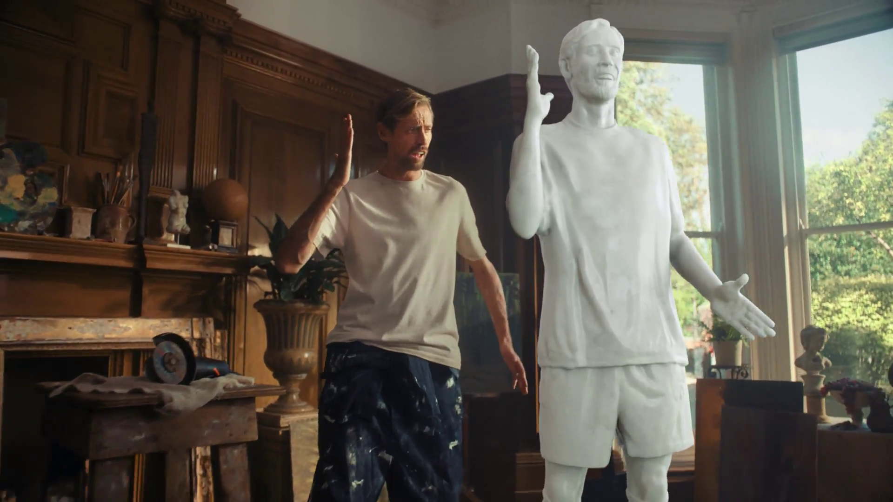

Monthly TV viewing report
January 2026
Ariel – Ditch the Dinge

Slide 2
January linear TV facts & figures
Total TV weekly reach %
Total TV viewed per day
Commercial TV viewed per day
Impacts
Individuals
74.2 | 49.2bn | 2h 12m | 1h 24m
77.3 | 48.0bn | 2h 30m | 1h 35m
77.0 | 19.0bn | 1h 59m | 1h 9m
56.5 | 2.7bn | 34m | 22m
75.9 | 21.6bn | 2h 25m | 1h 33m
78.6 | 26.4bn | 2h 35m | 1h 38m
74.6 | 2.7bn | 1h 9m | 42m
Adults
ABC1 adults
16-34
Men
Women
Housepersons with children
Sources: Barb January 2026, industry standard TV viewing in-home on a TV set. Reach 3min+. 30” equivalent impacts.
Notes:
January linear TV figures for weekly reach, impacts, total TV viewing hours and commercial TV viewing hours

Slide 3




Some notable TV moments in January
On 15 January, ITV2 aired an episode of Love Island All Stars to a TV Set audience of 1.11m and a device audience of 445k.
On 29 January, Channel 4 aired Patience to a pre-broadcast audience of 1.23m a live audience of 693k and time-shifted audience of 1.07m.
On 19 January, Channel 5 aired Police Suspect No.1 to an average audience of 1.82m.
On 18 January, Sky Atlantic launched A Knight of the Seven Kingdoms to an average audience of 934k.
Source: Barb, January 2026, individuals. Average audience figures, TV set and devices viewing 1-7 days (includes pre-broadcast figures, if applicable).

Slide 4

Top 5 ITV1 programmes
Coronation Street (5 January)
5.60 million viewers
Red Eye (12 January)
4.34 million viewers
Emmerdale (5 January)
4.23 million viewers
The 1% Club (10 January)
3.73 million viewers
The Masked Singer (10 January)
3.64 million viewers
Red Eye – ITV1
Source: Barb, January 2026, individuals. Average audience figures, TV set and devices viewing 1-7 days (includes pre-broadcast figures, if applicable)
Notes:
Top 5 programmes - ITV

Slide 5

Top 5 Channel 4 programmes
Patience (28 January)
3.19 million viewers
The Great Pottery Throw Down (25 January)
2.78 million viewers
24 Hours In Police Custody (13 January)
2.77 million viewers
The Great British Bake Off: Festive Specials (1 January)
2.10 million viewers
24 Hours in Police Custody Investigates (20 January)
2.05 million viewers
The Great Pottery throw Down – Channel 4
Source: Barb, January 2026, individuals. Average audience figures, TV set and devices viewing 1-7 days (includes pre-broadcast figures, if applicable)
Notes:
Top 5 programmes – Channel 4

Slide 6

Top 5 Channel 5 programmes
Police Suspect No.1 (19 January)
1.82 million viewers
The Good Ship Murder (27 January)
1.69 million viewers
Forensics: Crash Scene Investigators (26 January)
1.58 million viewers
World’s Strongest Man (1 January)
1.49 million viewers
Murder Suspect No.1 (5 January)
1.42 million viewers
World’s Strongest Man – Channel 5
Source: Barb, January 2026, individuals. Average audience figures, TV set and devices viewing 1-7 days (includes pre-broadcast figures, if applicable)
Notes:
Top 5 programmes – Channel 5

Slide 7

Top 5 commercial non-PSB* programmes (non-sport)
Love Island All Stars, ITV2 (16 January)
1.70 million viewers
Under Salt March, Sky Atlantic (29 January)
0.97 million viewers
A Knight of the Seven Kingdoms, Sky Atlantic (18 January)
0.93 million viewers
Corriedale: Backstage Pass, ITV3 (5 January)
0.81 million viewers
Our Farm Next Door: Amanda, Clive and Kids, More4 (26 January)
0.79 million viewers
Under Salt March – Sky Atlantic
Source: Barb, January 2026, individuals. Average audience figures, TV set and devices viewing 1-7 days (includes pre-broadcast figures, if applicable)
Notes:
Top 5 programmes – commercial non-public service broadcasting channels

Slide 8

Top 5 Netflix programmes
Stranger Things (1 January)
5.60 million viewers
Run Away (1 January)
3.79 million viewers
Agatha Christie’s Seven Dials (15 January)
3.04 million viewers
The Rip (16 January)
2.46 million viewers
Bridgerton (29 January)
2.37 million viewers
Stanger Things – Netflix
Source: Barb, January 2026, individuals. Average audience achieved during the first seven days of their availability. Only includes TV set viewing.
Notes:
Top 5 programmes – Netflix

Slide 9

Top 5 Amazon Prime Video programmes
Fallout (21 January)
1.60 million viewers
Steal (21 January)
0.98 million viewers
The Wrecking Crew (28 January)
0.85 million viewers
From the World of John Wick: Ballerina (10 January)
0.69 million viewers
Beast Game (7 January)
0.60 million viewers
Fallout – Prime Video
Source: Barb, January 2026, individuals. Average audience achieved during the first seven days of their availability. Only includes TV set viewing.
Notes:
Top 5 programmes – Amazon Prime Video

Slide 10

Top 5 Disney+ programmes
High Potential (21 January)
0.80 million viewers
Percy Jackson and the Olympians (21 January)
0.62 million viewers
Grey’s Anatomy (16 January)
0.51 million viewers
Wonder Man (28 January)
0.42 million viewers
Tron Ares (7 January)
0.41 million viewers
High Potential – Disney+
Source: Barb, January 2026, individuals. Average audience achieved during the first seven days of their availability. Only includes TV set viewing.
Notes:
Top 5 programmes – Disney+

Slide 11
Top commercial programmes with largest proportion of device viewing
Total audience
1.56m
1.01m
2.76m
1.75m
1.14m
Source: Barb, January 2026, individuals. Average audience figures, TV set and devices viewing up to 7 days post-broadcast. Based on programmes with 1 million+ total TV viewers
Notes:
Top commercial programmes with largest proportion of device viewing

Slide 12
Top commercial programmes with largest proportion of pre-broadcast boxset BVOD viewing
Total audience
4.34m
2.99m
3.53m
2.77m
1.68m
Source: Barb, January 2026, individuals. Average audience figures, TV set and devices viewing up to 7 days post-broadcast. Based on programmes with 1 million+ total TV viewers
Notes:
Top commercial programmes with largest proportion of pre-broadcast boxset BVOD viewing

Slide 13

Key new to linear TV advertisers in January
Freja Bone Broth
Freja Bone Broth launched its first ever TV campaign with a 30-second AI-generated film.
The Radiator Warehouse
The Radiator Warehouse made its inaugural TV ad telling audiences to ‘feel the heat’.
Honest Mobile
Honest Mobile debuted its first ever TV campaign claiming a phone without signal is about as useful as a banana.
The Radiator Warehouse - Feel The Heat
Notes:
New to TV advertisers in January.

