Slide 1
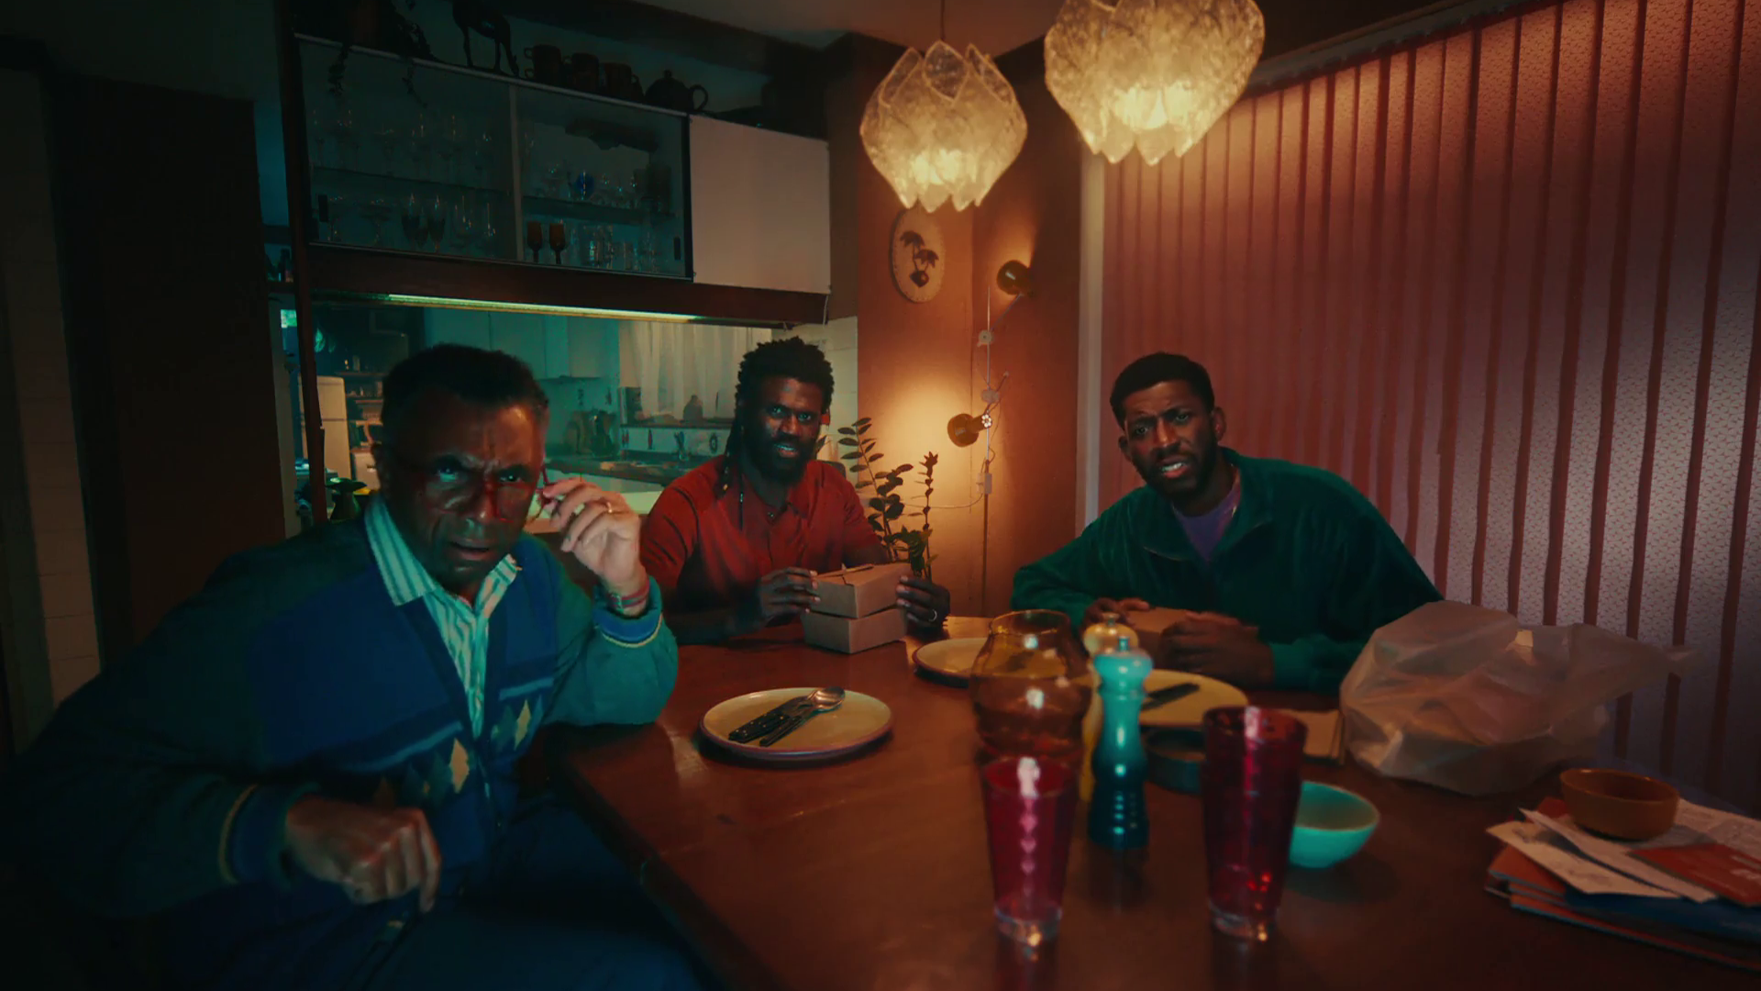

Monthly TV viewing report
September 2025
U – U Talking to Me

Slide 2
September linear TV facts & figures
Total TV weekly reach %
Total TV viewed per day
Commercial TV viewed per day
Impacts
Individuals
71.7 | 46.2bn | 1h 58m | 1h 20m
75.0 | 45.1bn | 2h 15m | 1h 32m
74.4 | 17.6bn | 1h 45m | 1h 6m
51.3 | 2.6bn | 29m | 21m
74.0 | 20.2bn | 2h 10m | 1h 29m
75.9 | 24.9bn | 2h 19m | 1h 34m
71.5 | 2.7bn | 1h 4m | 44m
Adults
ABC1 adults
16-34
Men
Women
Housepersons with children
Source: Barb, September 2025, industry standard TV viewing in-home on a TV set. Reach 3min+. 30” equivalent impacts.
Notes:
September linear TV figures for weekly reach, impacts, total TV viewing hours and commercial TV viewing hours

Slide 3



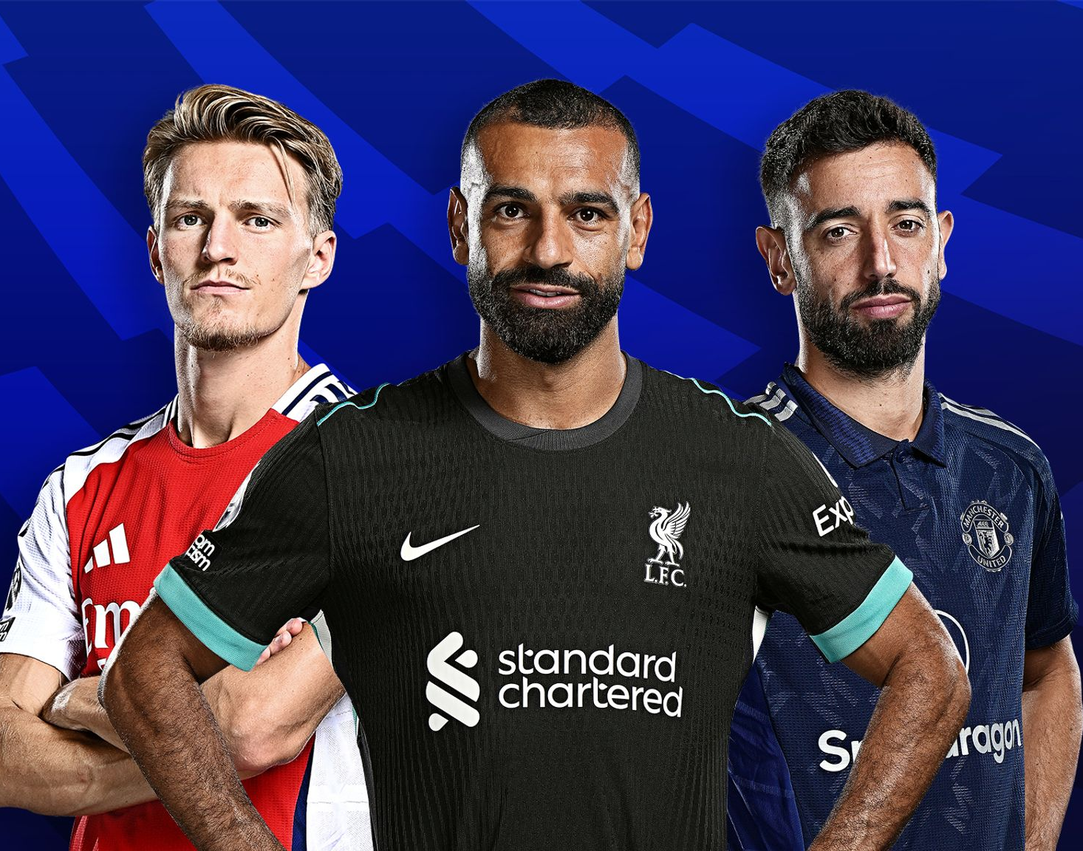
Some notable TV moments in September
On 14 September, ITV1 aired the first episode of Coldwater to an average audience of 3.96m.
On 2 September, Channel 4 aired the return of The Great British Off to an average audience of 5.98m.
On 25 September, Channel 5 launched season 6 of All Creatures Great and Small to an average audience of 3.17m.
On 20 September, Sky Sports Main Event hosted Manchester United v Chelsea to TV set audience of 1.07m and a device audience of 76k.
Source: Barb, September 2025, individuals. Average audience figures, TV set and devices viewing 1-7 days (includes pre-broadcast figures, if applicable).

Slide 4
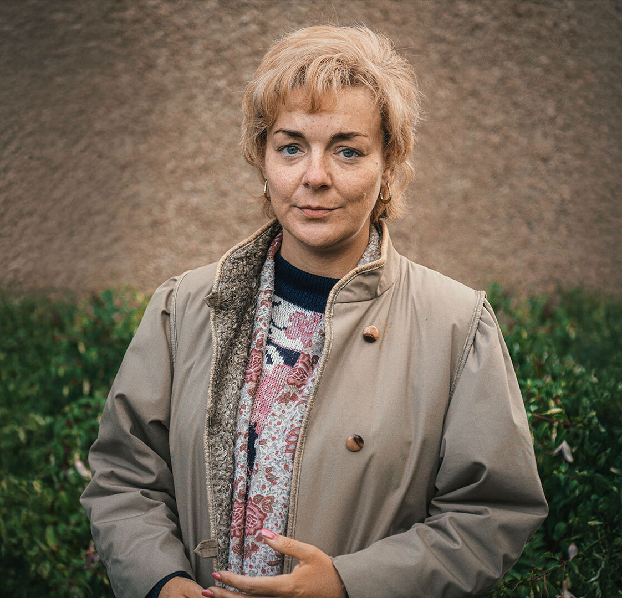
Top 5 ITV1 programmes
I Fought the Law (8 September) 4.90 million viewers
Emmerdale (19 September) 4.01 million viewers
Coldwater (14 September) 3.96 million viewers
Coronation Street (15 September) 3.94 million viewers
World Cup: Qualifiers (9 September) 3.94 million viewers
I Fought the Law, ITV1
Source: Barb, September 2025, individuals. Average audience figures, TV set and devices viewing 1-7 days (includes pre-broadcast figures, if applicable)
Notes:
Top 5 programmes - ITV

Slide 5
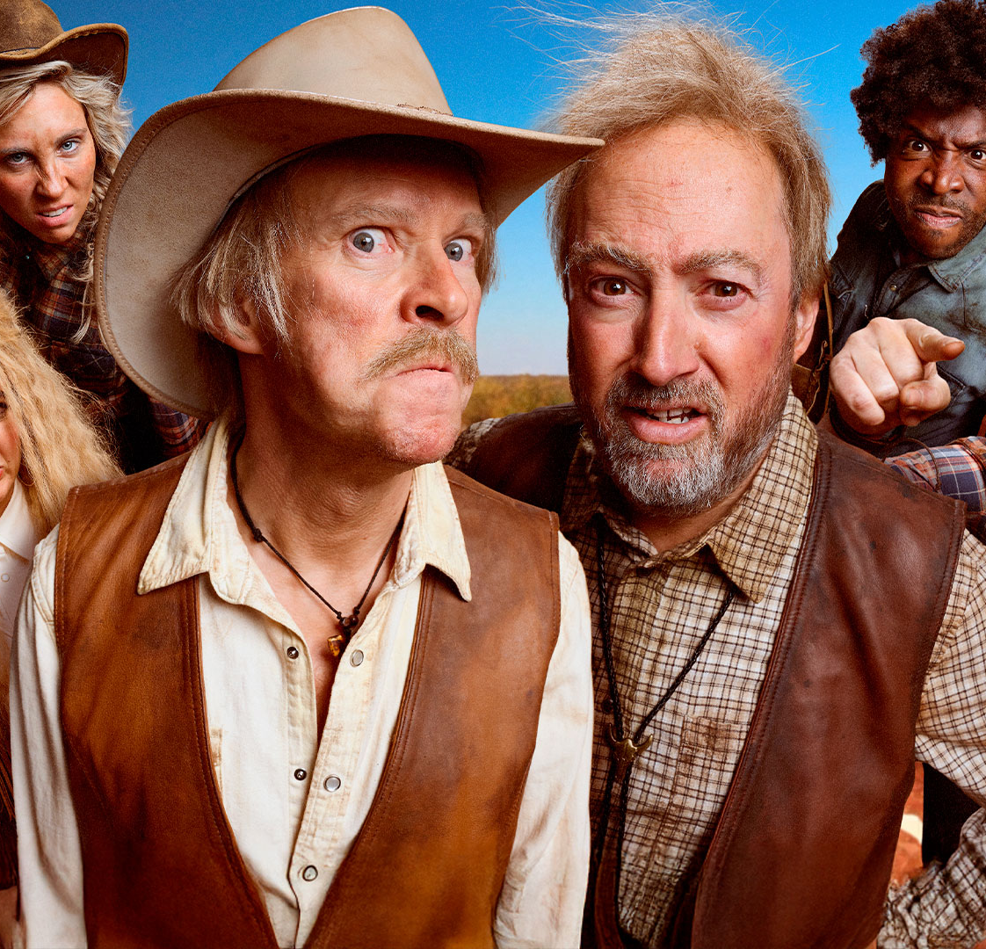
Top 5 Channel 4 programmes
The Great British Bake Off (2 September) 5.98 million viewers
Gogglebox (5 September) 3.08 million viewers
Taskmaster (11 September) 2.26 million viewers
Mitchell and Webb Are Not Helping (5 September) 1.87 million viewers
The Disappearance of Jay Slater (28 September) 1.60 million viewers
Mitchell and Webb Are Not Helping, Channel 4
Source: Barb, September 2025, individuals. Average audience figures, TV set and devices viewing 1-7 days (includes pre-broadcast figures, if applicable)
Notes:
Top 5 programmes – Channel 4

Slide 6

Top 5 Channel 5 programmes
All Creatures Great and Small (25 September) 3.17 million viewers
The Rumour (10 September) 1.64 million viewers
Police Interceptors (29 September) 1.21 million viewers
Traffic Cops: Pursuit Squad One (22 September) 1.20 million viewers
Michael Palin in Venezuela (16 September) 1.16 million viewers
The Rumour, Channel 5
Source: Barb, September 2025, individuals. Average audience figures, TV set and devices viewing 1-7 days (includes pre-broadcast figures, if applicable)
Notes:
Top 5 programmes – Channel 5

Slide 7

Top 5 commercial non-PSB* programmes (non-sport)
Married at First Sight UK, E4 (29 September) 2.22 million viewers
Big Brother, ITV2 (29 September) 1.16 million viewers
The Brokenwood Mysteries, U&Drama (15 September) 0.71 million viewers
The Rookie, Sky Witness (15 September) 0.68 million viewers
Sister Boniface Mysteries, U&Drama (26 September) 0.64 million viewers
The Rookie, Sky Witness
Source: Barb, September 2025, individuals. Average audience figures, TV set and devices viewing 1-7 days (includes pre-broadcast figures, if applicable)
Notes:
Top 5 programmes – commercial non-public service broadcasting channels

Slide 8

Top 5 Netflix programmes
Wednesday (3 September) 3.81 million viewers
House of Guinness (25 September) 2.19 million viewers
The Thursday Murder Club (28 August) 1.45 million viewers
Black Rabbit (18 September) 1.41 million viewers
Wayward (25 September) 1.19 million viewers
House of Guinness, Netflix
Source: Barb, September 2025, individuals. Average audience achieved during the first seven days of their availability. Only includes TV set viewing.
Notes:
Top 5 programmes – Netflix

Slide 9

Top 5 Amazon Prime Video programmes
The Girlfriend (10 September) 1.03 million viewers
The Summer I Turned Pretty (17 September) 0.93 million viewers
Ice Road: Vengeance (3 September) 0.69 million viewers
Gen V (17 September) 0.61 million viewers
UEFA Champions League (30 September) 0.54 million viewers
Gen V, Amazon Prime Video
Source: Barb, September 2025, individuals. Average audience achieved during the first seven days of their availability. Only includes TV set viewing.
Notes:
Top 5 programmes – Amazon Prime Video

Slide 10

Top 5 Disney+ programmes
Lilo & Stitch (3 September) 1.64 million viewers
Alien: Earth (24 September) 1.01 million viewers
High Potential (24 September) 0.97 million viewers
Only Murders in the Building (9 September) 0.81 million viewers
Elio (17 September) 0.80 million viewers
Alien: Earth, Disney+
Source: Barb, September 2025, individuals. Average audience achieved during the first seven days of their availability. Only includes TV set viewing.
Notes:
Top 5 programmes – Disney+

Slide 11
Top commercial programmes with largest proportion of device viewing
Total audience
2.02m
1.60m
1.11m
1.15m
1.50m
Source: Barb, September 2025, individuals. Average audience figures, TV set and devices viewing up to 7 days post-broadcast. Based on programmes with 1 million+ total TV viewers
Notes:
Top commercial programmes with largest proportion of device viewing

Slide 12
Top commercial programmes with largest proportion of pre-broadcast boxset BVOD viewing
Total audience
3.10m
4.90m
1.15m
1.70m
1.16m
Source: Barb, September 2025, individuals. Average audience figures, TV set and devices viewing up to 7 days post-broadcast. Based on programmes with 1 million+ total TV viewers
Notes:
Top commercial programmes with largest proportion of pre-broadcast boxset BVOD viewing

Slide 13

Key new to linear TV advertisers in September
Airband Rural broadband provider, Airband, debuted its first TV ad featuring voiceover from BAFTA award-winning actor Charlie Cooper.
Amicable Divorce service, Amicable, launched on TV offering a hopeful ad about divorce titled ‘Still a Family’.
Primark Primark launched its first ever TV campaign unveiling its Autumn / Winter women’s denim collection.
Airband – Ultrafast Broadband
Notes:
New to TV advertisers in September.

