Slide 1
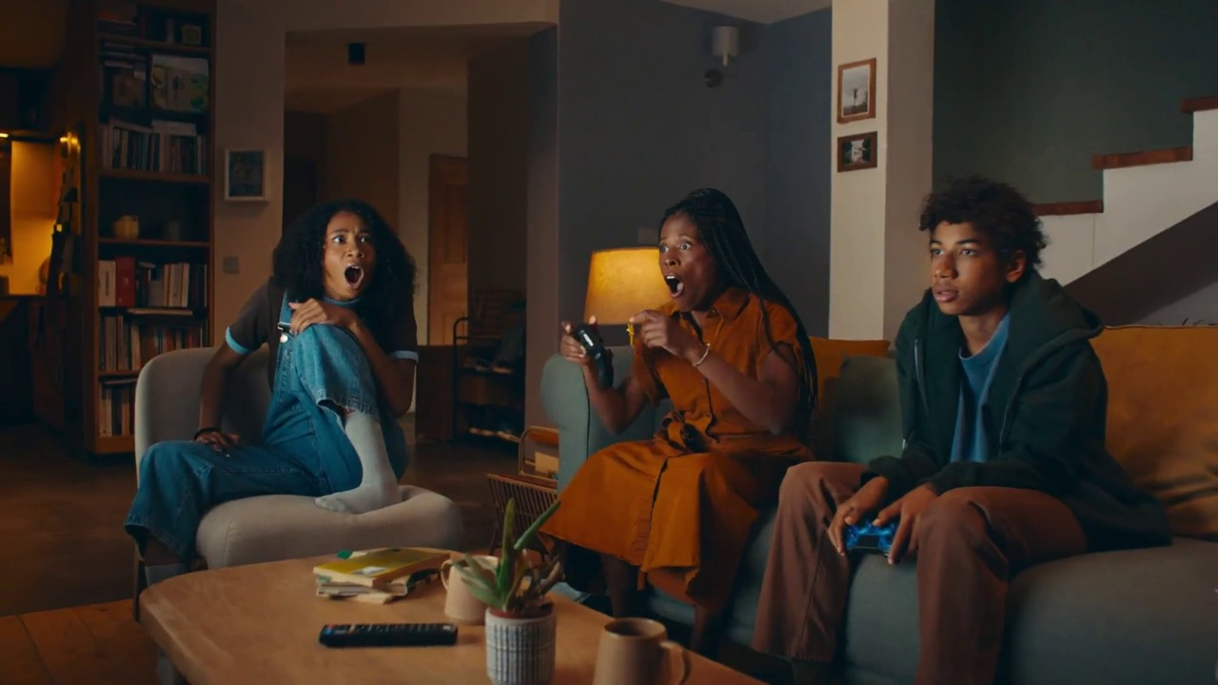

Monthly TV viewing report
August 2025
Birds Eye – That’s a Recipe for a Life Well Fed

Slide 2
August linear TV facts & figures
Total TV weekly reach %
Total TV viewed per day
Commercial TV viewed per day
Impacts
Individuals
68.9 | 46.1bn | 1h 52m | 1h 16m
72.6 | 44.9bn | 2h 8m | 1h 27m
70.9 | 17.3bn | 1h 38m | 1h 2m
49.5 | 2.2bn | 25m | 18m
71.8 | 20.5bn | 2h 5m | 1h 26m
73.3 | 24.5bn | 2h 10m | 1h 28m
64.5 | 2.4bn | 53m | 36m
Adults
ABC1 adults
16-34
Men
Women
Housepersons with children
Source: Barb, August 2025, industry standard TV viewing in-home on a TV set. Reach 3min+. 30” equivalent impacts.
Notes:
August linear TV figures for weekly reach, impacts, total TV viewing hours and commercial TV viewing hours

Slide 3
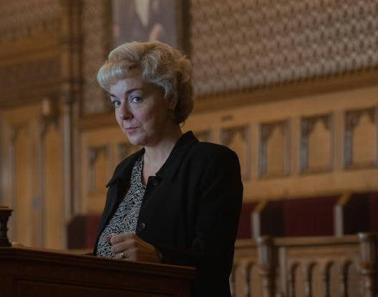

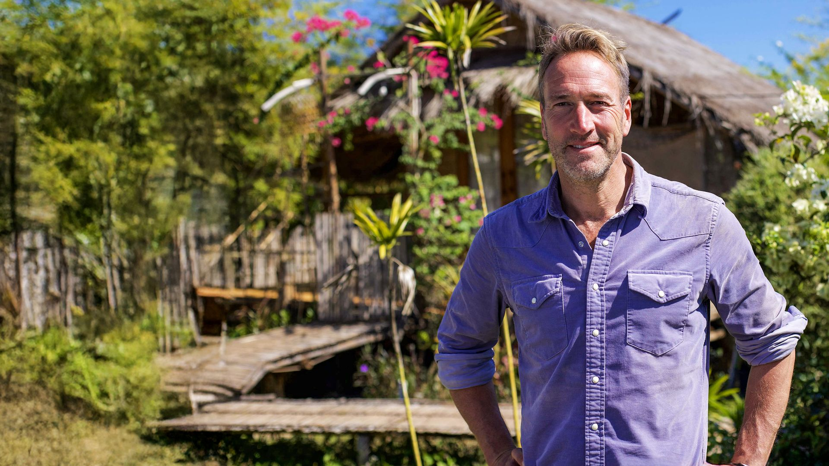
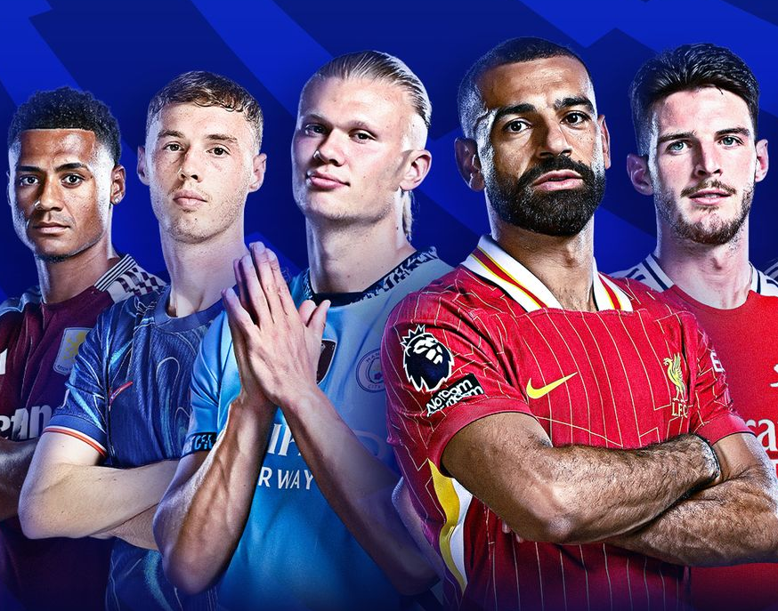
Some notable TV moments in August
On 31 August, ITV1 aired the first episode of I Fought the Law to an average audience of 4.28m.
On 31 August, Channel 4 aired the return of Educating Yorkshire to an average audience of 1.51m.
On 14 August, Channel 5 aired Ben Fogle: New Lives in the Wild to an average audience of 1.08m.
On 25 August, Sky Sports Main Event hosted Newcastle United v Liverpool to TV set audience of 1.03m and a device audience of 64k.
Source: Barb, August 2025, individuals. Average audience figures, TV set and devices viewing 1-7 days (includes pre-broadcast figures, if applicable).

Slide 4

Top 5 ITV1 programmes
I Fought the Law (31 August)
4.28 million viewers
Karen Pirie (3 August)
4.13 million viewers
Ridley (10 August)
3.94 million viewers
Coronation Street (6 August)
3.91 million viewers
Emmerdale (22 August)
3.71 million viewers
Ridley, ITV1
Source: Barb, August 2025, individuals. Average audience figures, TV set and devices viewing 1-7 days (includes pre-broadcast figures, if applicable)
Notes:
Top 5 programmes - ITV

Slide 5
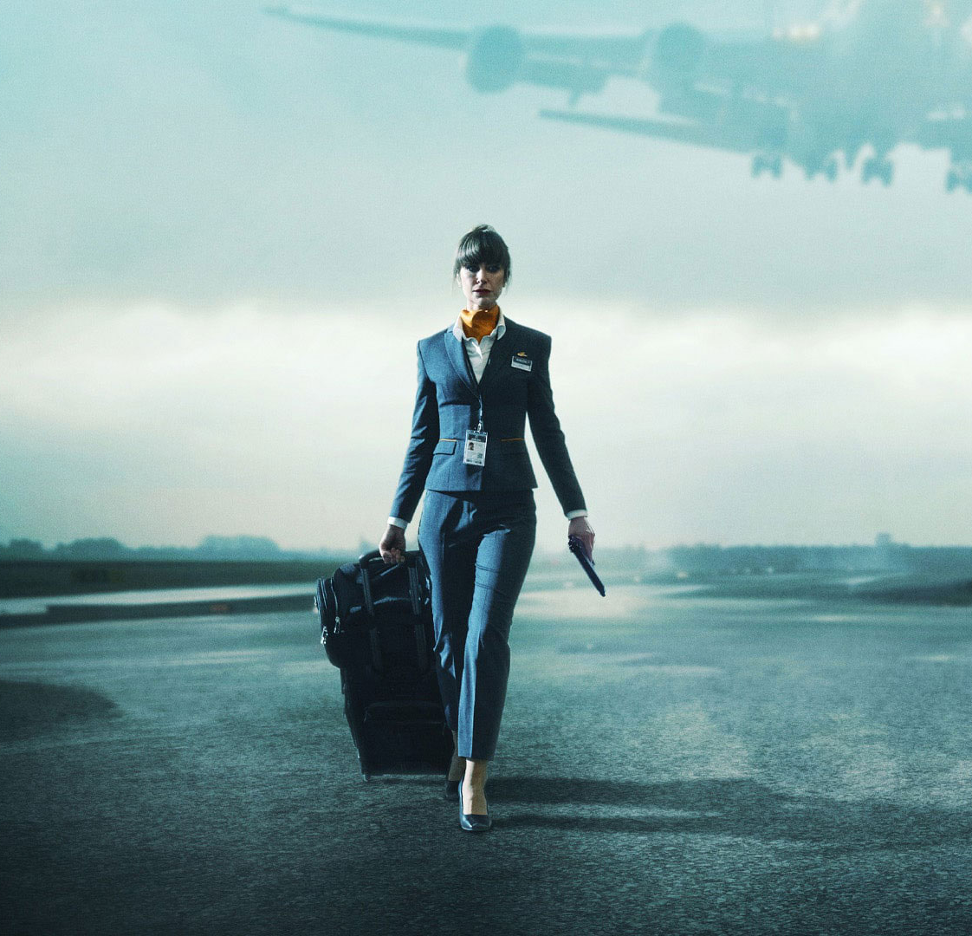
Top 5 Channel 4 programmes
In Flight (12 August)
2.23 million viewers
Celebrity SAS: Who Dares Win (3 August)
1.84 million viewers
The Jury: Murder Trial (26 August)
1.69 million viewers
Educating Yorkshire (31 August)
1.51 million viewers
Formula 1 (3 August)
1.26 million viewers
In Flight, Channel 4
Source: Barb, August 2025, individuals. Average audience figures, TV set and devices viewing 1-7 days (includes pre-broadcast figures, if applicable)
Notes:
Top 5 programmes – Channel 4

Slide 6
Top 5 Channel 5 programmes
Andrew & Fergie: The Duke & Duchess of Excess (16 August)
1.11 million viewers
Ben Fogle: New Lives in the Wild (14 August)
1.08 million viewers
The Day Diana Died (30 August)
1.08 million viewers
Motorway Cops: Catching Britain's Speeders (11 August)
1.07 million viewers
Police 999: Night Shift (11 August)
1.04 million viewers
Ben Fogle: New Lives in the Wild, Channel 5
Source: Barb, August 2025, individuals. Average audience figures, TV set and devices viewing 1-7 days (includes pre-broadcast figures, if applicable)
Notes:
Top 5 programmes – Channel 5

Slide 7

Top 5 commercial non-PSB* programmes (non-sport)
Love Island, ITV2 (1 August)
2.33 million viewers
Whitstable Pearl, U&Drama (29 August)
1.33 million viewers
The Princess Diaries, ITV2 (10 August)
0.74 million viewers
Love Island: Aftersun, ITV2 (3 August)
0.71 million viewers
The Brokenwood Mysteries, U&Drama (18 August)
0.68 million viewers
Love Island, ITV2
Source: Barb, August 2025, individuals. Average audience figures, TV set and devices viewing 1-7 days (includes pre-broadcast figures, if applicable)
Notes:
Top 5 programmes – commercial non-public service broadcasting channels

Slide 8
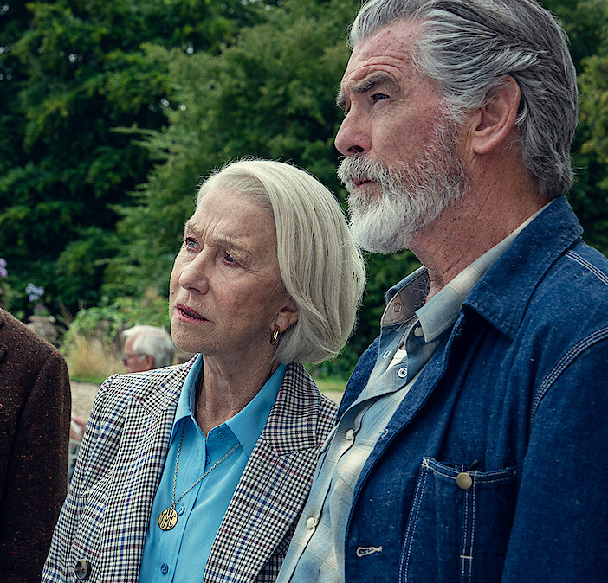
Top 5 Netflix programmes
The Thursday Murder Club (28 August)
5.41 million viewers
Wednesday (6 August)
4.74 million viewers
Hostage (21 August)
3.63 million viewers
My Oxford Year (1 August)
1.38 million viewers
Fit for TV: The Reality of the Biggest Loser (15 August)
1.30 million viewers
The Thursday Murder Club, Netflix
Source: Barb, August 2025, individuals. Average audience achieved during the first seven days of their availability. Only includes TV set viewing.
Notes:
Top 5 programmes – Netflix

Slide 9

Top 5 Amazon Prime Video programmes
The Pickup (6 August)
0.75 million viewers
Flight Risk (24 August)
0.72 million viewers
The Summer I Turned Pretty (20 August)
0.71 million viewers
Barbie (9 August)
0.52 million viewers
The Hunt for Shannon Matthews (18 August)
0.50 million viewers
Flight Risk, Amazon Prime Video
Source: Barb, August 2025, individuals. Average audience achieved during the first seven days of their availability. Only includes TV set viewing.
Notes:
Top 5 programmes – Amazon Prime Video

Slide 10
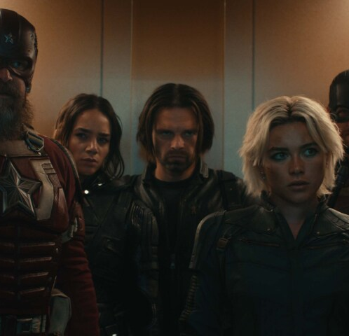
Top 5 Disney+ programmes
Alien: Earth (13 August)
1.31 million viewers
Thunderbolts* (27 August)
1.06 million viewers
Criminal Minds (1 August)
0.27 million viewers
Eyes of Wakanda (1 August)
0.20 million viewers
The Twisted Tale of Amanda Knox (20 August)
0.19 million viewers
Thunderbolts*, Disney+
Source: Barb, August 2025, individuals. Average audience achieved during the first seven days of their availability. Only includes TV set viewing.
Notes:
Top 5 programmes – Disney+

Slide 11
Top commercial programmes with largest proportion of device viewing
Total audience
2.30m
1.51m
1.01m
1.92m
1.20m
Source: Barb, August 2025, individuals. Average audience figures, TV set and devices viewing up to 7 days post-broadcast. Based on programmes with 1 million+ total TV viewers
Notes:
Top commercial programmes with largest proportion of device viewing

Slide 12
Top commercial programmes with largest proportion of pre-broadcast boxset BVOD viewing
Total audience
1.07m
1.20m
1.33m
4.13m
1.85m
Source: Barb, August 2025, individuals. Average audience figures, TV set and devices viewing up to 7 days post-broadcast. Based on programmes with 1 million+ total TV viewers
Notes:
Top commercial programmes with largest proportion of pre-broadcast boxset BVOD viewing

Slide 13
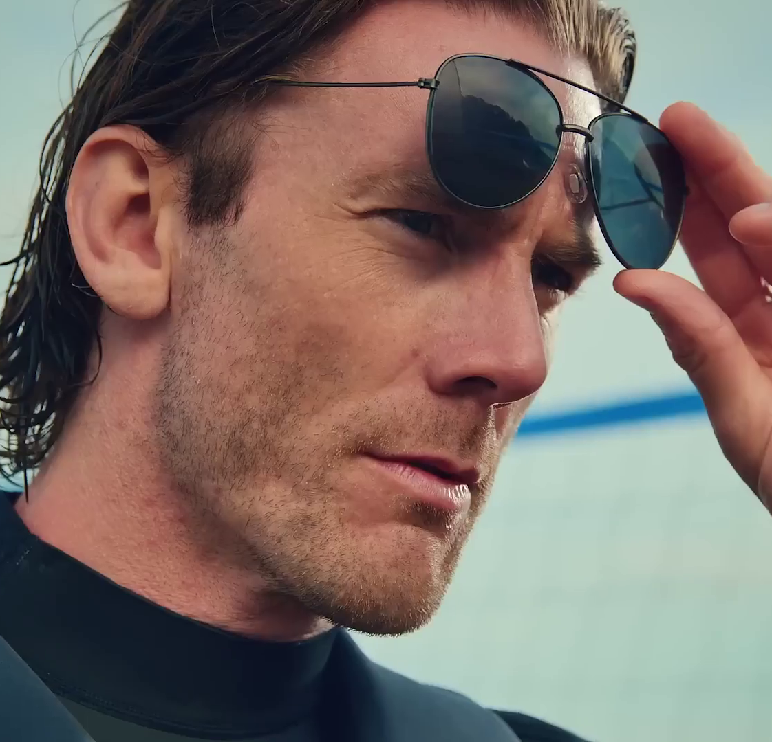
Key new to linear TV advertisers in August
Thameslink
Railway line, Thameslink, launched its inaugural TV Advert on Channel 4 for its “Every Stop is a Story” campaign.
Sprive
Mortgage overpayment app, Sprive, made its TV debut in August.
Slick Gorilla
Hair styling product, Slick Gorilla, launched three ads featuring the ‘Slick Squad’.
Slick Gorilla – A Job for the Slick Squad
Notes:
New to TV advertisers in August.

