Slide 1


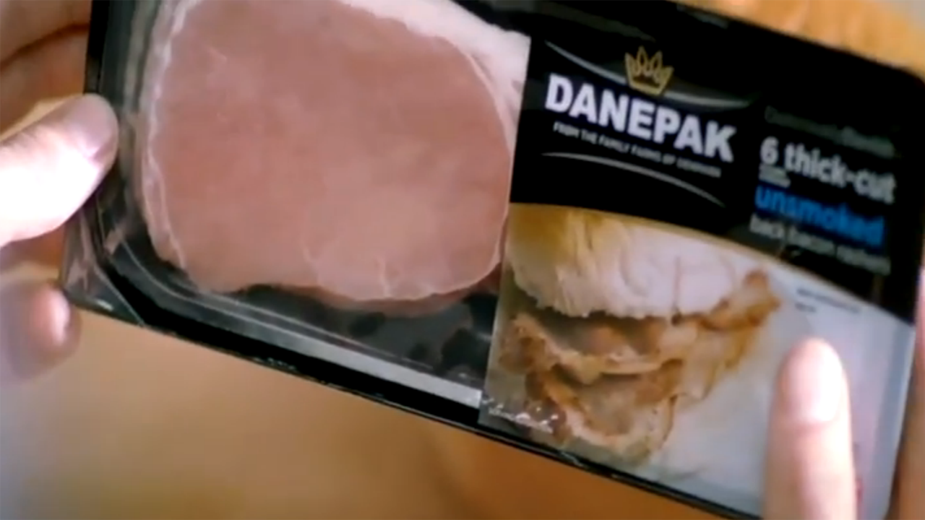
Danepak use TV to bring home the bacon
Challenge
Re-awaken consumer interest in the brand
Demonstrate to retailers they were serious about Danepak’s future to expand distribution
Solution
A bespoke airtime campaign with Channel 4 to be shown across their food portfolio over a 12-month period
Results
18% increase in brand awareness
14% increase in propensity to purchase with 50% of those planning to buy bacon, planning to buy Danepak
Notes:
Challenge:
Danepak has a long heritage. However the brand had been dormant in advertising for many years. It was no longer front of mind for consumers and was not a brand they considered other than at the shelf. The brand was also coming under pressure as many of their rivals were providing special offers and discounts.
It was important to gain some cut-through for the brand. In addition, they needed to demonstrate to retailers that they were serious about the future of the brand to secure and expand retail distribution.
The aims were to increase the retail value of the brand, to differentiate Danepak in a commoditised category, to establish Danepak as the quality brand in the category and finally to increase spontaneous brand awareness and drive trial.
Solution:
The bacon category is considered dull and low interest, lacking in emotional involvement. The predominance of the private label left the category lacking an identity and price promotion was commoditising the brand. In truth, bacon was bacon – there’s nothing too glamorous about it.
Danepak needed an emotional brand strategy to get people to take notice. The answer lay in a simple truth: perfect moments. In our increasingly hectic world where moments to enjoy life’s pleasures have become aspirational, Danepak created a series of moments to savour. Ensuring the brand remained true to its Danish roots led to Perfekt moments and the creative idea was born.
‘Savour the moment’ featured real people enjoying ‘perfekt’ moments – the first bite of a delicious bacon sandwich, or sausages sizzling in a pan. TV was the perfect vehicle to deliver the fame Danepak wanted and it could deliver the emotional connection of the creative as well as making people lust for a bacon sandwich!
Food programming was the ideal environment for Danepak messaging and having reviewed the broad shopper audience and given the fact that bacon is an everyday product this would naturally lead to an ‘easy cook’ style programme environment most likely in daytime.
However, Danepak wanted to build value back into the brand and decided the best way to do this was to associate with aspirational quality food programming in peak instead. They identified Channel4 as having the strongest food programming schedule and so bought a bespoke airtime campaign with advertising being shown across Channel4’s food portfolio for a 12 month period. There was a natural upweight towards the end of the week as Danepak’s own research concluded that consumption time peaked at this time. Through the adoption of a discrete channel campaign, Danepak realised they needed a long term presence to build a high level of reach to hit awareness objectives - hence their one year partnership.
Results:
Finalist in Thinkbox TV Planning Awards 2011 Best Newcomer to TV category
18% increase in brand awareness
21% increase in spontaneous awareness of Danepak bacon
14% increase in propensity to purchase with 50% of those planning to buy bacon, planning to buy Danepak
Significant shifts in consumer perceptions in particular for ‘Lets me savour my perfect bacon sandwich moment’ and ‘Tempts me to take a moment to enjoy food’
From the end of 2008, the underlying trend in sales had been downward but from when the TV commenced in April 2010, the decline was turned around and sales increased
For the full case study and to view the ad campaigns visit: https://www.thinkbox.tv/Case-studies/Danepak

