Slide 1


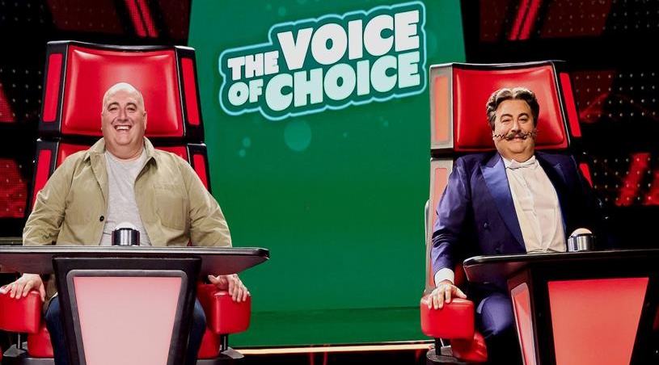
Go Compare and The Voice of Choice
Challenge
GoCompare were rebranding to Go.Compare and needed to communicate this subtle but important difference to a wide audience
Solution
They sponsored The Voice on ITV
The Voice of Choice was created – a parody of the show that told the story of finding Dot through sequential and entertaining idents
Results
12% increase in consideration for Go.Compare
Reached 16m people, driving awareness
Notes:
The Challenge
Go Compare, the price comparison website, first launched in 2006 and has gone from strength to strength. Much of their success is down to their impactful and engaging TV advertising featuring the moustachioed opera singer Gio Compario and his real-life counterpart Wynne Evans.
In 2022, they were re-branding to become Go.Compare – a subtle but important difference that needed to be communicated widely in an entertaining and memorable way.
The TV Solution
Historical research had shown that activity featuring Wynne Evans (the real man behind Gio), alongside his Italian alter ego, yielded positive upticks in brand perceptions, so what if the rebrand was communicated through the addition of a third character - the new Dot?! With such a distinctive jingle, the solution needed to involve music, so they partnered with ITV’s The Voice, which millions of viewers watch weekly, to bring this story to life.
Broadcast sponsorship alongside IP licensing, all brokered by Hearts & Science and DRUM, meant that they could establish their own search for talent to find the voice of Dot -The Voice of Choice. This was a parody of the show to find a talented rough diamond who is as passionate about singing and insurance as they are; famous red chairs included.
The Plan
Eighteen 10” & 15” films documenting the search for Dot were broadcast alongside the TV show. The idents were shot on a modified The Voice set, tailored to mimic the show’s schedule across its ten-week run; from auditions to coach mentoring and the final itself. Singing dogs, magicians and everything in-between helped develop the story arc at each stage and keep an avid audience entertained without fatigue.
The final episode of the show saw the three tenors sing the new jingle together. The idents showcased the brand ambassador, providing good awareness whilst also aligning with the style and tone of the show to bring added value to the viewer.
The story-based approach of the sponsorship was mirrored across Go.Compare’s own brand channels and ITV’s social channels with bespoke content on TikTok, Twitter and Facebook, and an extension into VOD.
To support the partnership and engage the audience even further, a three-minute branded mockumentary, “The Wyn-ner’s Story” told the full story of The Voice of Choice vocal competition and provided behind-the-scenes clips and character back story profiles.
Results
Reached 16m people driving awareness of the name change
Strong recall of The Voice idents among wider audience, increasing by 43% for those who claim to watch The Voice
35% claimed to be aware of the sponsorship, which sits significantly above sponsorship norms and increased a further 32% among viewers
+12% in consideration for Go.Compare with +8% claiming Go.Compare to be one of the first brands they would consider

