Slide 1
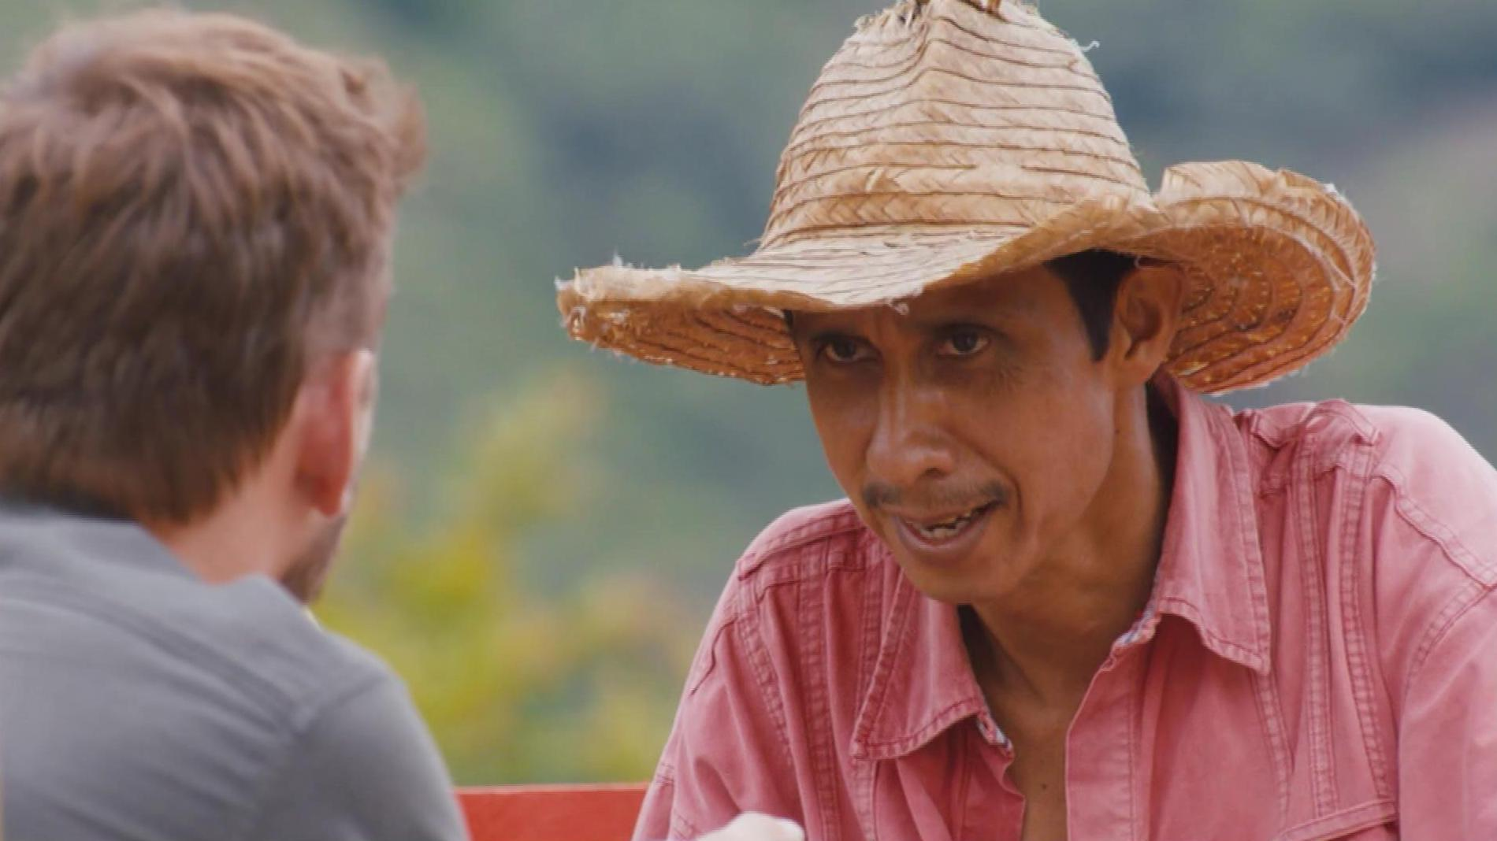
Taylors of Harrogate since 1886
Challenge
Taylors wanted to deepen understanding of their quality coffee credentials within a complex and evolving market
Solution
They created a beautiful 60” documentary style ad featuring farmer and foodie champion Jimmy Doherty, as well as a coffee navigation tool that featured on VOD ads
Results
Claimed trial of Taylors went up by 22.6% over the course of the campaign
63% of consumers said they would consider trying Taylors as a result of seeing the ad
Notes:
The Challenge
The coffee market is constantly changing with new brands and formats coming into play which makes it difficult for shoppers to keep up. Taylors of Harrogate were the brand leader in roast and ground coffee, but were seeing a long term decline in volume and value sales. Their primary objective was to halt the confusion and to help people navigate this category and understand why Taylors was worth paying more for. They wanted a campaign that would build consumer understanding of Taylors, their products and their personality.
The Solution
Goodstuff, Taylors’ media agency, advised them to make a mini programme style ad in order to help people understand the confusing and jargon-filled world of the coffee category and that having a well-known person to present it would be beneficial. They knew that TV would provide scale as well as credibility and so they set to work to create an engaging and compelling piece of content to run on TV.
Working with The Outfit to produce the ad, they selected Jimmy Doherty who is a famous pig farmer and foodie champion. His farming background meant he could reaffirm Taylors’ Fairtrade and ethical attributes. He went to Colombia to tour the coffee regions and meet the growers to find out about the lengths that Taylors and their farmers go to to deliver amazing coffee to the shelves of the UK shops. Goodstuff negotiated an exclusive deal with 4 Sales in order to make the most of their limited budget.
They created a beautiful 60 second TV ad with a Channel 4 editorial feel. All the pertinent points were delivered, but in an interesting and entertaining way. They launched the campaign with an advertising premiere and selected key Channel 4 programming in the early stages of the campaign in order to give the campaign a prominent start. This was followed up by a selection of programming across the 4 Sales channel portfolio. The ad also ran on VOD using Channel 4’s Ad Bloom interactive format.
Alongside the TV campaign, they wanted to deliver further interaction and to welcome more people in to Taylors’ world of coffee. Working with Innovid and Taylors, Goodstuff developed an interactive coffee navigation tool. By answering a range of questions, people could discover the flavour and origin of Taylors coffee that was right for them. They could also find out where they could buy it and if they were an online shopper, add in to their basket straight away.
The coffee navigation tool sat on the VOD ads as a click through and also as a stand-alone format on social channels where it was synced with the TV campaign.
Consumers were able to deep dive even further through additional written content and images captured during Jimmy’s trip.
Results
Claimed trial of Taylors went up by 22.6% over the course of the campaign
52 week penetration was the highest ever – up 12% year on year
The content approach proved the right route as sales uplift per 100 TVRs increased by 210%
63% of consumers said they would consider trying Taylors as a result of seeing the ad
Spontaneous awareness of Taylors rose by 3% during the campaign period
To read the full case study and access the creative visit: https://www.thinkbox.tv/Case-studies/Taylors-of-Harrogate-since-1886

