Slide 1
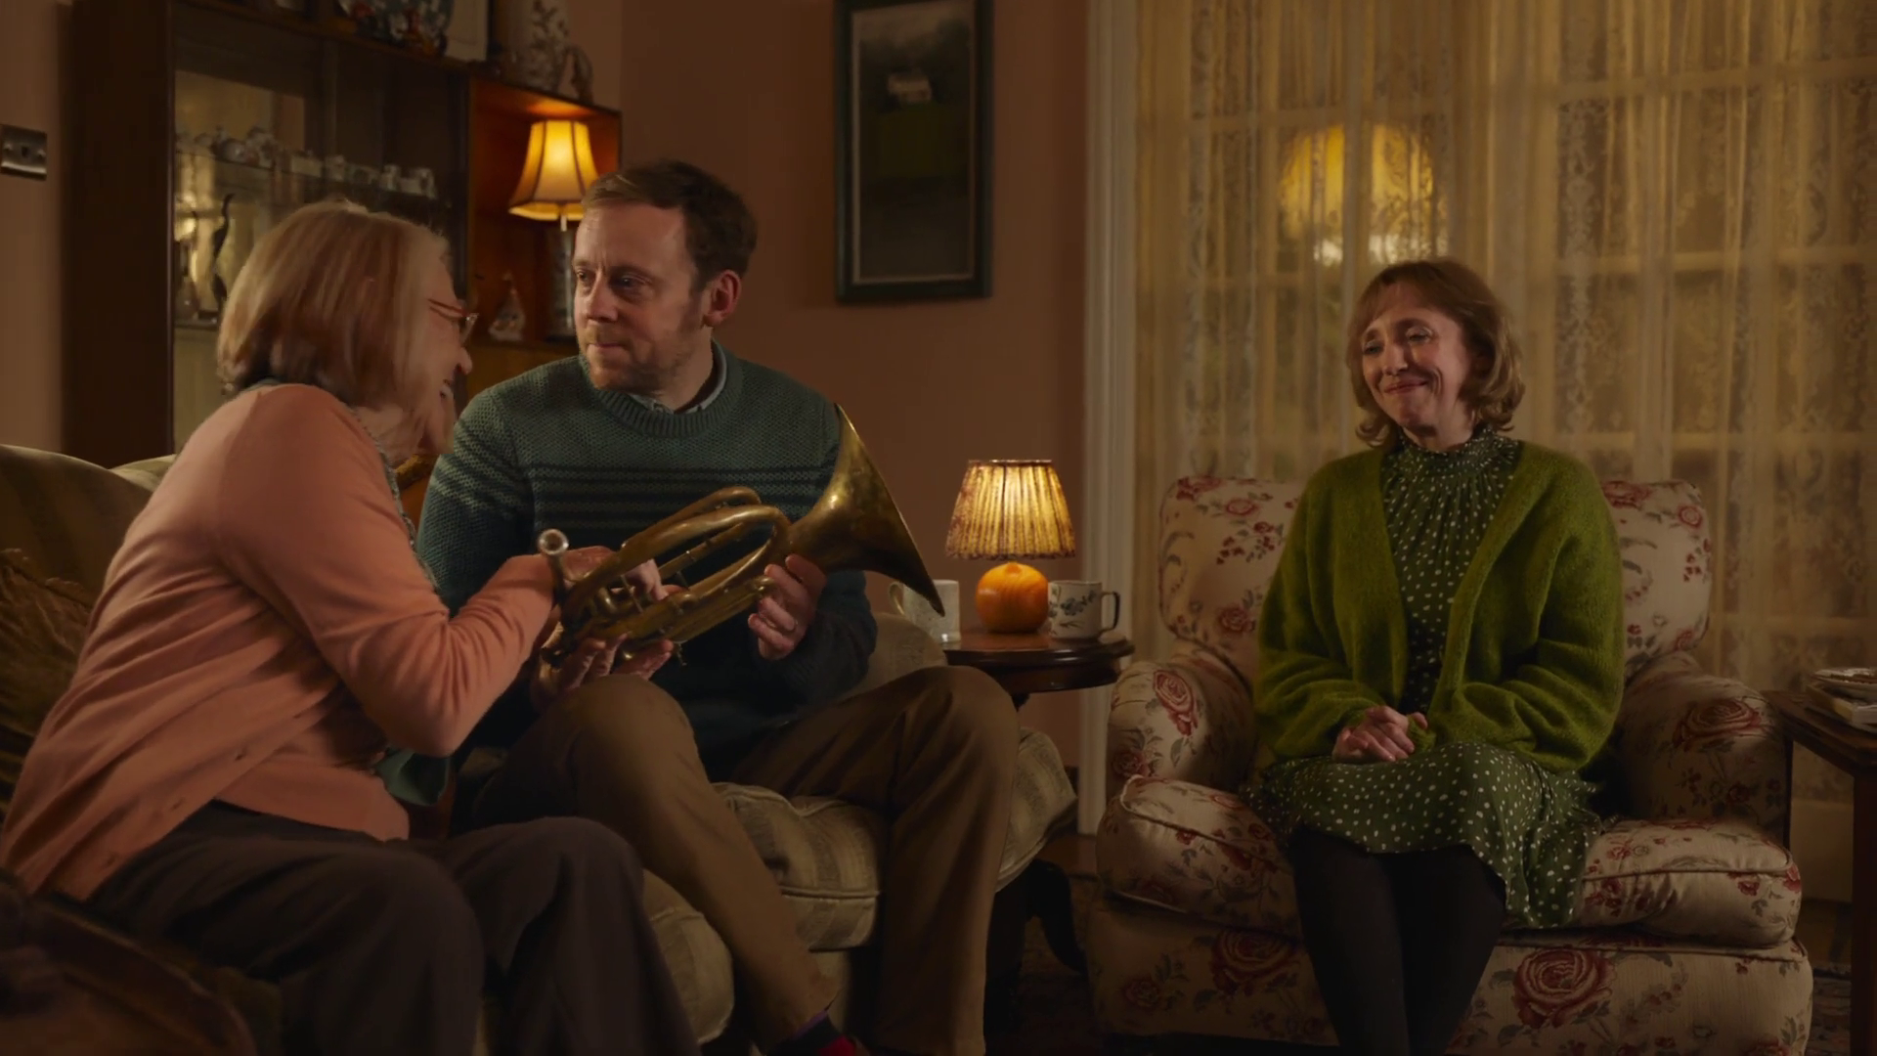

VOD Viewing
Boots – Pipe Down

Slide 2
2023 video viewing – 16-34
ALL INDIVIDUALS
Average video time per day
All Individuals: 4 hrs, 36 mins
16-34s
16-34s: 4 hrs, 6 mins
Source: 2023, Barb / ViewersLogic / IPA TouchPoints 2023 / Pornhub / UK Cinema Association
Notes:
Methodology
The quantitative analysis of total video consumption in the UK was undertaken by Thinkbox. It combined 2023 data from Barb, ViewersLogic, Pornhub, the IPA’s TouchPoints and UK Cinema Association.
Barb data shows how much time is spent viewing broadcaster content, live or time-shifted (including BVOD) on all devices as well as Blu-Ray/DVD viewing. This chart also utilises Barb’s expanding audience reporting capabilities to provide a view of time spent viewing content on YouTube, TikTok, other video sharing services (such as Twitch) as well as SVOD/AVOD platforms. Whilst Barb reports on in-home consumption, a combination of ViewersLogic and IPA TouchPoints data was used to determine the remaining out-of-home consumption.
The combination of these sources creates a solid estimate as it utilises the robustness of Barb data (11,500 panel members, representative of the UK TV population, metered actual consumption data, analysis across a whole year) alongside ViewersLogic and IPA TouchPoints data to capture any out-of-home consumption.
Time spent viewing video at cinemas was based on total admissions data from the UK Cinema Association profiled for each audience using data from DCM.

Slide 3




Viewing to TV content is predominantly done on the larger screen
 | Live TV | Playback / BVOD | SVOD / Other AVOD | YouTube | TikTok | All other online video | % of all video time
% of all video time* | 47.1% | 15.2% | 13.4% | 15.4% | 4.2% | 2.3% | % of all video time*
 | 99.4% | 94.8% | 84.7% | 31.0% | 0.3% | 4.5% | 83.6%
 | 0.2% | 1.0% | 7.1% | 16.7% | 1.6% | 59.1% | 3.8%
 | 0.3% | 2.2% | 3.6% | 12.5% | 3.0% | 2.1% | 2.7%
 | 0.1% | 1.9% | 4.6% | 39.8% | 95.1% | 34.3% | 9.9%
Source: Barb 2023, live +3 mins, adults
Notes:
Viewing to TV content is predominantly done on the larger screen

Slide 4

Incremental reach achieved by TV + VOD
ADULTS
15-34s
97.2%
97.6%
96.0%
96.2%
95.3%
93.1%
WEEKLY REACH%
Source: IPA TouchPoints 2021 (average of both waves), 2022 (average of both waves), 2023 Wave 1 (Fieldwork Dates: 17th January – 26th March 2023). Adults 15+, 15-34.

Slide 5








There are 8 need states which drive video viewing
content
7% ESCAPE
10% EXPERIENCE
9% INDULGE
12% IN TOUCH
2% DO
16% COMFORT
personal
social
18% DISTRACT
26% UNWIND
context
Source: The Age of Television, 2018, MTM/Thinkbox.
Notes:
The Age of Television study conducted by MTM, on behalf of Thinkbox, observed there are eight need states which define our video viewing habits:
ESCAPE
EXPERIENCE
IN TOUCH
COMFORT
UNWIND
DISTRACT
DO
INDULGE
The study sized these eight need states in terms of the time audiences spend meeting each one with video content.
We found that the largest proportion of time spent watching videos is to satisfy the need to unwind, the need for a distraction and the need for comfort.
The role of content and context differ across each need state, with content is particularly important for escape and experience.
In contrast, the need to unwind is far more likely to be driven by context – such as the need to wind down after work.
The need states also differ in terms of being personally or socially driven. For example, the need for comfort is driven by a desire to spend time with others, while the need for a distraction is more personal.

Slide 6
The need to immerse ourselves in content to ‘escape’ drives on-demand viewing
Source: The Age of Television, 2018, MTM/Thinkbox. Base: all adults (53 – 1,531)
Notes:
On-demand video – from subscription services and British broadcasters – plays a significant role when it comes to helping audiences escape by immersing themselves in content.
Collectively, around a third of time spent in the escape need state is with playback TV, broadcaster or subscription on demand.

Slide 7
Escape
7% of viewing time
The need to lose yourself in another world and become fully immersed in highly involving and engaging content
Viewers wanting to ‘lose themselves’ in content
Content has high production values
Platform choice is driven by where content available
Volume of content and flexibility of viewing is important
British or American content
Source: The Age of Television, 2018, MTM/Thinkbox. Base: all adults (375)
Notes:
Escape - 7% of total video viewing.
The escape need state is when audiences are most engaged and are looking to lose themselves in content – there’s a sense anticipation and excitement about the viewing experience.

Slide 8
Escape
7% of viewing time
Source: The Age of Television, 2018, MTM/Thinkbox. Base: all adults (375), 16-34 (118)
Notes:
Broadcaster video on demand is serving this need across ages. Audiences value the trusted ‘gatekeeper’ role of these broadcaster services.
Subscription on demand services, particularly Netflix, deliver strongly against this need state. These services enable viewers to seek out whole series to binge on and provide appealing, relevant content, particularly for younger audiences, such as Riverdale and Orange Is the New Black.
Specific platform choice is determined by the availability of content, which can push certain services to top of choice hierarchy until a series is completed. This means that engagement with services like Netflix can by erratic or cyclical - becoming first choice when viewers are into a series, but then falling back down the hierarchy when they’ve finished.

Slide 9










Escape
7% of viewing time
“
32% On-demand
38% Drama
68% evening viewing
With The Sinner I was just gripped from start to finish, watching one after another. I was going to bed at 1am and then 3am the next night. There were so many twists and turns, it really had me!
Served by high quality drama:
“
Source: The Age of Television, 2018, MTM/Thinkbox. Base: all adults (375)
Notes:
Content is heavily focused on drama, but can also include films and documentaries, and is characterised by high production values, high proﬁle talent and involving storylines.
It can be newer or older series – being of the moment is less of a factor here, it’s more about personal engagement and appeal. The volume of content and the flexibility of viewing are also important, which is where boxsets come into play.

Slide 10
SVOD & video-sharing seasonal viewing consistent across 23
Source: Barb, 2023, Individuals
Notes:
Broadcaster viewing across 2023 highlights the impact of seasonal viewing, whilst viewing to SVOD platforms and video sharing services was broadly consistent.

Slide 11
BVOD accounts for almost ¼ of 16-34s broadcaster TV viewing
Inds
16-34
2 hrs 40 mins
1 hr 5 mins
Source: 2023, Barb
Notes:
BVOD is vital to different audiences
Breaking down broadcaster TV into the different ways reveals the increasingly important role of BVOD for 16-34, now 24% of all broadcaster TV viewing.
This data uses both Barb data and includes an estimate of any unknown viewing that is thought to fall into Playback and Live viewing.

Slide 12
A 25:75 blend of Linear:BVOD is optimal for cost effective 16-34 reach
Source: Barb BVOD Planner (2023, 6 weeks 35-40) / natural delivery / station average prices. Optimised to determine linear and BVOD split.

Slide 13

Primetime drama has high levels of time-shifted viewing
2.97 million
Live TV set viewing
7.69 million total viewers
281k
Device viewing
Live, and time-shifted
4.44 million
Time-shifted TV set viewing within 28 days of broadcast
Source: Barb 2023. Individuals, Live +3min. Unforgotten, Episode 1, ITV1, 27 February 2023.
Notes:
Prime time drama has high levels of time-shifted viewing because it’s not time sensitive so people choose to watch it at a time that suits them
In this example, an episode of Unforgotten on ITV, 39% of viewing was live and 58% was time shifted on a TV set.
39% live on a TV set
58% time shifted on a TV set
3% device

Slide 14

Broad appeal entertainment shows have high TV set viewing
3.41 million
Live TV set viewing
8.39 million total viewers
351k
Device viewing
live, and time-shifted
4.63 million
Time-shifted TV set viewing within 28 days of broadcast
Source: Barb 2023. Individuals, Live +3min. The Great British Bake Off, Channel 4, 26 September 2023.
Notes:
Entertainment shows with broad appeal, have high TV set viewing, which is split between live and time-shifted.
An episode of 2023’s The Great British Bake Off had 41% of people watch it live.
41% live TV set
55% time shifted TV set
4% device

Slide 15

Content released as a boxset can receive high pre-broadcast viewing
1.4m
Pre-broadcast viewing (any device)
2.76 million total viewers
850k
Time-shifted viewing (any device) within 28 days of broadcast
504k
Live TV set viewing
Source: Barb 2023. Individuals, Live +3min. The Couple Next Door, Channel 4, 12 December 2023.
Notes:
Content that’s released as a boxset before being shown live on broadcaster TV often attracts high levels of pre-broadcast viewing.
In this example, an episode of The Couple Next Door, received 51% of the total audience to the pre-broadcast on-demand release.
51% pre-broadcast
18% live on a TV set
31% time shifted

Slide 16

Device viewing allows flexibility in watching reality TV
1.15 million
Live TV set viewing
3.40 million total viewers
616k
1.63 million
Device viewing
live, and time-shifted
Time-shifted TV set viewing within 28 days of broadcast
Source: Barb 2023. Individuals, Live +3min. Love Island, ITV2, 5 June 2023.
Notes:
For programmes that appeal to young people, who want flexible viewing options, there is much higher levels of device viewing.
In this example, for the first episode of Love Island, 18% of all viewing was done via a device.
34% live
48% time shifted
18% device

Slide 17
Top 5 commercial programmes with largest proportion of pre-broadcast boxset BVOD viewing
Total audience
2.76m
7.90m
4.12m
1.93m
Source: Barb, 2023, individuals. Average audience figures, TV and Online Pre-broadcast and 1-28 days, TV set and devices viewing. Based on programmes with 1 million+ total TV viewers
Notes:
Top 5 commercial programmes with largest proportion of pre-broadcast boxset BVOD viewing
In 2023, an episode of Channel 4’s The Couple Next Door was watched by a pre-broadcast audience of 50.9%, time-shifted audience of 31.4%, and live audience of 17.7%.

Slide 18

Weight of viewing is a key factor in incremental reach
4
12
25
47
75
115
169
244
360
734
Average mins per day of linear TV
Lightest tier 0-19%
Middle tier 20-49%
Heaviest tier 50-100%
Source: PwC UK, Barb, all viewers split into tenths based upon their weight of linear TV viewing
Notes:
Detailed analysis by PwC (as reported in ‘BVOD Almighty: Reach and Return’) has identified a segment that are important drivers of why BVOD is delivering incremental reach.
This chart shows the viewing population split into ten equal groups (deciles) based upon amount of liner TV viewing per week.
The lightest decile averages 4-mins of linear viewing per day. Up to the heaviest decile who view for 734-minutes (12-hours 14-minutes) per day.
The deciles have been split into three groups:
Lightest tier. These are very hard to reach on TV (linear or BVOD) and are most likely to be targeted via platforms such as YouTube
Middle tier.
Heaviest tier. These are quite east to reach via linear TV and, as a result, BVOD probably has little role to play.

Slide 19
‘Middle tier’ of viewers are key to BVOD’s incremental reach
All viewers split into tenths based on their weight of linear TV viewing
Linear
0-19%
Lightest tier
Middle tier 20-49%
Heaviest tier 50-100%
BVOD
% contribution to viewing
Source: PwC UK, Barb, all viewers split into tenths based upon their weight of linear TV viewing
Notes:
This chart shows for each of the three tiers (and the deciles within them) what proportion of linear and BVOD consumption they account for.
Key to note is that the middle tier (green) proportionally watch a lot of BVOD. Whilst they account for 7% of linear TV viewing, they make up 28% of BVOD consumption.
This makes them the key audience for extending campaign via the use of BVOD – relatively they are easier to reach via BVOD then linear TV.

Slide 20
BVOD provides good odds of reaching an attractive audience
Lightest tier
0-19%
Middle tier
20-49%
Heaviest tier
50-100%
Hard to reach via TV
TV reach extenders
Easily reachable via linear TV
Average odds of reaching segment per exposure
Linear: 1 in 185
Linear: 1 in 14
Linear: 1 in 1.1
BVOD: 1 in 12
BVOD: 1 in 4
BVOD: 1 in 2
Average linear TV viewing per day
8 minutes
49 minutes
5 hours and 24 minutes
skews towards:
ABC1 adults (71%) and 16-34 adults (42%)
Source: PwC UK, Barb, all viewers split into tenths based upon their weight of linear TV viewing
Notes:
… or to put it another way, for every 14 impressions you buy on linear one person falls into the middle tier group (assuming natural delivery)
But on BVOD, it only takes four impressions to, on average, reach somebody in the middle tier. As such, on average, using BVOD is three and a half more efficient than linear at reaching the middle tier of viewers.
The middle tier are very attractive audiences for many advertisers (proportionally younger and upscale) and BVOD enables them to be reached in an efficient way.

Slide 21
Almost three quarters of individuals now have access to a SVOD service
Source: Barb Establishment Survey, % of population, *Q1 2021 data unavailable as fieldwork was suspended
Notes:
Almost three quarters of individuals now have access to a SVOD service (Amazon Prime Video, Apple TV +, Britbox, Disney +, Hayu, NowTV, Paramount+, Discovery and Netflix.)

Slide 22
How the SVOD / other AVOD market breaks down – 16-34
Inds
16-34
39 mins
56 mins
Source: Barb, In-home viewing, All devices excluding Blu-ray/DVD, 2023, Online Multiple Screens Network
Notes:
How the SVOD / other AVOD market breaks down
As the streaming wars continue to hot up, we now have several major players competing for eyeballs. As it currently stands, Netflix takes the lion’s share of viewing time.

Slide 23
Commercial broadcasters are unrivalled for scale
All Individuals – All devices
Bubble area represents total volume of daily viewing
AVERAGE DAILY REACH (000s)
Other AVOD
Other
SVOD
Twitch
Dailymotion
AVE TIME VIEWED PER VIEWER PER DAY
Source: Barb / All Individuals, all devices – 2023
Notes:
This chart breaks down viewing to the various platforms in terms of the average number of people watching per day (for at least 3 minutes) compared with the average time spent watching per viewer (i.e. only counting those who watched on that day).
Analysis across 2023 shows that the commercial broadcasters (linear and on demand) collectively reach just over 31 million viewers every day, with each of those viewers watching for an average of 3hrs, 33 mins a day. The combined portfolio of BBC channels (linear and on demand) attracts the second largest volume of viewing, with 25 million daily reach and an average view time of just over 2 hours. YouTube is next, with a daily reach of 21 million people and a view time of 1hr 49 mins (Barb only measure in-home viewing, we estimate that YouTube would be larger in viewing time if out of home viewing was included).
SVOD services such as Netflix has a daily reach of 12.3 million people and a view time of 1hr 47 mins.

Slide 24
All platforms obey Pareto’s law to varying degrees
66% of viewing
71% of viewing
AVERAGE TIME VIEWED
59% of viewing
67% of viewing
95% of viewing
Each Decile = 5.2 million viewers
(5.8m non-viewers)
Each Decile = 4.2 million viewers
(14.7m non-viewers)
Each Decile = 4.5 million viewers
(12.2m non-viewers)
Each Decile = 0.1 million viewers
(56.7m non-viewers)
Each Decile = 4.7 million viewers
(10.8m non-viewers)
Source: Barb, Sep 23, All devices
Notes:
The heaviest 10% account for the majority of viewing.

Slide 25
What matters is the reach opportunity in ad-supported content
TV set viewing to ad supported content
AVERAGE TIME VIEWED
Source: Barb, Sep 23, decile ranked in terms of weight of viewing to linear TV, TV set viewing
Notes:
What matters is the reach opportunity in ad-supported content

Slide 26
BVOD & SVOD ad tiers are key to reaching lighter linear viewers
AVE HRS OF TV SET VIEWING TIME PER GROUP PER DAY
Source: Barb – Sept 2023, Adults, TV set viewing, deciles ranked on weight of viewing to linear TV
Notes:
BVOD & SVOD ad tiers are key to reaching lighter linear viewers

Slide 27
SVOD viewing broadly consistent across 2023
Source: Barb, 2023, Online Multiple Screens Network, Individuals, All devices
Notes:
Broadcaster viewing across 2023 highlights the impact of seasonal viewing, whilst viewing to SVOD platforms was broadly consistent.

