Slide 1
Why TV is still at the heart of effectiveness

Slide 2

TV’s enduring role in effectiveness cases
Usage of TV amongst effectiveness cases in now rising
TV remains the driving force for brand building

Slide 3
Mental availability drives business success
Source: IPA Databank, 2000-2022 for-profit cases

Slide 4
Mental availability still drives business success
Mental availability is just as important in today’s market
Source: IPA Databank, 2020-2022 for-profit cases

Slide 5
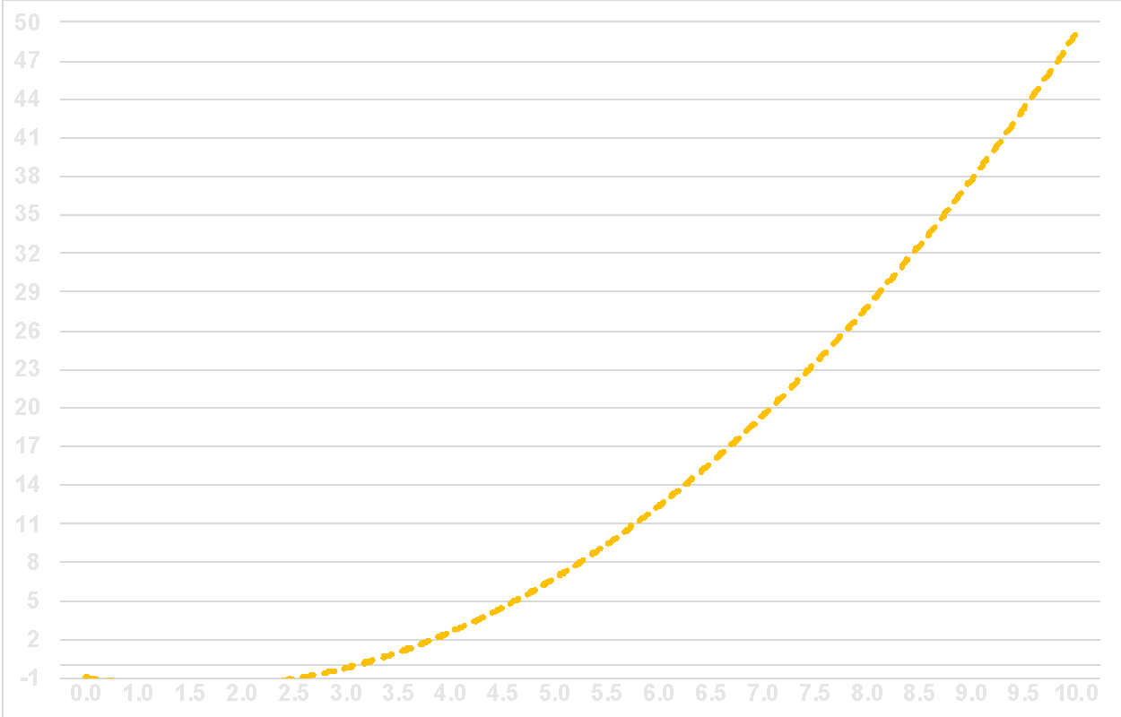
Memory starts to kick in 2.5 seconds
Relationship between Active Attention Seconds and Days in Memory.
Source: Internal Amplified Intelligence Attention data - gathered from over 40,000 Ad-Views and choice measures
(r = .76, p = < .05)

Slide 6
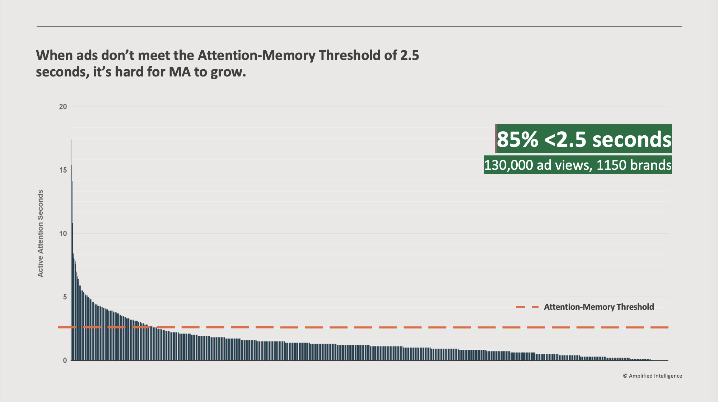
The digital mental availability building challenge

Slide 7
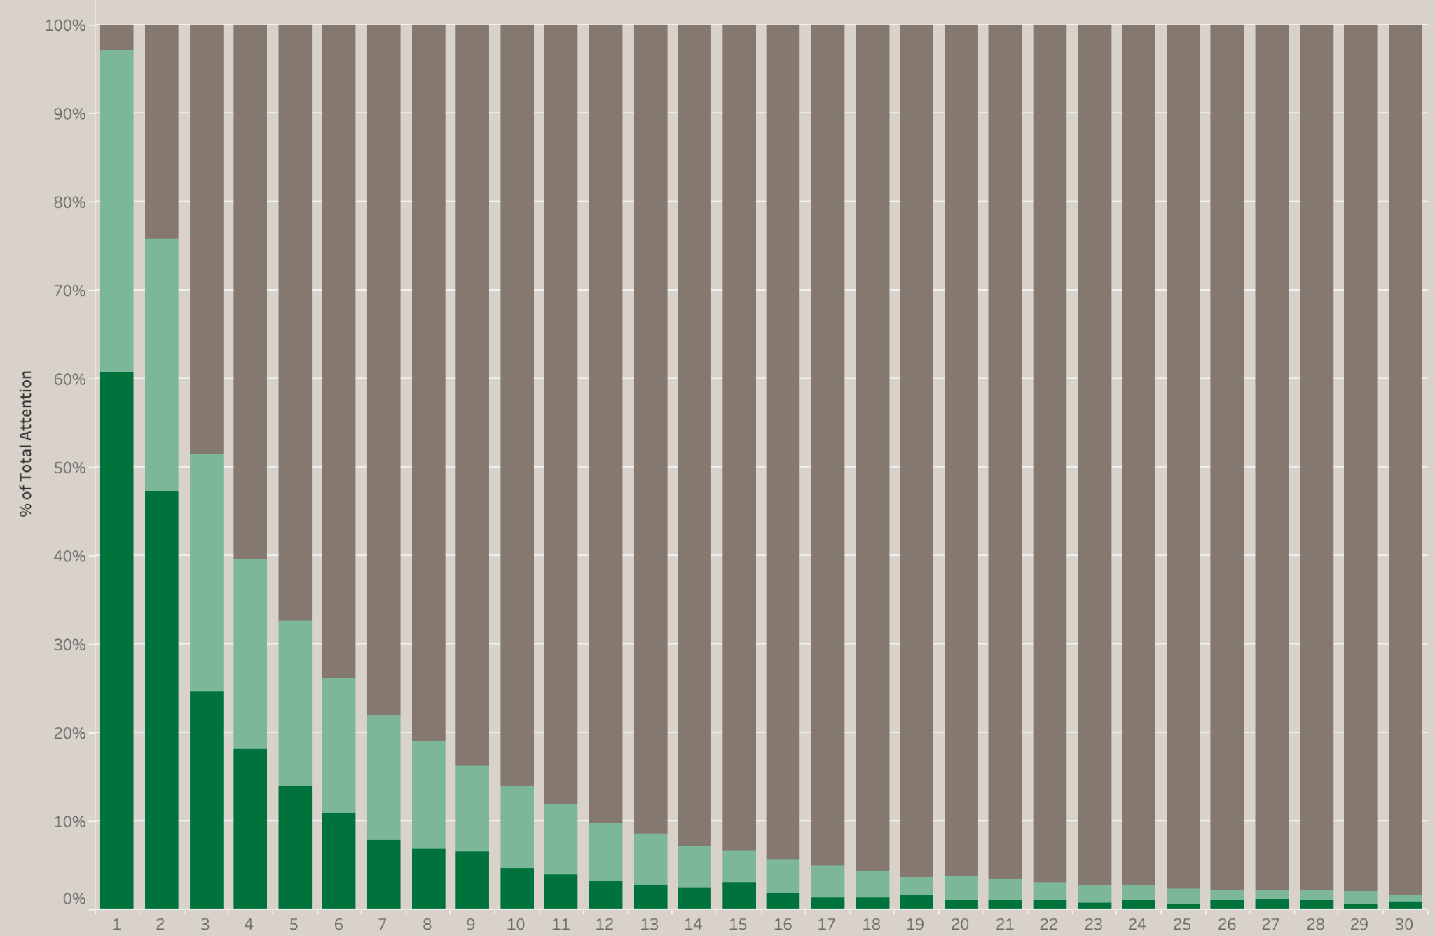

Online platforms suffer from fast decay in visual attention
30” Ad
Fast decay looks like this.
Lots of active attention early, then a then a super fast and steep drop off.
61% viewing actively
1% viewing actively

Slide 8
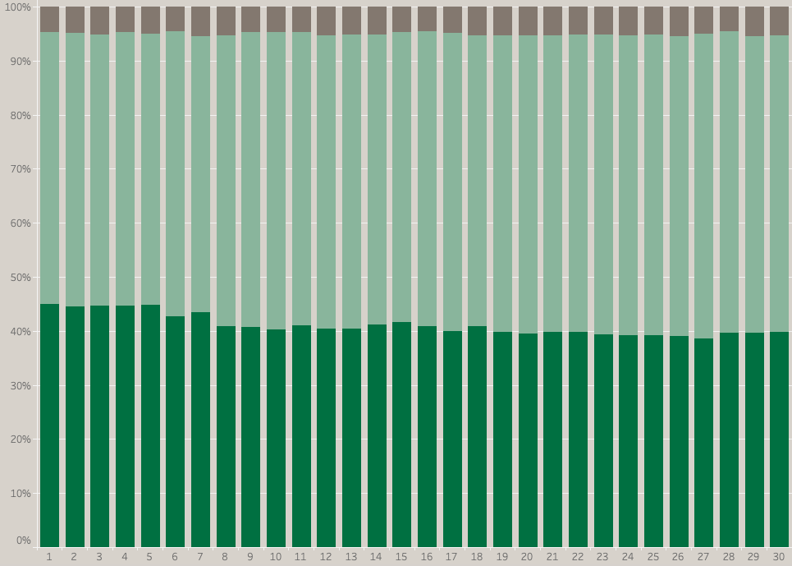
TV delivers stable levels of visual attention throughout an ad
30” Ad
Slow decay looks like this.
Active attention is largely stable across the entire course of the view.
45% viewing actively
40% viewing actively

Slide 9
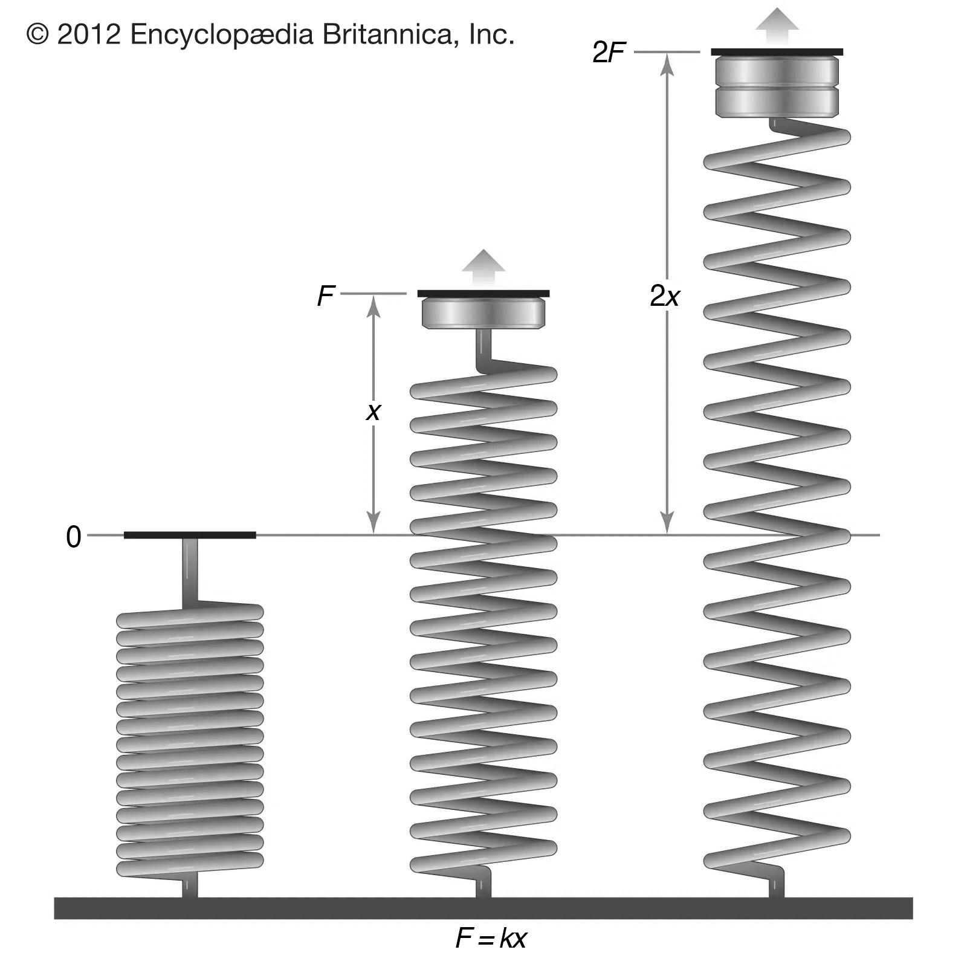
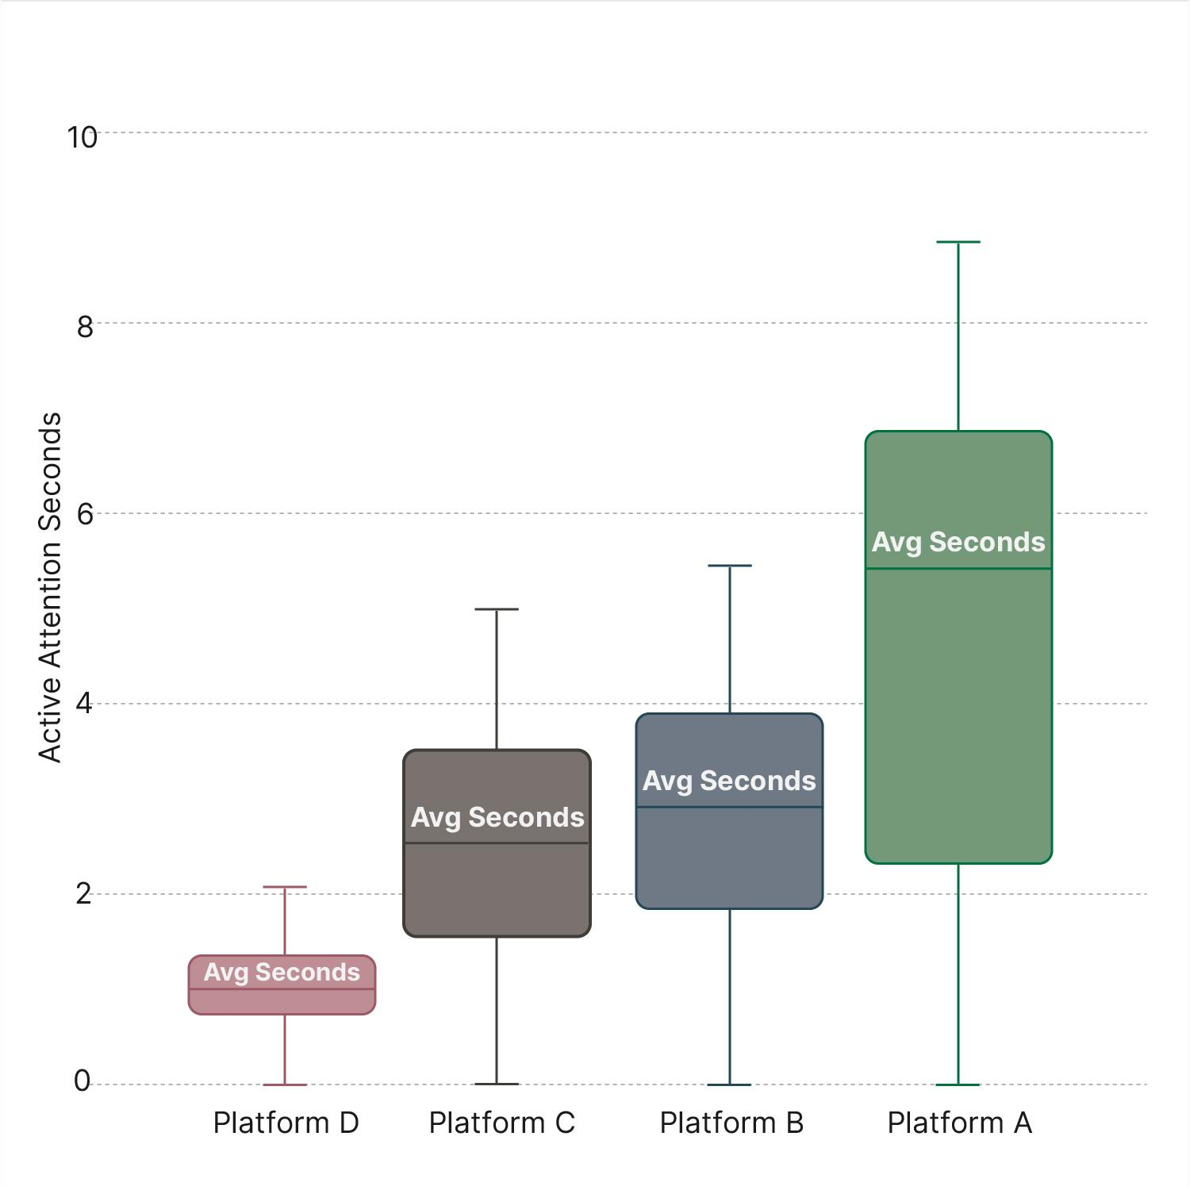
Attention elasticity varies by platform impacting on the creative opportunity
This is why each platform has its own Attention Elasticity
The range of attention seconds possible under the conditions of that platform or format.
Attention elasticity forms the attention opportunity for ad creative.
Avg Seconds
Avg Seconds
Avg Seconds
Avg Seconds

Slide 10
Investment in higher attention platforms enables creative to work more effectively
+65%
Lower attention platforms
Higher attention platforms

Slide 11


Video viewing time varies dramatically between media
Sources: Attention data from TVision (TV), Lumen (Digital) latest 2023 data

Slide 12

Today’s trading currency does not reflect attention

Slide 13
The cost of attention tells a different story

Slide 14
ALL INDIVIDUALS
Broadcasters account for over 80% of all video advertising
Average video advertising time per day
All Individuals: 17 mins
16-34s
16-34s: 10.3 mins
Source: 2022, Barb / Broadcaster stream data / IPA TouchPoints 2022 / UK Cinema Association / ViewersLogic to model OOH viewing time * YouTube ad time modelled at 4.1% of content time, TikTok ad time modelled at 3.4% of content time using agency and broadcaster data, Other online modelled at 4% of content time)

Slide 15
ALL INDIVIDUALS
Broadcasters
account for 94%
of all attention
weighted video
advertising
Attention-weighted share of average video advertising time per day
16-34s
Source: 2022, Barb / Broadcaster stream data / IPA TouchPoints 2022 / UK Cinema Association / ViewersLogic to model OOH viewing time * YouTube ad time modelled at 4.1% of content time, TikTok ad time modelled at 3.4% of content time using agency and broadcaster data, Other online modelled at 4% of content time). Attention weighting using 2023 Dentsu data and 2022 Dentsu / Lumen - Attention Economy study. All audience averages for most popular formats.

Slide 16
Emotional advertising drives effectiveness
Source: IPA Databank, 1998-2022 cases

Slide 17
TV is important for emotional campaigns
Source: IPA Databank, 2014-2022 cases

Slide 18
TV boosts effectiveness of emotional campaigns
Source: IPA Databank, 2014-2022 cases

Slide 19
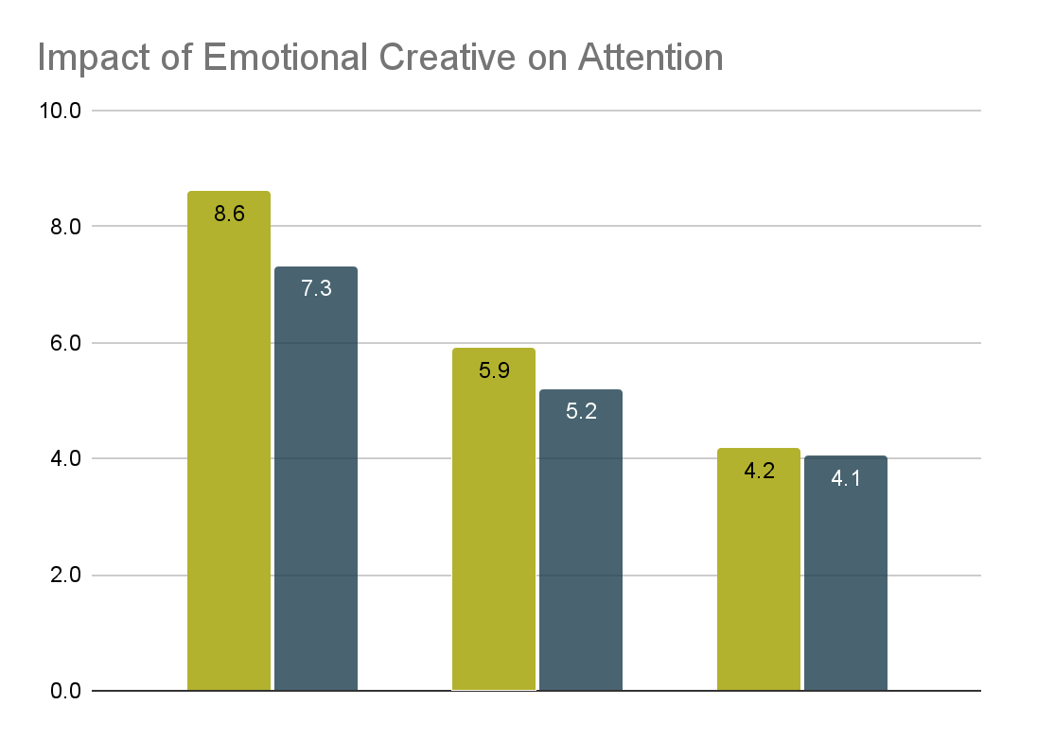
High attention media works harder for emotive advertising
The double benefit of high attention media
There is a bigger uplift in attention seconds from low emotion to high emotion, the better the platform.
HIGH Positive Emotion
+18%
LOW Positive Emotion
+14%
High Emotion
HIgh Attention
Active Attention Seconds
Low Emotion
HIgh Attention
+3%
High Emotion
Mid Attention
Low Emotion
Mid Attention
High Emotion
Low Attention
Low Emotion
Low Attention
HIGH
Attention Media
MID
Attention Media
LOW
Attention Media

Slide 20
The link between trust and profit has grown especially strongly
Base: IPA Databank 2004-2022 for profit cases reporting very large trust improvements
NB: insufficient data prior to 2008

Slide 21
TV is one of the trusted media
Source: IPA Databank 2014-2022 for profit cases *data available from 2016

Slide 22
TV’s impact on profit
Source: IPA Databank 2010-2022 for profit cases

Slide 23
The most effective campaigns spend 45% of their budget on TV
Peak at ~45% TV
Source: IPA Databank 2014-2022 for profit cases

Slide 24
Pricing power is a powerful driver of profit growth
Source: IPA Databank, 2000-2022 for-profit cases

Slide 25
Pricing power argues for greater TV share
Peak at ~80% TV
Source: IPA Databank 2014-2022 for profit cases *4-point scale

Slide 26
The most profitable campaigns spend 50% of their budget on TV
Peak at ~50% TV
Source: IPA Databank 2014-2022 for profit cases *4-point scale

