Slide 1


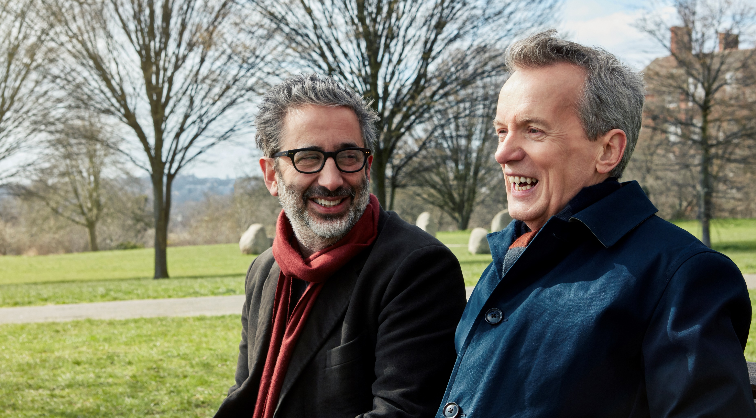
Pension Wise create a compelling piece of content
Challenge
Pension Wise wanted to build awareness, trust and affinity as well as drive appointments
Solution
Harnessed ‘moments that matter’ via dual viewing programming to encourage conversation
TV for trust, BVOD to reach lighter viewers and Sky AdSmart to target over 55s
Results
40% increase on bookings
15 % pt increase in unprompted awareness
Beat target appointments by 16% each month
Notes:
The Challenge
Launched in 2015, Pension Wise exists to help people understand and navigate their pension options, supporting economic stability in retirement. They offer free, impartial guidance for anyone aged 50 or over with a personal or workplace pension and the business has grown steadily since launch, based on appointment bookings.
Although Pension Wise already had the strongest share of voice in the market at 50%, in 2018 they wanted to take the business up a notch and encourage even more people to seek pension guidance. Their objectives were as follows:
Build brand awareness amongst non-retirees whilst injecting warmth into the brand
Build trust and affinity in the Pension Wise brand
Book a minimum of 7,500 appointments per month
Increase web visits by 10%
Increase unprompted awareness
Increase people feeling comfortable contacting Pension Wise and agreeing that Pension Wise is a good idea
The TV Solution
Pension Wise tasked their agency, Wavemaker, to come up with a solution to meet their objectives. Wavemaker knew that friends and family are the most commonly used source for guidance about pensions (source: IPSOS MORI). So, they created a campaign with the idea to harness the ‘moments that matter’ and to inspire the target audience to start a conversation about pensions with their loved ones whilst positioning Pension Wise as THE trusted resource.
To bring this to life, Wavemaker’s idea was to leverage a familiar and public relationship between two people where they can advocate, discuss and highlight the importance of pension planning in a relatable way. They found the perfect pair in best friends David Baddiel and Frank Skinner. They were the right age, had a recognisable relationship and embodied a compatible tone of voice. It was thought that their light hearted approach would bring humour and warmth to the topic and would inspire others to start a conversation about their own pension.
Wavemaker knew that TV would be the key medium needed to achieve their objectives. Not only is it emotive and trusted, but it has the scale and reach they needed to tell the story to a large number of people. In addition, it meant they could communicate with people when they were with their friends and family in a dual viewing environment. TV is the only format proven to drive both emotional equity and action - which was exactly what was needed.
The Plan
Wavemaker created two pieces of 30 second content featuring Baddiel and Skinner, positioning Pension Wise as the perfect partner to help people on their pension journey. They partnered with Sky Media in order to utilise the full suite of Sky Media assets. The spots ran across Sky Media’s wide range of channels and they achieved some additional contextual relevance by placing the spots in Frank Skinner’s Sky Arts programming. The linear activity was supported by targeted VOD activity to extend reach amongst lighter viewers. On top of this, they added some Sky AdSmart spots, where they could target people over the age of 55 who were thinking about retirement.
Through working closely with Sky, they were able to utilise Sky’s advanced technology to stretch their relatively small budget in order to create high impact, PR worthy content that told the story in the most effective way.
Results
Pension Wise saw a 40% increase on bookings and appointment for the same quarter year on year
1 in 3 people took action after seeing the advert
They beat the target of 7,500 appointments by at least 16% each month
Web visits saw an uplift of 40,000 organic visits
+15%pt increase in unprompted awareness
+17%pt increase in people feeling comfortable contacting Pension Wise
+16%pt increase agreeing that Pension Wise is a good idea
Two thirds of the audience thought Baddiel and Skinner were a ‘great fit’ for the campaign

