Slide 1




Inflation in context
Taskmaster, Channel 4

Slide 2
Consumer price inflation
Source: ONS
Notes:
Using ONS data, we can see the consumer price inflation for different sectors. Data shows that Education is the sector that has inflated the most over the last 12 years, indexing at 2022 vs 2010. Alcohol is the next highest in terms of the increase compared with 2010 prices, whilst Food has remained pretty well priced.

Slide 3
ABC1 and Adult CPTs are well behind CPI inflation
Source: Barb, AA/WARC / The Economist / ONS / Thinkbox optimal Linear:BVOD split over time
Notes:
This chart uses the Big Mac index to demonstrate the relative cost, a measure invented by The Economist magazine in 1986 as a lighthearted way to gauge if currencies were at their ‘correct’ level.
This chart plots the changing price of linear TV advertising in the UK over time for three buying audiences (all Adults, ABC1 Adults, and 16-34s) alongside consumer price inflation (CPI) and the average price of a Big Mac.
Linear TV’s price has inflated over time, yet compared to the rest of the economy, its value has remained extremely competitive. Although the average cost of buying 1,000 Adult impacts was 26% higher in 2022 than it was in 2010, and for ABC1 adults it was 16% higher, both these are well behind the overall CPI inflation – the cost of goods has risen by 36% and the cost of a Big Mac has gone up by 59%.

Slide 4
UK linear TV is great value
Source: WARC estimates 2022, calculated by applying the WFA’s media inflation figures – drawn from a panel of agencies and consultancies – to historic data
Notes:
This chart (from WARC) shows how TV advertising in the UK is a bargain relative to the rest of world.

Slide 5
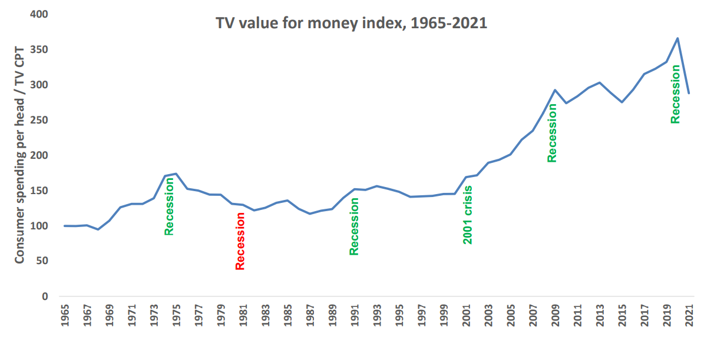
The value of TV increases during downturns
A high TV value for money index means that the price of TV is low, relative to total consumer spend levels
TV value for money index*
Source: Les Binet, ‘Marketing in the post-covid economy: A planning framework for turbulent times’. ONS, Advertising Association, WARC. *TV value for money index = consumer spending / TV CPT indexed from 1965
Notes:
Given the current economic climate, marketing budgets are increasingly under pressure with every investment needing to be justified.
At the 2022 IPA EffWorks Global, Les Binet (Group Head of Effectiveness of adam&eveDDB) provided a framework for planning media in economic uncertainty. During the session, ‘Marketing in the post covid economy’, Binet highlighted how short and long term investments should be dialled up and down depending on various factors.
One of the factors that Binet advises marketers to take advantage of is the value for money ratio for TV – a measure of the relative cost (CPT) of TV compared with the volume of total consumer spending. Binet’s data shows that the ratio has been rising over time as TV pricing has not kept pace with consumer spending in the long run – TV’s value for money has been getting better over time, particularly since 2000 due to increased competition from the tech giants.
Interestingly, when we focus specifically on times of recession (the 1970s, the 1990s, 2001 and more recently 2020 which was impacted by the global financial crisis and Covid), TV’s value for money increased sharply. The 1981 recession is the only exception.
This highlights the opportunity that advertisers and planners can take advantage of. If your particular sector is performing well, this is the perfect opportunity to buy share of voice, a method utilised by FMCG advertisers as they increased investment in TV during the pandemic.
For more insight on how brands can navigate through turbulent economic times, click here: https://www.thinkbox.tv/research/media-mix-navigator/strategies-for-marketing-through-a-downturn/

Slide 6
TV remains the lowest priced video channel
Average cost per 30 second (000s)
Other online video
TV
YouTube
£130
£8
£12
Source: 2022, Thinkbox estimates using AA/WARC, Barb, ViewersLogic, IPA TouchPoints 2022
Notes:
The chart combines AA/WARC revenue estimates, with the video advertising time data to create a relative cost per 30 seconds of AV ad exposure.
Spot TV advertising (linear and BVOD) averages £8 per thousand exposures. YouTube is pretty close at £12. Other online video however is £130.

Slide 7
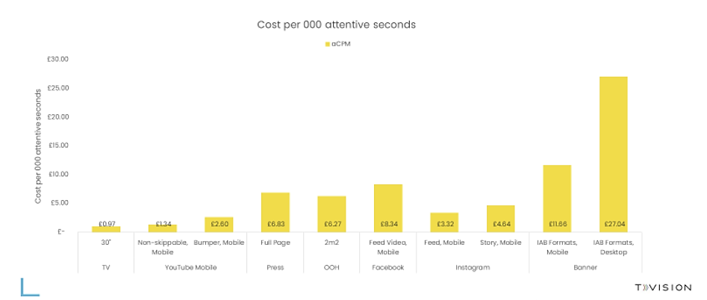
TV appears to be an ‘attention bargain’
Source: TV: Tvision / Lumen UK TV Panel. YT, Instream, Teads, Facebook Feed, Banners: Lumen digital panels. Press: Lumen Omnibus. OOH: AM4DOOH project. IG, FB Watch, TikTok: Lumen studies (weighted to be consistent with passive panel). CPM sources: Ebiquity / Fou Analytics (taken from The Challenge of Attention, 2020)
Notes:
Analysis from Lumen/Tvision of the different cost per second of attention by media channel shows that a 30-second TV spot comes out as the lowest cost, YouTube is second and Facebook Video is around 8 times the cost.

