Slide 1



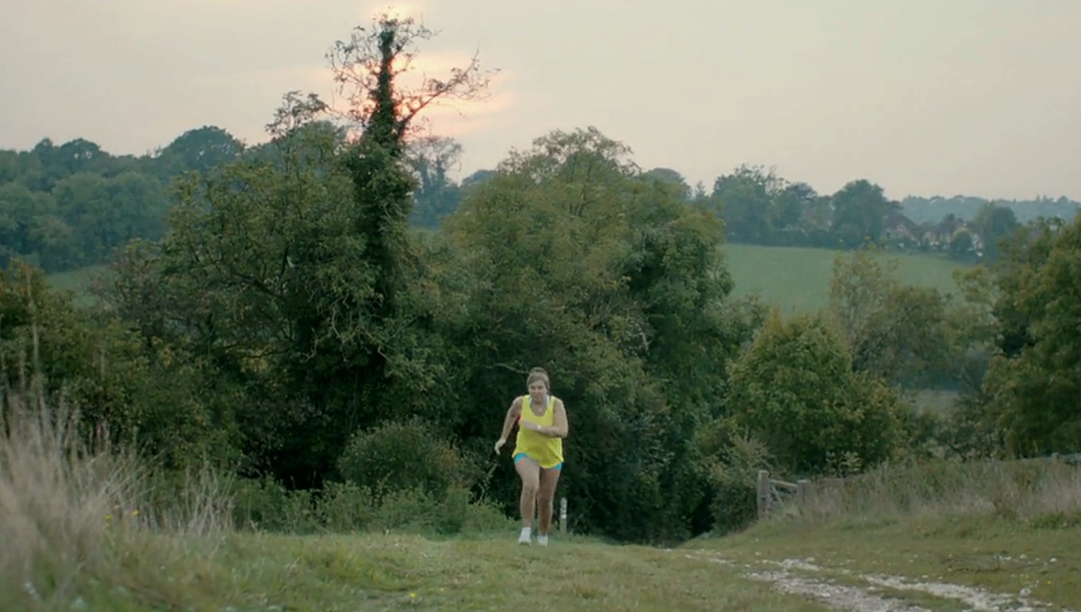
This Girl Can by Sport England
Challenge
Research showed that there were two million fewer women than men regularly playing sport
Sport England wanted to change attitudes and get more women being active
Solution
Using TV to maximise reach, Sport England launched an ad with a refreshingly honest portrayal of women of various ages and body shapes taking part in a range of sports
The activity featured 90, 60 and 30” spots, and sat at the heart of a multi-media integrated campaign
Results
2.8m women aged 14-40 who recognised the campaign said they had done some or more activity as a result
The number of women playing sport and getting active once a week increased by 261,200
Notes:
The Challenge
Research conducted by Sport England showed that there were two million fewer women than men regularly playing sport. Despite this, 75% said that they would like to participate more in sport and physical activity. In some other European countries, this disparity doesn’t exist. It seemed that many UK women and girls are put off exercising for fear of judgement – about their appearance, their ability, their fitness or that they choose to spend time on themselves.
The challenge for Sport England was how to find a way to change women’s attitudes to exercising, to help boost their confidence and to find a way to motivate them to take part. They wanted to address the barriers that stopped them from exercising, in order to ensure that women felt that taking part in sport and exercise was an acceptable and achievable thing to do. They knew that building up appeal and stimulating positive motivation will draw women in, but they also needed a trigger to create momentum and spur the target audience to take action.
The TV Solution:
Working with their advertising agency FCB Inferno, they produced a campaign called This Girl Can. At its core was a stunning TV ad that offered a refreshingly honest portrayal of exercise. Women of various ages and body shapes were pictured taking part in a range of sports - looking sweaty, red-faced and exhausted but happy.
There were 90 second, 60 second and 30 second versions of the ad. During the ad, hard-hitting lines were included to encourage women to overcome their barriers, to prompt a change in attitudes and help boost women’s confidence. These included “I kick balls, deal with it” and “Sweating like a pig, feeling like a fox”.
TV was essential for its ability to generate an emotional response sufficient to change behaviour and for its scale and reach.
The Plan:
Sport England wanted to reach as many women and girls as possible, particularly those aged between 14 and 40. They worked with their media agency Carat to produce a fully integrated campaign using all media channels but with TV at its heart.
The TV campaign ran from 12th January to 15th February 2015 and then there was a follow up burst that ran from 5th to 28th June 2015. The TV was supported by cinema, OOH, online ads and social media. On social media, viewers could find out more about the real women featured in the ad as well as share their own exercise journey.
In addition, they teamed up with Sport Relief. Women could create their own ‘This Girl Can’ posters to show everyone what they were doing to raise money.
Results
2.8 million women aged 14 to 40 who recognise the campaign say they have done some or more activity as a result
1.6 million of these say they have started exercising
The number of women playing sport and getting active once a week has increased by 261,200
Awareness and recognition of the campaign was high with good recall of key campaign messages - 6.8m (72%) women aged 14-40 recognised the ad
The campaign motivated women - 70% of women reported being motivated when shown the ad
2.8m women (41%) that recognised the campaign said that they have done some or more activity in response
5.6m women (60%) agreed that “I feel exercise is for me” – up from 4.9m (52%)
5.4m women (57%) agreed that “I don’t worry about what other people think of me when I’m exercising” – up from 4.2m women (45%)
To read the full case study and access the creative visit: https://www.thinkbox.tv/Case-studies/Sport-England

