Slide 1
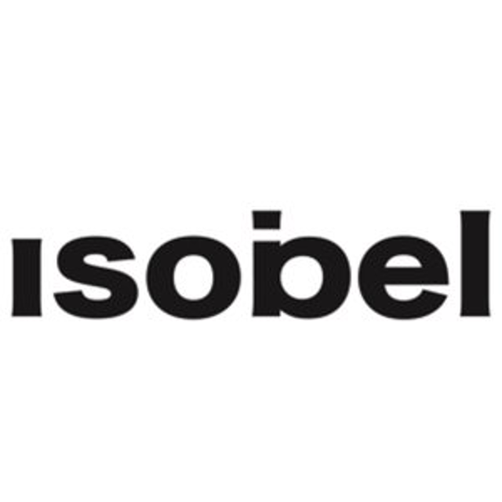
JET – Building a Brand in Lockdown
Challenge
JET needed to build awareness and brand consideration of their fast and convenient filling stations – but lockdown hit and car journeys collapsed.
Solution
They moved their entire budget to addressable TV advertising, with specific target audiences who lived within 15 minutes of a JET station.
Results
Campaign recall was 5 x higher in exposed households, brand awareness surged and 9000 more people purchased fuel.
Notes:
THE CHALLENGE
JET, Phillips 66’s forecourt retail brand – a diversified energy manufacturing and logistics company, had very low awareness as a retailer with only 2% of people saying that JET was their preferred supplier (YouGov, 2020).
As petrol stations have evolved into mini-supermarkets, JET’s offering bucked the trend by selling only what was needed and nothing more, to enable their customers to get in and out quickly when on the move.
Most people still go to work by car and most journeys are repetitive with people travelling the same route every-day and making habitual choices about fuel. JET only had c.4% market share, so their objective was simple – they wanted to increase brand awareness and consideration.
THE SOLUTION
The strategy was to focus on customers local to JET stations and make them aware that JET was fast and convenient.
Creative agency ISOBEL were appointed and identified two key audiences who were both driven by a need for speed and convenience.
• Older, affluent men wanting good efficient service with no frills.
• Younger busy women, many working with families, who are time poor.
Both were heavy TV viewers and research indicated that they were more likely to live in Yorkshire and the East Midlands. A surreal and engaging ad was created, and the plans were finalised.
THE PLAN
Sky AdSmart was used to target drivers who lived within a 15 minute drive of a JET station and key arterial routes were to be supported with roadside poster sites and a high profile cinema strategy.
THE PROBLEM
The plan was due to go live in April 2020... Then lockdown hit. Car journeys collapsed by 70% in a matter of weeks.
JET decided to revise their plan and spend 100% of their budget on targeted addressable TV close to their core garages, leveraging their TV ad’s creative power and their captive audience. They also chose to invest in post campaign research to compare AdSmart exposed homes to unexposed homes, to more accurately prove the effects of the investment.
By targeting micro-areas closest to key JET stations for a month with 60” ads before introducing the 30” copy, JET managed to create the impact of a significant national brand but spent less than £2,500 per location.
THE RESULTS
The campaign achieved a recall of 53.5% amongst target households – almost 5 times more than unexposed households.
The campaigns yielded one of the best sets of results of all Adsmart campaigns ever researched.
Brand awareness in homes exposed to the campaigns was 14%, versus 10% in exposed homes, moving it above a key competitor and demonstrating the power of TV – which was the only activity running at the time of the campaign.
JET went from almost no spontaneous advertising awareness to surpassing a main competitor and supermarket petrol brands.
As a result of the campaign, 9,000 more people purchased fuel, with a media ROI of 2.44.

