Slide 1
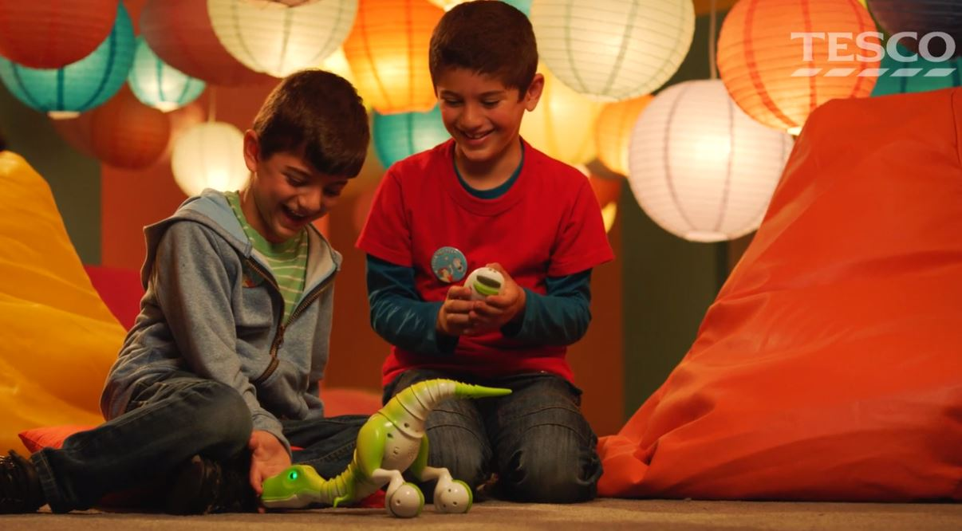
Tesco plays smart with TV and online
Challenge
Drive consideration of Tesco as a destination for buying toys at Christmas
Drive sales of the toys that were most wanted by children at Christmas 2014
Solution
Use TV to create an emotional connection, reaching a large number of parents and children
Create series of online films showing children opening ‘must have’ toys
Two main TV bursts to reach ‘strategic shoppers’ (early purchasers) and to hit the peak toy shopping period
Targeted shoppers researching toys online using search and online video series
Results
Sales of toys at Tesco increased by 10% year on year over the campaign period
Notes:
Challenge
Despite overall good brand awareness, there was very little association between the Tesco brand and toys, even at Christmas. Despite the fact that Tesco had over 15,000 toy products for sale during Christmas 2014, very few people had any idea that Tesco stocked toys at all.
The challenge, therefore, was to create an association with Tesco’s toy range and Christmas gift giving. This would mean pushing Tesco into uncharted territory with an entirely new competitive set, coming up against brands like Argos and Toys R Us who already had a strong association with toys.
They had two clear objectives:
Drive consideration of Tesco as a destination for buying toys at Christmas, both among existing Tesco customers and those that normally shop elsewhere.
Drive sales of the toys that were most wanted by children at Christmas 2014
The Solution
Extensive research from Tesco’s media agency, Initiative, revealed that buying toys is very much an emotionally driven decision and so they wanted to find a way to use that emotion as a vehicle to communicate the range as well as driving sales.
TV had to form a part of the communication strategy because it is brilliant at creating an emotional connection with people and is able to reach a large number of parents and children.
In addition, as a large number of people research toys online, they decided to create some mini films for online that would show children opening ‘must have’ toys.
They ran two 20 seconds ads on children’s TV channels, including Nickelodeon, Cartoon Network and Disney Junior. The campaign ran from 15th October to 2nd November as this is a key period for parents planning and buying their children’s main present. They also upweighted weekends in order to take advantage of the increased time available for shopping and searching for toys.
This was followed up by a 30 second ad across all national stations in the last week of November, the busiest toy-buying period. The TV activity not only drove awareness of the range, but would also drive the consumer online to see the mini films.
They created nine mini films showing real children opening the toy they really wanted. These were hosted on YouTube, Facebook and Twitter. They targeted users searching for keywords related to toys, Christmas and gifting.
Results
The TV campaign reached 15.9 million housepersons (over 60%) and 2.1 million housepersons with children (31%)
Online, there were over 8m views across the entire Toy Team playlist. 2.3m views were opt-in, a result of users actively choosing to play or not to skip the content within social channels.
Sales of toys at Tesco increased by 10% year on year over the campaign period

