Slide 1
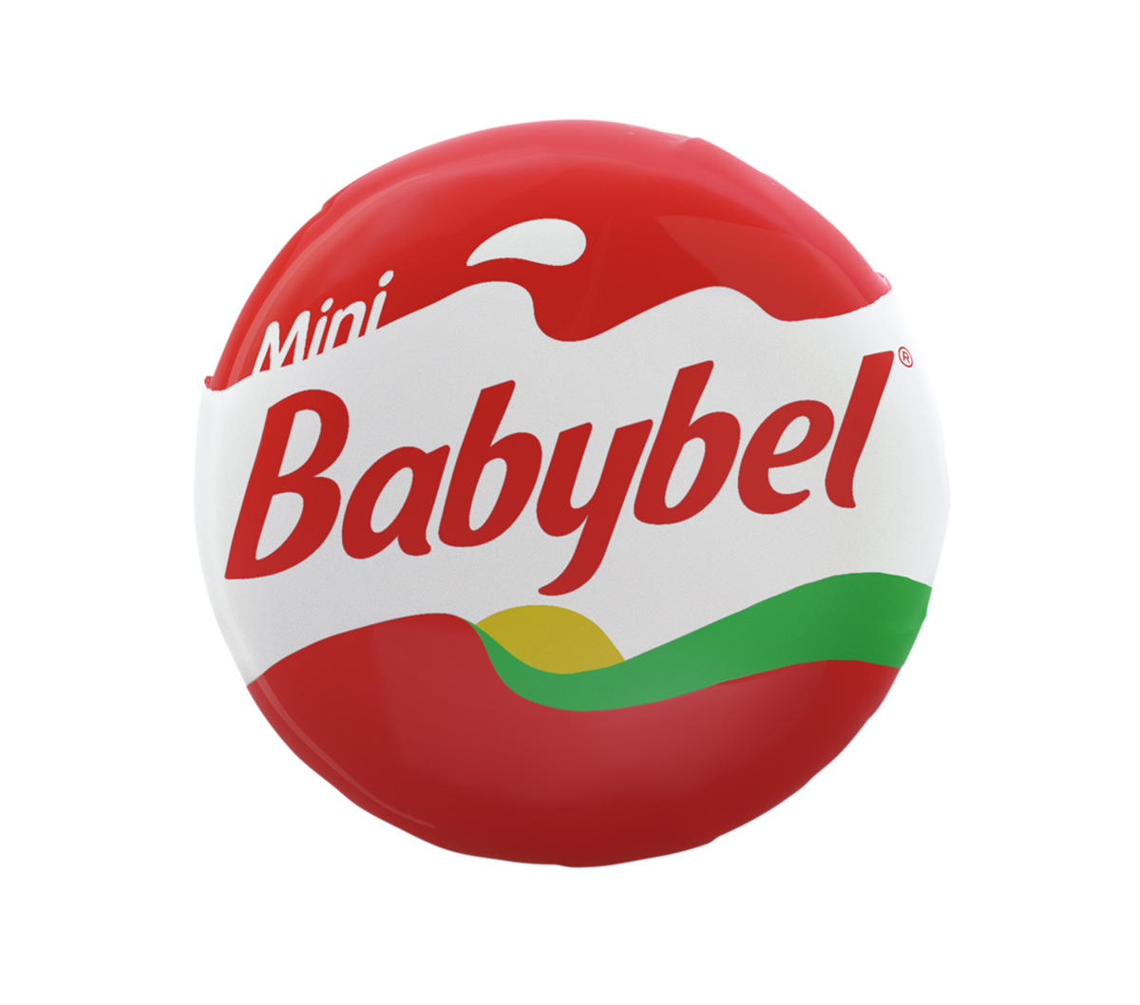
Mini Babybel Saves Snack Time
Challenge
Mini Babybel wanted to increase penetration amongst their two target audiences during the FIFA World Cup
Solution
Spark Foundry positioned Mini Babybel as a fun and more natural, protein-filled option for ‘Snack Time’
The ‘Saving Snack Time campaign ran for 3 weeks around the lead-up and starting games of the World Cup
Results
Mini Babybel became the UK’s no. 1 cheese brand during the World Cup in value
8% increase in sales versus same period in 2017
Attracted an additional 252,000 buyers
Notes:
The Challenge
Over recent years, Mini Babybel has seen a decline in penetration amongst their two core audiences - parents with children aged 2-9 and adults aged 25-34. To regain penetration amongst these key audiences, which had been at the heart of their success, Babybel decided to present themselves as the natural and healthy alternative for snacking during the World Cup.
The most significant advertising opportunity in 2018 was the FIFA World Cup and Babybel wanted a piece of the action. However, without official sponsorship of the competition, the campaign could have no direct association with the tournament. Therefore, an innovative campaign had to be produced to capitalise on this immense snacking moment opportunity.
The TV Solution
Despite all the excitement and adrenaline-fueled moments of the World Cup, there are also lulls and tedious moments. During these dull moments, snacks come to the forefront of the mind and junk food prevails. Spark Foundry, Mini Babybel’s media agency, determined that the brand needed to present itself as a fun and more natural, protein filled option for ‘Snack Time’.
TV was crucial to drive awareness and deliver the brand’s message of 'Saving Snack Time' at scale. To capture the audience’s attention during the World Cup, Mini Babybel positioned themselves as a fun brand for all to enjoy. Being a healthy, protein-filled alternative, the brand could deliver a relevant message that resonated with both core audiences. They created a video campaign that entertained and distracted viewers from the boredom moments throughout the tournament.
The Plan
The campaign ran for three weeks and focused around the lead up and starting games of the World Cup to ensure it had the most impact. They ran a 20" 'Saving Snack Time' creative across ITV, Channel 4 and Sky, with an upweight in the first two weeks. The varied use of broadcasters allowed Mini Babybel to reach their two core audiences effectively and allowed the brand to leverage this cultural moment successfully. In addition, to ensure the campaign had access to premium quality football matches, the buying audience was slightly adjusted and so the effects were maximised.
Alongside the TV campaign, there was activity on social channels such as Facebook, Twitter, Instagram and YouTube. These creative executions were designed to prompt engagement amongst the audience through a new challenge under the hashtag 'CheeseGoals'. The social content included four simple challenges that the audience could try and then share via the hashtag. By prompting engagement, it strengthened and established customer-brand relationships.
Results
Mini Babybel became the UK’s number one cheese snack brand during the World Cup in value
8% increase in sales versus same period in 2017
Attracted an additional 252,000 buyers
Achieved 1+ coverage of 68% amongst housepersons with children
Over 11m video views across social with #Cheesegoals
An increase of 540% in brand interest (3.5 x higher than previous year).

