Slide 1


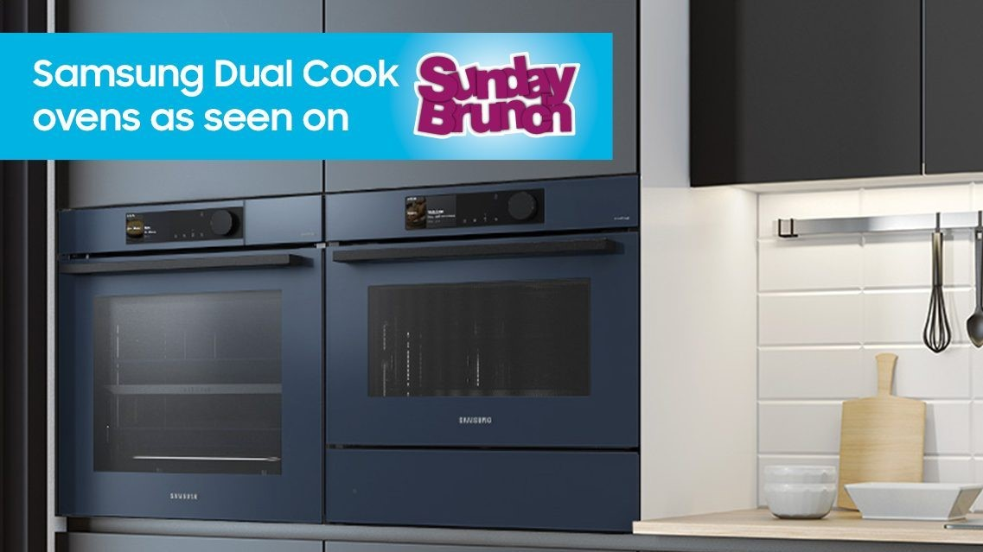
Samsung Appliances: Cooking up consideration with Sunday Brunch
The Challenge:
A slow moving, distress driven appliance market was leaving Samsung Appliances behind. When people entered the market, they weren’t picking Samsung. They needed to move themselves up into the top 3 for consideration when you need to make the purchase.
The Solution:
By partnering with Channel 4’s Sunday Brunch, Samsung were able to authentically integrate their products into the fabric of the show.
The Results:
Moved into top 3 for consideration across Europe. Increase in familiarity scores with exposed audiences, improved consideration with exposed audiences and spikes in sales across most featured products.
Notes:
The Challenge
The appliance market is slow moving, with long purchase cycles and high consideration before making the choice. As a result of this, Samsung had followed traditional category behaviour, they focused their attention on ‘distress purchases’ with a focus on price promotions and product functionality. While this was delivering some sort of result for the business, a closer look at the search data indicated that Samsung wasn’t among the top 3 brands in an urgent buying situation, so promotional activity was coming too late to influence the purchase choice. Samsung Appliances handed media agency Starcom a clear set of objectives as a result. Starcom would need to grow market share by growing consideration and taking the brand into the top 3 of consideration.
The TV Solution
With a clear objective to work toward, Starcom set about understanding the problem at hand. Using bespoke research, they found that household purchases like those of a washing machine or fridge is driven largely by a recommendation or personal experience but envy was also a powerful motivator. This insight was a game changer, while Samsung were very good to showcasing their appliances’ technical prowess, they had overlooked the importance of forging a personal connection with consumers.
To deliver against this new approach, Starcom were certain that only one channel would deliver the results, it was TV. With TV, they would be able to harness TV’s ability to drive emotion and fame. But a simple TV campaign wouldn’t be enough, so Starcom made the case for sponsorship. It would provide Samsung with the platform to maintain a presence in their target audience lives with multiple touch points to nurture the bond created and shift consideration.
The Plan
With sponsorship in mind, Starcom got to work in putting in place their media plan. Samsung needed a property were they could from close bonds with their target audience over time. Using data from IPA TouchPoints, Starcom were able to identify the importance of Sunday mornings to their audiences relationship with their home, for them it was a time to be productive. Insights had highlighted that TV chefs could be a proxy for these personal connections with their warm and inviting manner. In fact to some consumers, they were household regulars, akin to family members, the perfect source of trust for Samsung’s audience. They now needed a property that would deliver the required cut through, and build a presence in their audiences Sunday routine. In steps Sunday Brunch.
Sunday Brunch presented as the perfect sponsorship opportunity which also included creative product placement. The sponsorship wasn’t a simple badging exercise for Samsung, they fully integrated the products in the show itself, giving them a regular presence in people’s homes every Sunday morning. The format of the show played into Samsung’s hands also. With new guests each week, Samsung were able to mirror the real world experience of stepping into someone’s kitchen and being wowed by the stand out features of the Samsung domestic appliance range. This familiarity bred by the presence on the show was crucial in aiding the consideration targets handed down to Starcom.
To support the onscreen sponsorship and product placement, Samsung and Starcom ran behind the scenes previews across social media to amplify buzz around the product integration. Samsung went one step further by running an extensive influencer campaign, which leveraged the Sunday Brunch partnership. The influencers didn’t just endorse the products they showed them being used in their daily lives; building a connection with consumers. The partnership was leveraged across the marketing campaign across all channels. In retail for example, Samsung were able to apply ‘As Seen on Sunday Brunch’ messaging at point of sale both in store and online. This allowed the brand to reinforce their new narrative and broaden their reach.
Results
The Sunday Brunch partnership was pivotal in helping to drive a perception change of Samsung appliances. As a result of the sponsorship, Samsung were able to overtake Beko as of the top 3 most searched brands in the category on Google.
The performance didn’t just stop at the consideration change, it carried over to a number of other areas to. Familiarity with Samsung appliances was 13% higher with the exposed audience vs the control. This followed onto to upticks in wanting to know more about the brand, with 92% saying that the Sunday Brunch partnership made them more curious about Samsung Appliances. While the partnership was designed to work in the long term, Samsung are already seeing increases in sales across the products most featured with upticks in sales to built in ovens, fridges and freezers and vacuum cleaners.
Client quote
‘we’re excited to be continuing our partnership with ‘Sunday Brunch’, which will again enable Samsung to have a strong platform from where we can continually showcase our premium bespoke appliance range to a large and relevant audience every week. Investing in idents that highlight our products’ strengths while seamlessly fitting the show’s tone, demonstrates how this strategic sponsorship has significantly boosted Samsung’s brand appeal’ Gino Grossi, Head of Brand Marketing for Home Appliances, Samsung Electronics UK

