Slide 1


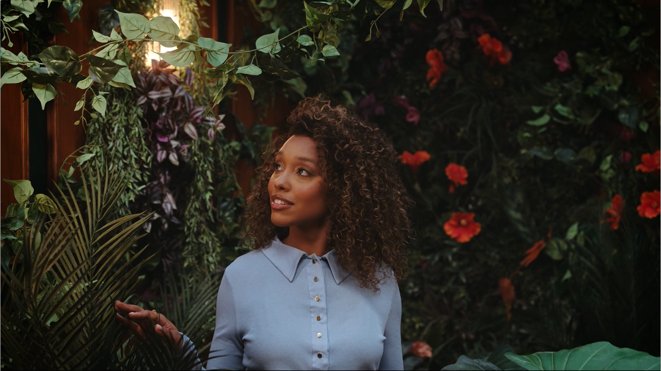
Flora & Curl: TV for the first time with Channel 4 and Lloyds’ ‘Black in Business’
The Challenge:
Launched in 2017, Flora & Curl provides plant-based hair care to those with textured hair. They were looking to grow brand awareness, increase site visits and ultimately sales in the long term.
The Solution:
Entered Channel 4 and Lloyds’ ‘Black in Business’ Initiative to launch on TV across the Channel 4 ecosystem.
The Results:
The campaign saw an increase in recognition with a core audience of 25–44-year-old women with textured hair and delivered improvements in key brand statements above those of Channel 4’s micro brand norms.
Notes:
The Challenge
Flora & Curl are a plant-based hair care brand with a focus on those with textured hair, either wavy, curly, or coily. Founded in 2017 by Rose Ovensehi, who herself was dealing with dry and brittle hair. After taking a break from chemical relaxers, Rose started mixing in her kitchen and Flora & Curl was born.
With a focus on sustainability, the brand had gone from strength to strength but were keen to grow beyond their loyal fan base. They wanted to introduce the brand to as many people as possible as fast as possible, while growing site visits and ultimately sales in the long run.
The TV Solution
With TV feeling like a distant dream, Flora & Curl had typically focused on social campaigns targeting those who were their exact demographic. However, to accelerate their brand, they discovered something that would become a silver bullet for their growth ambitions.
Being a Black-owned business, Flora & Curl had already seen the success that similar brands had had with Channel 4 and Lloyds’ Black in Business initiative.
The scheme, now in its second year, was designed to highlight the struggles that Black-owned businesses face when it comes to funding, with research highlighting that 56% of Black businesses only receive funding once the business is already successful. The research also highlighted that just 0.24% of venture capital goes to black businesses.
The initiative offers black entrepreneurs £150,000 of free airtime across Channel 4, alongside 6 months of business mentoring provided by Channel 4 and Lloyds.
After a process attracting over 200 applicants, Flora & Curl successfully pitched to win the opportunity to use TV to drive awareness, thanks to Channel 4’s ability to reach people en masse at the right time with the right messaging.
The Plan
With planning undertaken by Channel 4’s commercial team and armed with a creative led by Quiet Storm, Flora & Curl were ready to leverage the power of TV.
The campaign kicked off with a premier break alongside all other winning brands, with the spot playing out during Bake Off: The Professionals, reaching 1.4 million people. Following the launch, Channel 4 took Flora & Curl to new environments with a campaign planned across the Channel 4 ecosystem, featuring in top channel programming including The Handmaid’s Tale, Below Deck, The Couple Next Door and Sunday Brunch, hitting key dayparts and engaging an audience alongside the content they love the most. This programming presence continued across Channel 4 Streaming with the campaign featuring in the top programming for the audience and platform during the campaign period, such as 24 Hours in Police Custody, Taskmaster and Married at First Sight Australia.
Results
The campaign was a huge success for Flora & Curl. With the aim of lifting brand awareness for the brand, the campaign successfully delivered ad recognition in line with Channel 4’s Micro brand norms, while also seeing an uptick in recognition with the key audience of women aged 25-44 and those with textured hair.
Alongside this, there was a rise in spontaneous awareness among 25–44-year-old women with textured hair, above that of the micro brand norms and above those of competitors also included in Channel 4’s brand tracking study.
The creative for the campaign was also hugely impactful for Flora & Curl, delivering scores above the Black in Business norm for statements including ‘something I’d share with others’, ‘portraying the brand in a positive way’ and ‘telling me something new about the brand’. This culminated in seeing an improvement in overall opinion with both a general audience and the target audience of those with textured hair. Finally, brand awareness rose above those of key competitors throughout the course of the campaign.

