Slide 1
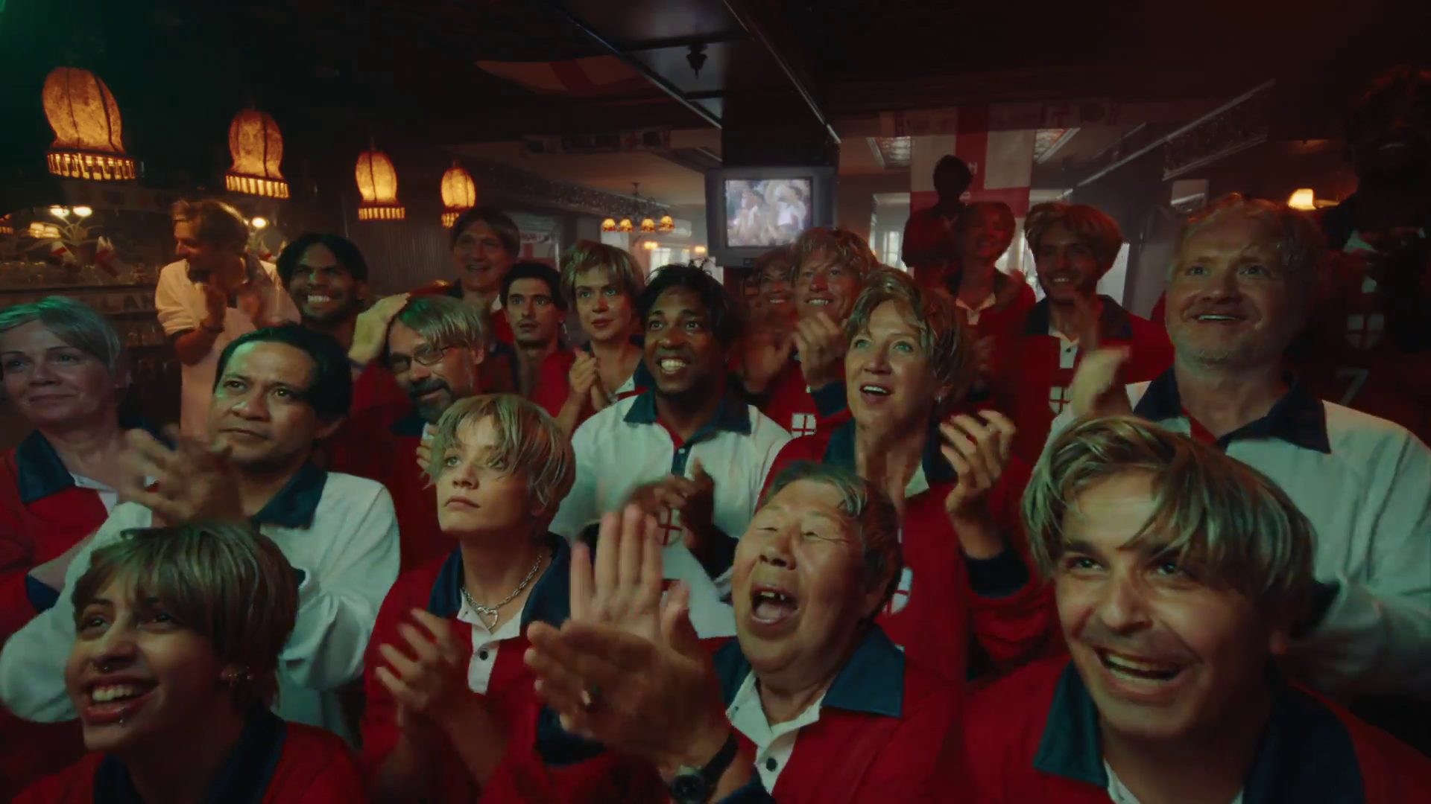
Power of shared viewing
ITV – There’s no place like ITV

Slide 2






Not all advertising contexts deliver the same impact
Big screen
Professionally produced content
Location
Mood
Occasion satisfaction
Shared viewing
Source: Context Effects, Map The Territory & Tapestry Research, 2024
Notes:
Context is key. The right in-home advertising context can increase ad recall by up to 6.3 times.
Looking at specific rooms within the home, the living room emerges as the most impactful, driving better ad recall than any other room, 176% higher than the kitchen, 10% better than the bedroom and 22% higher than any of the other rooms in the house.
So what exactly is going on in living rooms to make this such a powerful environment for advertisers?
Analysis of 87 variables via SEM identified key contextual factors that drive ad recall at home, both individually and collectively. Each of them are an important ingredient in creating the perfect advertising recipe. These are:
1. Device – larger screens such as the TV set have a higher impact on ad recall
2. Content – professionally produced content produced stronger results than non-professionally produced content
3. Location – different locations such as the living room produced different results
4. Mood – being in a positive mood has shown to produce stronger results
5. Occasion satisfaction – overall satisfaction with the viewing occasion drives ad recall
6. Other people – shared viewing plays a role in driving ad recall and satisfaction
Read more about the power of context here: https://www.thinkbox.tv/research/thinkbox-research/context-effects#in-brief

Slide 3
Shared TV viewing occasions drive ad performance
+23% higher ad recall
+15% higher brand trust
+75% greater liking of the TV ads
Source: Context Effects, Map The Territory & Tapestry Research, 2024.
Staying Power, Tapestry Research, 2025.
Notes:
As seen in Context Effects, analysis found that being with others has a marked impact on ad recall, increasing by 23% vs. watching alone. viewing with other people has a positive impact on ad recall. In the same way, Staying Power showed how TV’s lasting impact is closely tied to the way we watch it. Unlike Social Media, TV remains a shared experience — often viewed on a big screen, in a relaxed living room setting, and crucially, with other people.
Across the eight-week period, liking of the TV ads in this study was 75% higher among those who were exposed to them with others (vs. seeing alone.) The findings suggest that TV’s enduring influence isn’t just about sight and sound — it’s about the social connection that comes from watching together.

Slide 4
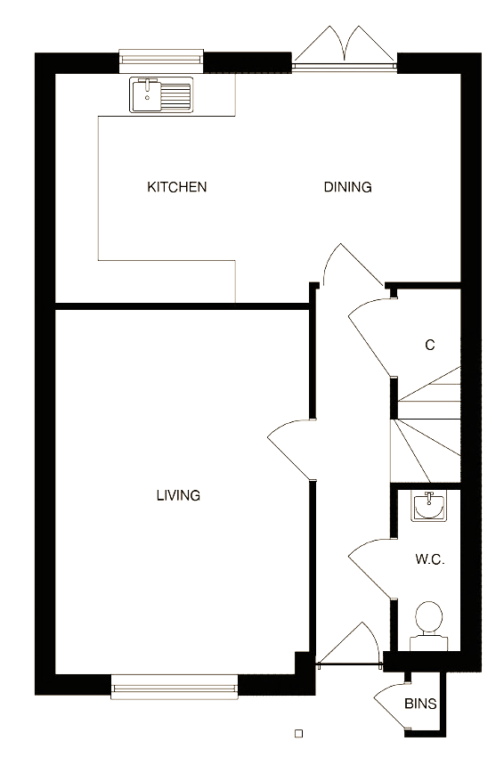
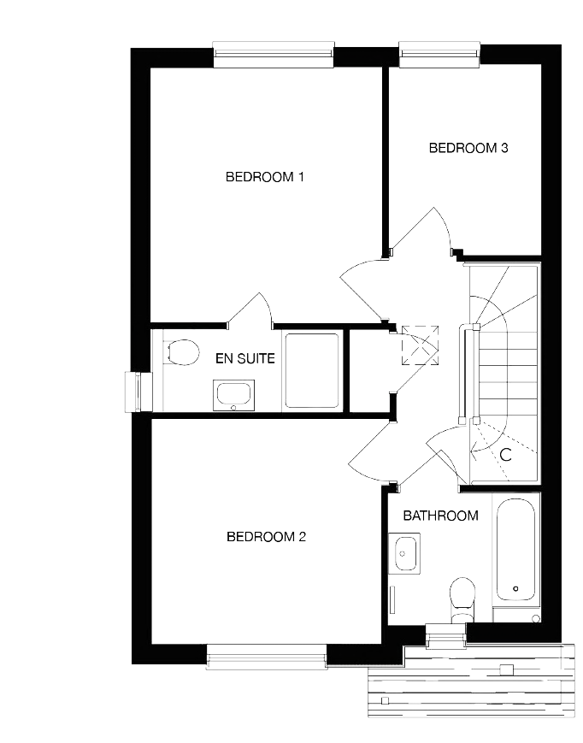
The living room is the location with the highest ad recall
176%
higher vs. the kitchen
10%
higher than in the bedroom
22%
higher than all other rooms in the home
Source: Context Effects, Map The Territory & Tapestry Research, 2024
Notes:
In the home, the living room is the location with the highest ad recall.
A18. Do you remember seeing any advertising when you watched [OCCASION]?
A5. Where were you when you watched [OCCASION]?
Base: 4,005 viewing occasions with ads answered by 2,017 online respondents aged 18-75 who watched any type of video content via any source the previous day. Sample matched to Barb.

Slide 5
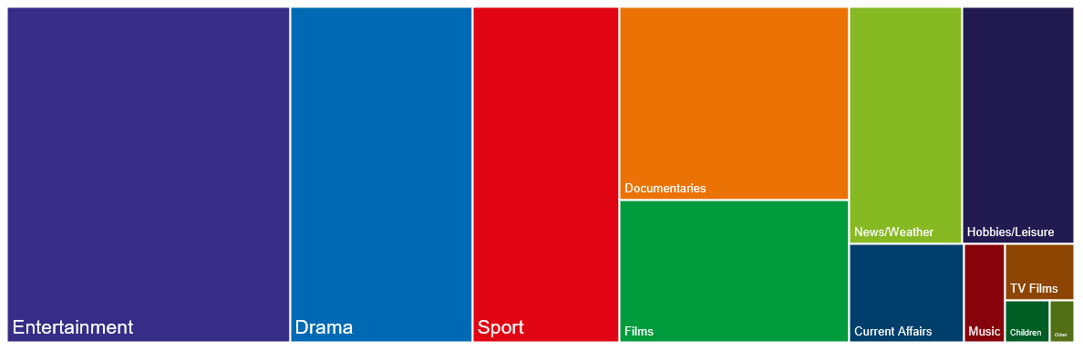
Shared viewing happens in all TV genres
Source: Barb 2025, Co-viewing 2+, Commercial Broadcasters. % of all co-viewing
Notes:
Using Barb data, we can see that shared viewing happened in all TV genres, with Entertainment and Drama seeing the largest proportion of viewing.

Slide 6
TV shows that brought people together
Rank | Channel Group | Genre | Programme Title | Total Audience | Co-Viewing Proportion
1 | Sky | Drama | The Last Of Us | 1.3 | 69%
2 | Sky | Entertainment | Rob & Romesh vs... | 1.3 | 69%
3 | Prime Video Ad Tier | Entertainment | LOL: Last One Laughing UK | 5.0 | 69%
4 | Channel 4 | Entertainment | Taskmaster | 2.2 | 68%
5 | UKTV | Drama | Bookish | 1.3 | 68%
6 | ITV | Entertainment | The 1% Club | 2.9 | 68%
7 | Prime Video Ad Tier | Entertainment | LOL: Last One Laughing Ireland | 1.1 | 68%
8 | Sky | Drama | The Day Of The Jackal | 1.1 | 67%
9 | ITV | Drama | Code of Silence | 1.1 | 67%
10 | Sky | Drama | Brassic | 1.2 | 67%
11 | ITV | Entertainment | Win Win with People’s Postcode Lottery | 1.0 | 66%
12 | ITV | Entertainment | Ant & Dec's Limitless Win | 3.5 | 66%
13 | Channel 4 | Entertainment | Gogglebox | 2.3 | 66%
14 | ITV | Drama | Trigger Point | 7.0 | 65%
15 | Sky | Drama | Atomic | 1.2 | 65%
Source: Barb, 2025, 16+ co-viewing, commercial TV set, entertainment & drama, over 1m total audience, all Christmas specials and one-offs removed, ranked by shared viewing proportion.
Notes:
Using Barb data to analyse the top two performing genres with the largest proportion of co-viewing (Entertainment and Drama), we can see that comedy shows such as LOL: Last One Laughing and Tasmakster as well as gripping dramas such as The Last of Us and The Day of the Jackal were largely watched with other.

