Slide 1
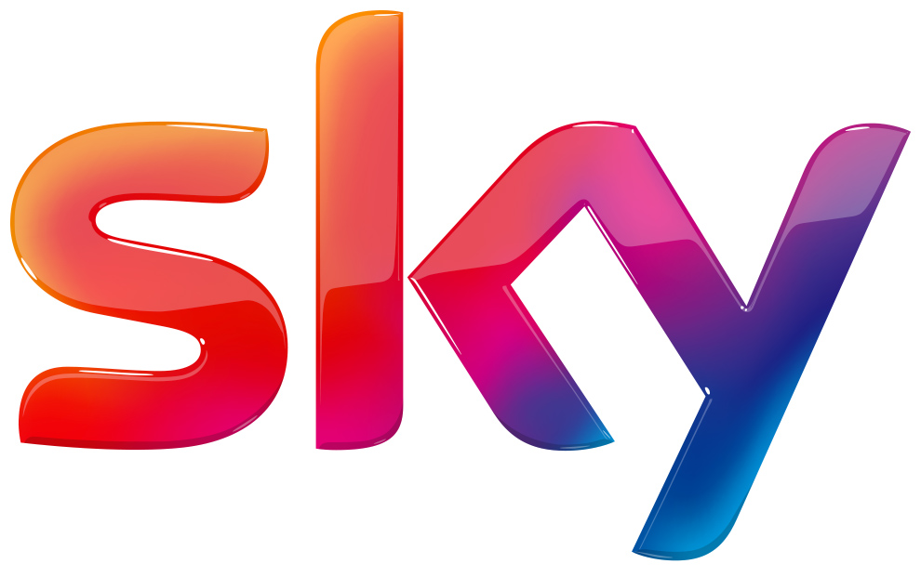
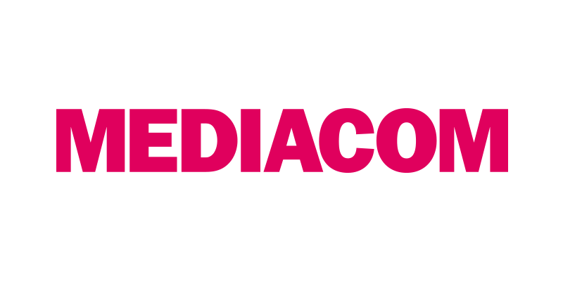
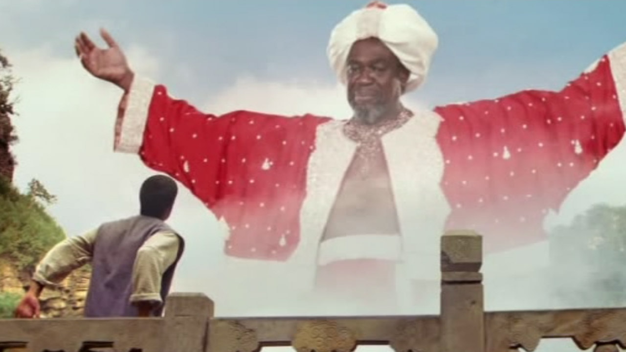
Sky launched their fairy-tale broadband campaign… cue the happy ending
Challenge
Sky needed to increase sales in an aggressive marketplace with broadband headroom diminishing
Solution
Simplify Sky’s offering and bundle up all products to form a triple play proposition – all for under £20
Used DRTV to drive response but incorporated some early and late peak dayparts to help reach a more upmarket audience
Result
Record Q1 product sales of 893k – up 13%
Triple product bundle uptake increased by 39%
Broadband specific net additions were up 78%
Lowest ever cost per click DRTV efficiency
Notes:
Challenge:
In 2010, Sky Broadband had reached 2.5 million customers, becoming the fastest growing broadband provider. However, they were operating in a switchers market. Also, the marketplace was becoming more cluttered and price orientated.
Research highlighted two barriers to success – firstly a perceived lack of value in comparison with competitors and secondly no perceived areas of superiority against their main competitors. Sky was seen as a TV provider but less so a true value triple play provider (TV, broadband and calls). They needed a campaign that would give them more credibility as a broadband provider in order to compete more effectively in the marketplace and also to break down the barriers surrounding value and quality of Sky TV.
Sky needed the creative and media plans to be hard hitting and with a broad reach to drive the volume required to encourage signups. The creative needed to leverage the positive messaging around Sky Broadband whilst also positioning the service alongside Sky TV and calls. Sky’s activity was going to be judged on new acquisition volume and cost efficiency so it was important to focus clearly on the value of Sky packages to drive sales.
Solution:
he solution was to simplify Sky’s offering and bundle up all the products to form a triple play proposition. United under a single price point rather than being promotion led, Sky Broadband, Sky TV and Sky Talk all for under £20 was to be the focus. All the upgrade messaging was stripped out, with the aim being to state clearly the value of Sky and not confuse consumers with additional messaging outside of the core offering.
DRTV was a key response channel for Sky, not only in driving sales from the specific advert spot, but also in driving a significant volume of incremental sales across other routes to market such as online. Sky also drew on Thinkbox research highlighting the clear correlation between watching TV and being online at the same time.
Sky decided to target women as the primary audience due to their increasing influence on the utility decisions. Through research, they identified the best stations to use and formulated the optimum station mix with E4 and MTV performing exceptionally well.
The Sky campaign would also look at timebands outside the traditional DRTV dayparts such as early peak as this is a daypart that has been identified as being very effective at driving web response particularly on weekdays. Early peak and also a little sprinkling of late peak on the campaign also helped to reach a more upmarket audience that broadband resonates particularly well with.
The campaign was supported by press, media inserts, outdoor, DM and door drops with TV at the heart of its integration and activation.
DRTV was used as a broadcast channel but also to drive the effectiveness of other direct response channels so it was important that there was creative synergy across all media.
Results:
Record Q1 product sales of 893k – up 13% year on year
Triple product bundle uptake up by 39% - the highest level ever seen
Broadband specific net additions were up a massive 78%
Significant increase in spontaneous Sky Broadband awareness following the fairytale launch
Lowest ever cost per click DRTV efficiency when compared with six other Sky DRTV campaigns
DRTV was the cheapest medium compared to all the others when looking at cost per acquisition
Winner of the Best Use of TV for Response category in the Thinkbox TV Planning Awards 2011
For the full case study and to view the ad campaigns visit: https://www.thinkbox.tv/Case-studies/Sky-Broadband

