Slide 1


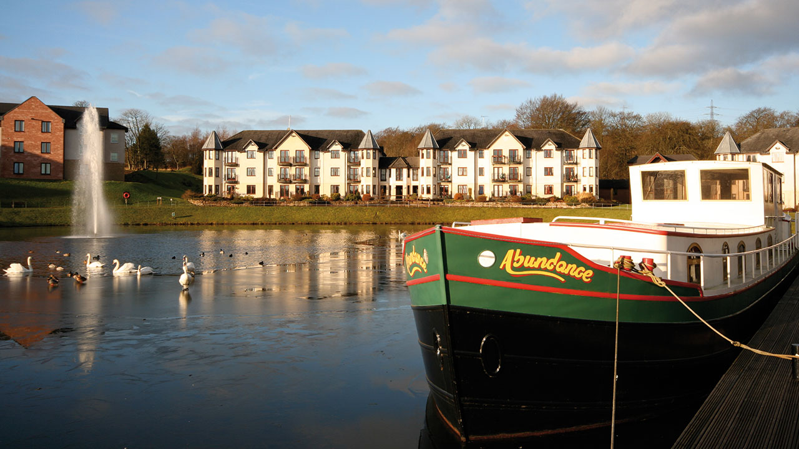
MHA Auchlochan Garden Village tries TV for the first time
Challenge
MHA needed to drive interest in and bookings for their Open Day at Auchlochan Garden Village
Solution
They tried TV for the first time with a limited area campaign in Scotland on STV
Daytime only campaign for cost efficient reach of target audience
Results
Attendance at the Open Day was up 450%
ROI was 200:1
Notes:
The Challenge
MHA is one of the UK’s largest charities, providing care, accommodation and support for people in later life. Auchlochan Garden Village is MHA’s largest retirement living development, set in the heart of Scotland’s picturesque Lanarkshire. The village offers a variety of accommodation options which can be bought or rented and additional care is available if and when needed.
Previous marketing activity had focussed on local press, supported by door drops, PPC and paid social activity - although conveying all that the village has to offer within a press ad or door drop, especially the emotional benefits, was challenging. In addition, they wanted to expand the area in which they were promoting the village. An ‘Open Day’ was scheduled for the village in October 2018. The key objectives for the campaign were therefore:
Drive interest in and bookings for the open day. Goal was to increase attendance by 50% on the previous open day
Generate leads to feed the sales enquiry pipeline, growing the database by 30%
Convert property sales with a target of 3 sales and 1 rental
Raise awareness both locally and further afield, reaching new audiences
To do this on a limited budget
The TV Solution
MHA had never used TV previously and there were some reservations around the cost of both the airtime and the production of the ad. However, their media agency Alchemy Media convinced them to give TV a try on the basis that the visual and emotive nature of the medium would allow them to create something really inspiring. It also meant that they could deliver their message at scale and with speed, bringing the proposition to life to a much wider audience. It was TV’s unique ability to reach viewers in a relaxed mood, to cement long-term memories, to start conversations and also to drive conversions from more response-led channels that convinced MHA to trial this medium.
Alchemy Media looked at all available TV options, but opted for a deal with STV on a part-area basis. Their two key audiences were potential residents, aged 65+ and the wider influencer audience, aged 45+. Both of these audiences are heavy viewers of TV in Scotland.
To keep production costs to a minimum, they used existing drone footage of the village and worked with STV’s production team to make the ad. This low cost production meant they had enough money left over for a robust TV test.
The Plan
Analysis showed that the best time of day to reach their target audience was 12 to 5.30pm. This daytime only strategy, along with the fact that they were a new to TV advertiser, enabled them to get the best price possible. Using this daypart also meant they could access programmes that indexed particularly well for retired viewers.
They opted to use only the Glasgow and Edinburgh regions within STV. Using these regions meant they could expand the area covered by previous campaigns but, by cutting out Aberdeen and Dundee, meant a reduction on cost. They also allocated a small budget to STV Player to widen reach.
Alchemy Media knew that the TV activity would drive an online response and so the plan included other media that would harvest the awareness driven by the TV ad – PPC, social video, local press and a DM campaign that utilised the existing database.
Results
There was an immediate spike in web traffic as the TV ad went to air
Daily traffic increased on average by 540% during the campaign period with over 10,000 more web visits recorded vs the same period year on year
PPC click through rate doubled
Attendance at the Open Day increased from a previous average of 8 to 44 visitors at this event – up 450%
The quality of attendees was high with six property reservations taken.
The timescale from enquiry to reservation reduced significantly from a 6-12 month period to under a month
The activity also drove an increase in warm leads, with 75 contacts added to the database
ROI was 200:1
There was a follow up campaign in January 2019 that built on the learnings from the test
Finalist in TV Planning Awards 2019 – Best Low Budget Use of TV category

