Slide 1
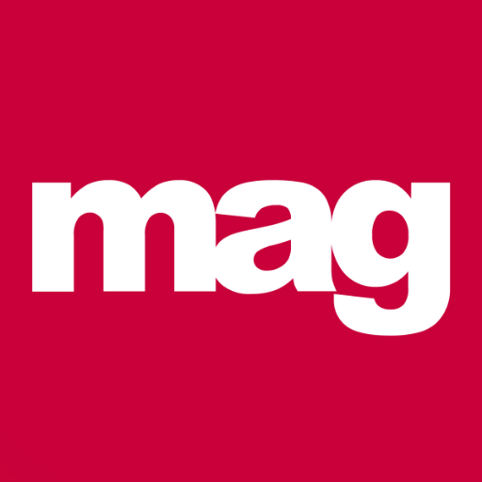
Sykes Holiday Cottages finds TV is the perfect place
Challenge
Sykes wanted to grow their business and become a household name by driving brand awareness, increasing consideration and growing market share
Solution
Launched 26th Dec on TV with a linear, regional plan; heavyweight for 3 weeks, light for 4 weeks
Used Experian Audience Data heat mapped onto TV regions combined with Sykes’ first party data to select the test regions
Weekly tracking to identify most cost effective spots and optimising throughout
Results
Achieved goal of 15% min share of voice vs competitors
TV drove incremental bookings to deliver positive ROI
Significant uplift in brand awareness and consideration
Delivered 21,363 incremental leads
Notes:
The Challenge:
Sykes Holiday Cottages have been around for over 25 years, offering customers a huge range of more than 12,000 holiday homes to rent across the UK and Ireland – from cosy cottages for two to larger properties that sleep 20 or more. Previously, Sykes relied heavily on PPC and online marketing to drive sales. However, in 2017, they wanted to grow the business and become a household name, so they knew they needed to change their strategy.
The Solution:
Sykes’ agency, Media Agency Group (MAG), knew that TV would drive brand awareness, increase consideration and grow market share. Because Sykes had never advertised on TV before, MAG recommended a linear, regional TV plan. This meant that they were able to track and optimise the campaign as they went along, seeing business and marketing results by region and so could take learnings forward to a second, stronger campaign.
MAG analysed the best time of year to advertise looking at schedules and competitor activity and decided that December/January would be the optimum time, when holiday consideration is highest.
MAG used Experian Audience Data heat mapped onto TV regions combined with Sykes’ first party data in order to select the test regions.
The campaign was tracked on a weekly basis to gain a full understanding of how spots were performing and which ones were generating leads, to see which spots, channels, dayparts and programmes were the most cost effective. They closely monitored all activity and optimised where possible throughout the campaign, moving spots around to get the best results for Sykes.
Results:
• Achieved the minimum goal of 15% share of voice within their competitor set
• TV activity drove incremental bookings and so provided a positive ROI on lifetime value
• TV provided a statistically significant uplift in brand awareness and consideration within the exposed regions
• They got 53.4 million adult impacts
• There were 21,363 attributed leads
• There were 128,000 incremental branded sessions online

