Slide 1
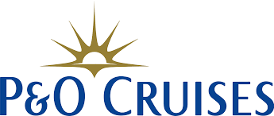

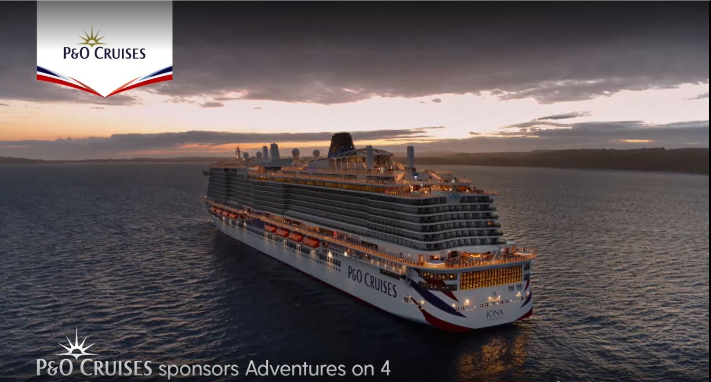
P&O Cruises uses sponsorship to cruise to success
Challenge
P&O Cruises wanted to grow the market, attracting non-cruisers to the brand and challenging the perception of the category
Solution
To position itself as a gateway to incredible experiences, the brand embarked on a two-year sponsorship of “Adventures of 4” - Channel 4’s most adventurous programming
Results
Opinion improved by 28%
Consideration grew by 26%
42% said they learned something new
Notes:
The Challenge
P&O Cruises is the market leader within cruising but had bigger ambitions to be amongst the UK's favourite holiday brands. At the end of 2021, and with the impact of the pandemic still looming, this was a huge task.
Success lay in thinking beyond existing cruisers and looking to grow the market, attracting non-cruisers (newcomers) to the brand and challenging the perception of the category. With its spend achieving a 30% SOV within the cruise category, but only a 2% SOV within travel, it couldn’t simply spend its way to its objective - it was more than just a salience game.
It knew that holidaymakers only consider three brands when booking their holidays and so it had to find a powerful, persuasive way to connect with this new audience.
The TV Solution
Wavemaker, its media agency, knew the key to success was not just salience but also creating an emotional connection with the broader “newcomers” target audience, and associating the holiday experience they sought. To achieve this, a specific audience was constructed using TGI data, identifying individuals who valued variety and adventure in their travels.
Addressing misconceptions about cruising was another essential aspect of the strategy. Many non-cruisers perceived cruising as unexciting, limited, and lacking cultural immersion and adventure. These negative perceptions posed a challenge, especially after the impact of COVID-19.
TV was identified as a potent platform for showcasing experiences effectively and driving sales, but there was a need to stand out amidst more substantial spending by competitors. Data from Wavemaker revealed that TV sponsorships not only have a high impact, but they are also the most effective at changing perceptions. So, as the category continued to recover and the target audience began to consider their holiday options, Wavemaker set out to find a property which had the ideal personality to associate with adventure and exploration, provide consistent presence to help re-frame the brand, and capitalise on the high-attention environment that only TV can provide.
The Plan
P&O Cruises wanted to position itself as a gateway to incredible experiences rather than simply being a cruise provider and to achieve this, it partnered with Channel 4 to create "Adventures on 4" - a two-year sponsorship programme aligned with the broadcaster’s most adventurous programming.
The package included 36 hours of peak Channel 4 programming - including viewer favourites such as Hunted, Sue Perkins’ Big American Road Trip, Guy Martin and The Bridge - ensuring consistent visibility and exposure on Channel 4 throughout the year along with presence on All4, historic content and repeats across their portfolio.
Knowing that a strong set of idents would ensure the sponsorship felt fresh throughout the year, would align with different types of content easily and would appeal to a broader spectrum of audiences, the creative agency produced 14 different idents showcasing the adventurous spirit of cruising holidays.
To integrate further, P&O Cruises sponsored social content for shows like "The Bridge" and "Hunted" with its branding included on exclusive content each week, engaging a younger demographic and increasing brand exposure.
Results
A 6%pt increase in share of search across 2022
28% of viewers who recognised the sponsorship said their opinion of P&O Cruises was much better
26% of viewers who recognised the sponsorship said it made them much more likely to consider travelling with P&O Cruises for their next holiday abroad
Within this, 35% of our newcomer audience were now considering the brand (following exposure to the sponsorship)
77% respondents agreed that P&O Cruises was an appropriate sponsor of Adventures on 4
27% of this group attributing this sentiment to their newfound perception of cruises as being adventurous
42% of the audience stated that they learned something new about P&O Cruises from the campaign

