Slide 1


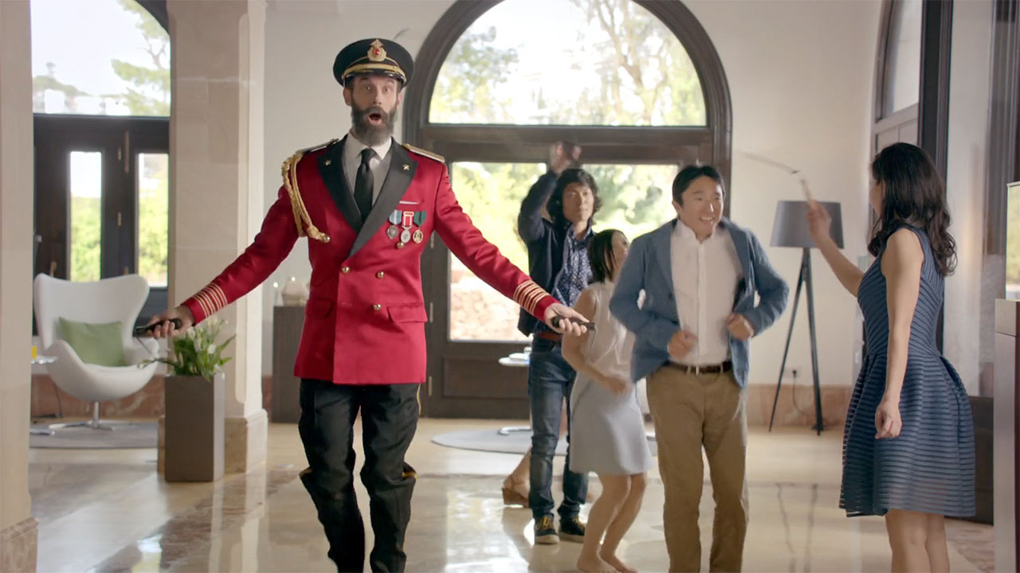
Hotels.com ‘Skippable advert’ on All4
Challenge
To deliver a light-hearted, contextually relevant ad that was specific to the digital environment
Solution
Partnered with All4 to offer viewers an interactive ad that they could ‘skip’ and ‘unskip’
If they clicked ‘skip ad’ they saw all the characters in the ad skipping and the ad was synced exactly so they could ‘unskip’ at any time
Results
The ad received the highest interaction ever received on the All 4 platform, with over 50% engagement rate
Notes:
The Challenge
Hotel aggregator Hotels.com were looking for a new and innovative way to promote their site in a digital environment.
They wanted to use their comical number 1 fan Captain obvious in their communications and challenged their ad agency CP+B to come up with an idea that was specific to the digital environment, contextually relevant and in line with the humorous tone of voice.
They also needed an environment that fitted with their light-hearted approach whilst providing a platform capable of delivering the message
The Solution
CP+B decided to play with the idea with the skip button and creatively flip its meaning to a more literal one. They filmed two versions of the ad, one normally and one where all characters in the ad were skipping both of which were perfectly synced
They looked for a partner to deliver this idea and All4 the was the perfect environment in terms of tone and their enhanced VOD opportunities enabled to execute their idea, this is one of the first times an advertiser has used the innate interactivity of VOD at the time the ad was filmed
Channel 4 also believe that as advertisers spend lots of money on creative it is a real shame that some platforms allow them to be skipped therefore this creative idea fit very neatly into the ethos around ad skipping.
Results
The results of the campaign were ‘mind blowing’ the ad saw the highest ever levels of interaction on the All4 platform with over 50% engagement rate and more than half of those people clicking on the “unskip” button for even further interaction.
To read the full case study and access the creative visit: https://www.thinkbox.tv/Case-studies/Hotels-com

