Slide 1


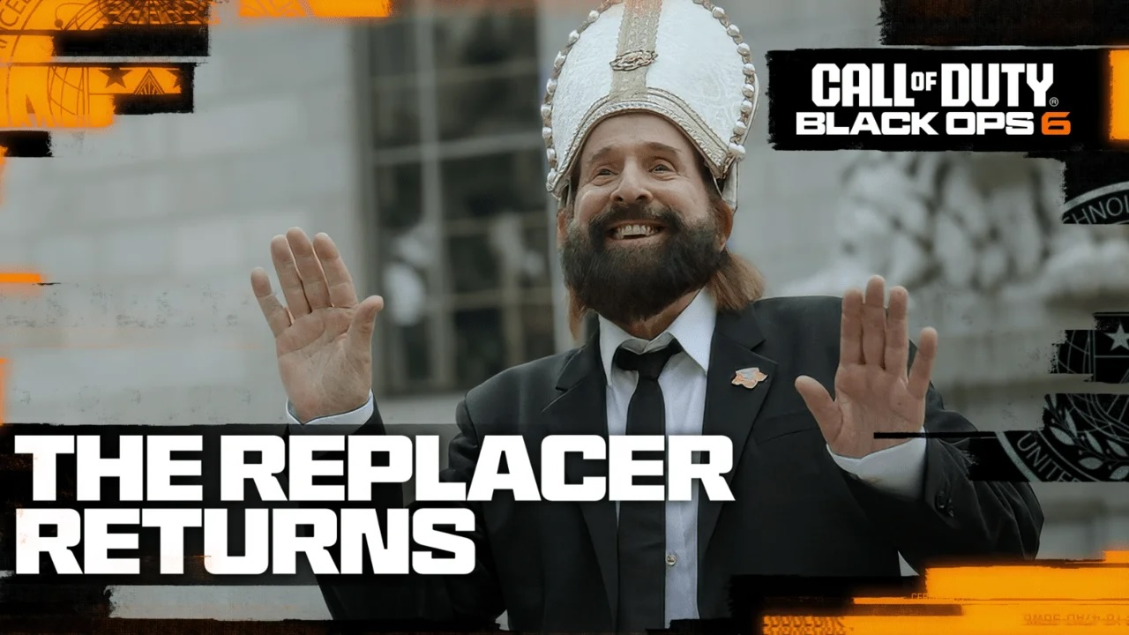
Activision Blizzard’s media takeover launch for Black Ops 6
The Challenge:
The launch of Black Ops 6 needed to be big and bold to maintain the high level of demand for previous game launches
They wanted to captivate fans and drive sales
The Solution:
IPG Mediabrands opted for a content solution
They stitched the character ‘The Replacer’ into popular cultural moments, where he took over people’s responsibilities in a humourous way so that they were free to play Black Ops
The Results:
UK awareness increased from 8.2% to 14.6%
Over 10 million downloads globally
UK hit set target for unit sales
Notes:
The Challenge
Call of Duty, by Activision Blizzard, is one of the most popular video games with a 20-year legacy, whose annual release is a highly anticipated event in the gaming calendar.
In 2024, they were launching the latest instalment, Black Ops 6, and needed the launch to be as big and bold as always to maintain the high level of demand. Activision were looking for an innovative marketing strategy that would captivate fans and drive sales.
Their broad objective was to sell over 10 million units worldwide and deliver a peak of 8 million daily active users. Within this, the UK market was tasked with delivering 7% of global performance and their approach was all about infiltrating popular culture in unexpected ways to drive social chatter
The TV Solution
‘The Replacer’ is a playable character who features in the Black Ops series. Played by Peter Stormare, The Replacer personifies the Black Ops swagger by taking over people’s everyday responsibilities in a humourous way, freeing up their time to play Black Ops.
For Black Ops 6, IPG Mediabrands Red Snap, created multiple, regionally relevant pieces of content that placed him in real life scenarios. By seamlessly stitching The Replacer into popular cultural moments, they were able to provide contextually relevant treatments that surprised and delighted the target audience.
In the UK, they partnered with Sky Sports News, so they could access their market-leading sports journalists and disrupt a breaking news story with the signature chaos and humour The Replacer brings.
They created a segment where The Replacer takes the place of a reporter, interacting with Mike Wedderburn and Hayley McQueen, while mimicking the format viewers expect. This piece went last in break, so was in commercial airtime but blended seamlessly with the show itself.
The Plan
The Replacer asset ran 40 times on Sky Sports News for 20 days from 12th to 25th October to coincide with the launch of the game. They also negotiated 8 spots in pre-match and halftime breaks in Premier League games on Sky Sports.
The Sky Sports partnership was supported by spots on BVOD, cinema and YouTube, with the aim of maximising reach and frequency amongst 18 to 44 year old men.
Results
UK awareness increased from 8.2% to 14.6% (source: Nielsen gamer panel)
UK drove 20 million social mentions (source : Spinkler Data)
Globally, there were over 10 million downloads on day one, with the UK delivering on target
Globally, daily active users peaked at over 8 million
UK hit set target for unit sales

