Slide 1


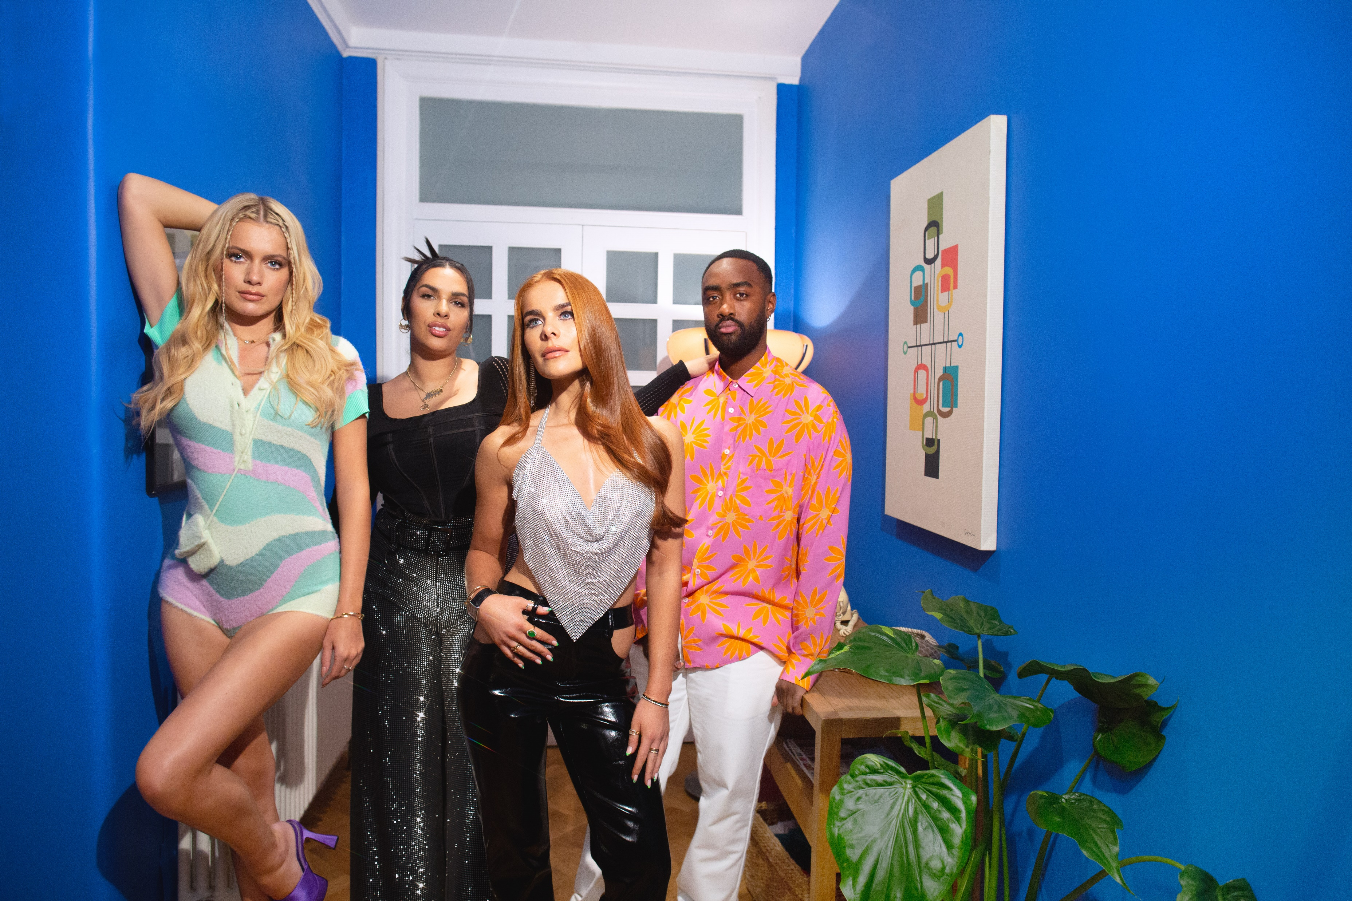
eBay: Making the pre-loved Loved with a TV Partnership
The Challenge:
eBay wanted to drive mass appeal for second-hand fashion with 16-34-year-olds against a backdrop where fast fashion was still king.
The Solution:
A partnership with Love Island that would reframe second-hand clothing as ‘pre-loved’.
The Results:
1,700 positive pieces of press coverage which resulted in over 14 billion impressions. A 935% increase in mentions of ‘pre-loved fashion’ recorded across all online platforms. 7,000% increase in ‘pre-loved fashion’ searches on eBay and 756% increase in searches on Google for ‘eBay pre-loved clothes’.
Notes:
The Challenge
eBay is the world’s original second-hand marketplace, launching in the UK in 1999, with the first item sold being a copy of ‘You & I’ by German rock band Scorpions for £2.89. Going into 2022 however they wanted to drive mass appeal for second-hand clothing because if the category grew, eBay would too.
Against a backdrop of a world where fast fashion was still king, but this activity was damaging the environment. Greenpeace research showed that 300,000 tonnes of clothing are burned in the UK every year. With eBay having a long history in the second-hand clothing there was still a perception problem with the category. It didn’t have anywhere the mass appeal of fast fashion. A study from Leeds University highlighted this with findings showing that 69% of shoppers had a negative view of second-hand clothing.
Put simply, second-hand clothing wasn’t seen as either stylish or cool. eBay needed to shift these perceptions and ignite a second-hand clothing revolution among Gen Z and Millennial audiences. They needed to show that second-hand clothing was on-trend and desirable.
The TV Solution
EssenceMediacom (EM), armed with clear objectives of shifting the perception of pre-loved clothing, got to work in finding the right way to engage with a younger audience and get them talking about second-hand fashion.
Despite the growth of digital channels, TV was seen as the best way to reach the younger audience on mass and make a cultural impact. And EM found the perfect property in ITV’s Love Island. Love Island is the biggest commercial show on TV for the 16-34 audience, reaching 1.4 million of them. Now in its 8th series, Love Island had had a fast fashion sponsor for 7 of the 8 series. Through product placement and advertising, fast fashion that featured on the show regularly sold out in under 10 minutes. Couple this with ex-Love Islanders becoming fast fashion brand advocates when leaving the show, eBay wanted to take the power of Love Island and rewrite the narrative.
The Plan
Having identified Love Island as the perfect property, EM and eBay got to work in bring ‘Pre-Love Island’ to life. The partnership was a deep collaboration between client, agency and broadcaster, creating a partnership that would see Love Island and eBay work as one.
For the first time ever, EM created a pre-loved product placement at the heart of the show. Having recognised the power of product placement to impact viewer behaviour; eBay provided islanders with a wardrobe of second-hand clothes, chosen by a celebrity stylist, with looks bang on trend. Islanders were encouraged to re-wear and shape items and talk about it. Show narrator Iain Sterling, made regular in show shout outs about the brand. To embed the partnership beyond the product partnership, eBay created a selection of TV and video ads that celebrated the amazing pre-loved looks. To make second-hand more loved, EM changed the wording to ‘pre-loved’, giving the category a Love Island twist.
With TV spots that were designed to amplify the connection between eBay’s preloved fashion and Love Island, EM needed to maximise reach to the 16-34 audience in moments of high talkability. Using traditional Barb data, analysed on a minute-by-minute basis to work out the episodes, breaks and positions within breaks to maximise 1+ reach and maximise engagement. Along with this, EM leverage social listening tools to identify episodes and breaks where chat was most potent. These insights lead to buying into the first three episodes with first in breaks, to ensure reach to the target audience at the start of the series. The bespoke assets reached 15% of 16–34-year-olds in three days through linear alone. They then planned a spot in the Monday of each week, as it was the best performing day of the 2021 series. EM then extended this to BVOD with 50% of Love Island viewing coming from BVOD in 2021. To make sure TV ads drove conversation, eBay layered in time targeted twitter content to naturally insert pre-loved fashion into the Love Island conversation.
EM harnessed the power of live TV by giving viewers the opportunity to buy the clothes just seen on screen. Around the shows most talked about moments, eBay created live auctions. This enabled fans to get the look with the chance to bid on over 40 of the season’s most-coveted outfits. With Love Island’s power to turn people into platforms, with millions of followers waiting for them on social media when they leave. So, on social media, eBay created content that showed contestants unboxing pre-loved clothing and talking about their favourite looks. And finally, eBay, wanted to follow suit to the fast fashion sponsors of the past by signing up contestant, Tash, as a pre-loved ambassador.
Results
The campaign was a roaring success for eBay. There were over 1,700 pieces of positive press coverage from the first season’s partnership alone. This activity generated over 14 billion impressions across all the content. The campaign also got people talking about ‘pre-loved’ fashion. There was a 935% increase in mentions of ‘pre-loved fashion’ recorded across all online platforms’ vs the same period the pervious year.
With a goal of changing behaviour, the campaign was a huge success. eBay saw more people than ever before looking for ‘pre-loved’ clothing, with searches up 7,000% across the site. Across Google, there was a 756% increase in searches for ‘eBay pre-loved clothes’ and a 600% increase month on month. eBay is now the number one for pre-loved fashion in the UK.

