Slide 1
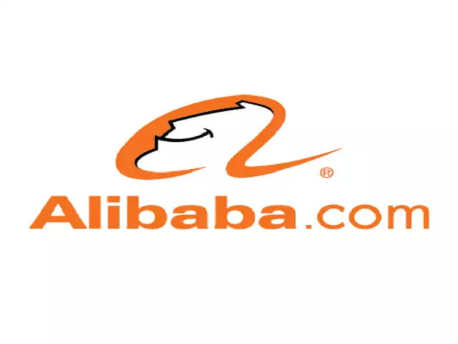

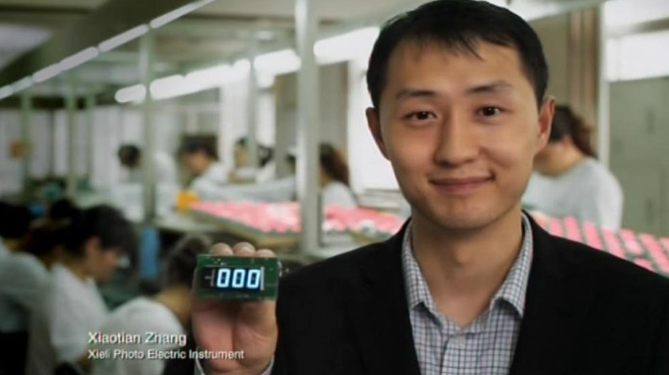
Alibaba.com used TV to get close to businesses
Challenge
Alibaba.com needed to increase brand awareness and build trust amongst a time-poor audience with a limited budget
Solution
They focused on key programming and days of the week for the audience, and a mixture of second lengths in August to help the budget stretch further
Results
227% increase in awareness post campaign
200% increase in web traffic YoY
Notes:
The Challenge
Alibaba.com is the global leader in B2B e-commerce across the world, with over 48m buyers and sellers in 240 countries. However, they were relatively unknown in the UK and they needed to build trust and increase brand awareness and website traffic.
Research identified that trust was the biggest barrier to entry in using the site and trust is a key element in creating a long term relationship with the brand.
Through TGI and Touchpoints research plus Alibaba’s own data, they established several key insights that would feed into the TV solution – namely that they are attempting to target a time-poor audience in a cluttered B2B marketplace and they needed to target their audience when they are close to a business mind-set.
With this in mind, they identified Sunday and Monday evenings as the perfect time to target their business audience – a key time when they were in a receptive ‘to-do list mindset’ without too many other distractions.
Once the key times were defined, they needed to work them into a TV solution. Alibaba.com is an internet business so driving traffic to their website and translating the traffic to conversions was the next step.
They needed media channels that would create trust, drive awareness and provide significant reach amongst the SME community.
The Solution
TV was chosen as the lead medium due to its ability to generate trust and also to drive viewers online – assisted by the numbers of viewers who watch TV whilst going online. In addition, TV would assist with brand recognition and awareness.
Having identified Sunday and Monday evenings as the key days of the week, they also created a bespoke programme strategy designed to maximise reach of their target audience. These programmes included business documentaries, news and current affairs.
Alibaba.com used a mixture of 30” and 10” spots during the campaign. The 30” were used to build the brand and educate the audience whilst the 10” helped extend cover and frequency whilst keeping costs down. This was also helped by advertising in August – traditionally a cheaper month to advertise on TV.
With the focus on trust central to building awareness and driving traffic to the website, Alibaba.com used their existing database to build an online community through a microsite. People were invited to comment and share videos of how Alibaba had helped their business with the winners promoted on national TV as part of the TV creative. By showcasing how Alibaba.com had helped businesses, the focus was on trust and the user generated content element of the campaign helped create buzz around the TV campaign.
To support the TV campaign, they used radio, outdoor and PR. The radio ad replicated the audio from the TV to create synergy and also to act as a reminder on the previous night’s TV campaign. The outdoor route was black cabs in order to reach business people.
The PR team used the brand awareness generated by the TV campaign to focus on B2B environments such as business magazines and business sectors of national press.
Results
227% increase in awareness post campaign
200% increase in web traffic year on year
Sustained elevated traffic volumes post TV campaign
Planned campaign for Summer 2011 due to success of 2010 campaign
To read the full case study and access the creative visit: https://www.thinkbox.tv/Case-studies/Alibaba

