Slide 1
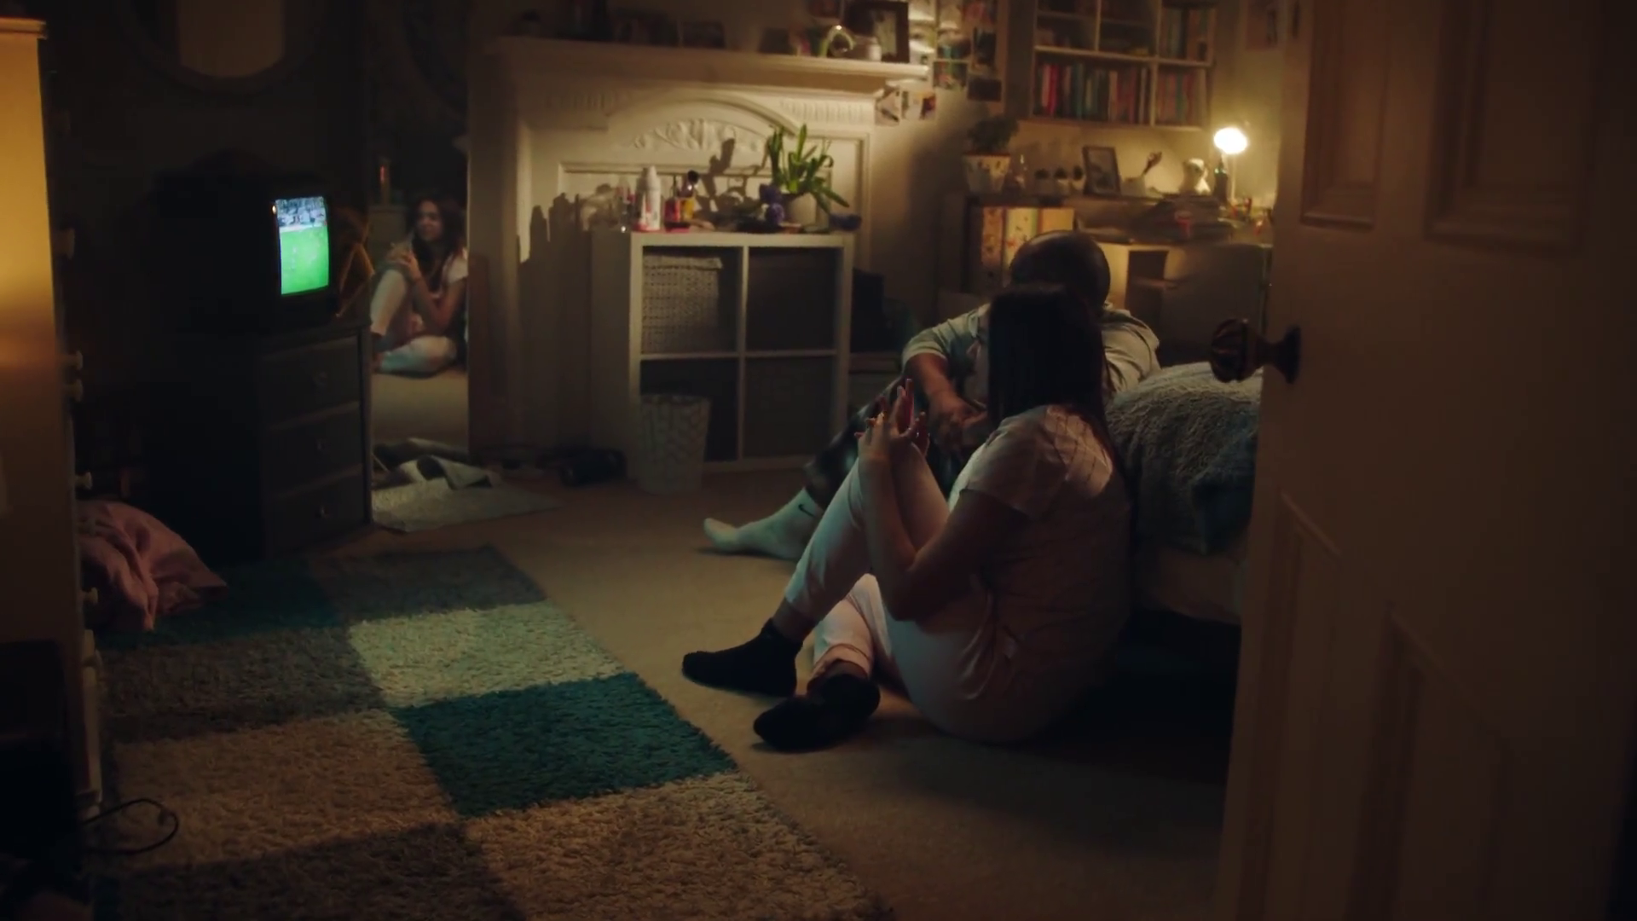

Time spent viewing
Alzheimer’s Society – Football Memories

Slide 2
Video viewing has reverted to pre-pandemic levels
HOURS PER PERSON PER DAY (Adults)
Source: IPA TouchPoints, Adults, Average of Wave 1 and Wave 2 2022, Barb and Broadcaster data

Slide 3
How we watch broadcaster TV – 16-34s
Inds
16-34s
2 hrs 41 mins
1 hr 1 min
Source: 2022, Barb / Broadcaster stream data
Notes:
BVOD is vital to different audiences
Breaking down broadcaster TV into the different ways it can be accessed reveals the increasingly important role of BVOD for 16-34, now 28% of all broadcaster TV viewing.

Slide 4
2022 video viewing – 16-34s
ALL INDIVIDUALS
Average video time per day
All Individuals: 4 hrs, 30 mins
16-34s
16-34s: 3 hrs, 47 mins
Source: 2022, Barb / Broadcaster stream data / ViewersLogic / IPA TouchPoints 2022 (wave 1 and 2) / Pornhub / UK Cinema Association
Notes:
Methodology
The quantitative analysis of total video consumption in the UK was undertaken by Thinkbox. It combined 2022 data from Barb, ViewersLogic, Pornhub, the IPA’s TouchPoints and UK Cinema Association.
Barb data shows how much time is spent viewing broadcaster content, live or time-shifted (including BVOD) on all devices as well as Blu-Ray/DVD viewing. This chart also utilises Barb’s expanding audience reporting capabilities to provide a view of time spent viewing content on YouTube, TikTok, other video sharing services (such as Twitch) as well as SVOD/AVOD platforms. Whilst Barb reports on in-home consumption, a combination of ViewersLogic and IPA TouchPoints data was used to determine the remaining out-of-home consumption.
The analysis also used census level broadcaster stream data to estimate the time spent watching Broadcaster VOD on both the TV set and other devices and profiled for each audience using Barb.
The combination of these sources creates a solid estimate as it utilises the robustness of Barb data (11,500 panel members, representative of the UK TV population, metered actual consumption data, analysis across a whole year) alongside ViewersLogic and IPA TouchPoints data to capture any out-of-home consumption.
Time spent viewing video at cinemas was based on total admissions data from the UK Cinema Association profiled for each audience using data from DCM.

Slide 5
SVOD is complimentary to TV, but mostly ad free
5.2m viewers
All viewers of commercial TV in October split into deciles (5.3m viewers each)
Source: Barb, October 2022

Slide 6
Broadcasters deliver the biggest hits
Source: Barb, 2022, individuals. Average audience figures. Consolidated 1-28 days, excludes one-offs, films and sports

Slide 7
ALL INDIVIDUALS
Broadcasters account for over 80% of all video advertising
Average video advertising time per day
All Individuals: 17 mins
16-34s
16-34s: 10.3 mins
Source: 2022, Barb / Broadcaster stream data / IPA TouchPoints 2022 / UK Cinema Association / ViewersLogic to model OOH viewing time * YouTube ad time modelled at 4.1% of content time, TikTok ad time modelled at 3.4% of content time using agency and broadcaster data, Other online modelled at 4% of content time)
Notes:
Without a single source data provider on time-spent watching AV advertising, this analysis takes a jigsaw approach, using a variety of data sources to build the most accurate picture of AV viewing time possible.
The data approach used to build the estimate for each platform:
Broadcaster TV: Barb data for linear and playback advertising time and the broadcasters’ own census data for BVOD advertising viewing time.
Cinema: The UK Cinema Association provides total box office seats sold. We’ve estimated 15 minutes of advertising per seat.
YouTube: Barb data for time spent viewing content, ViewersLogic panel data to estimate out of home viewing not measured by Barb (73.5% in home, 26.5% out of home), broadcasters’ own data of ad load per hour of YouTube viewing, and agency data for average duration of ad view.
TikTok: Barb data for time spent viewing content, ViewersLogic panel data to estimate out of home viewing not measured by Barb (77.5% in home, 22.5% out of home), Thinkbox estimates for ad load per hour of TikTok viewing, and agency data for average duration of view.
Other online video: IPA TouchPoints data for % of other online video viewing relative to all video viewing, Thinkbox estimate of % ad time to content time (based on YouTube/TikTok).

