Slide 1
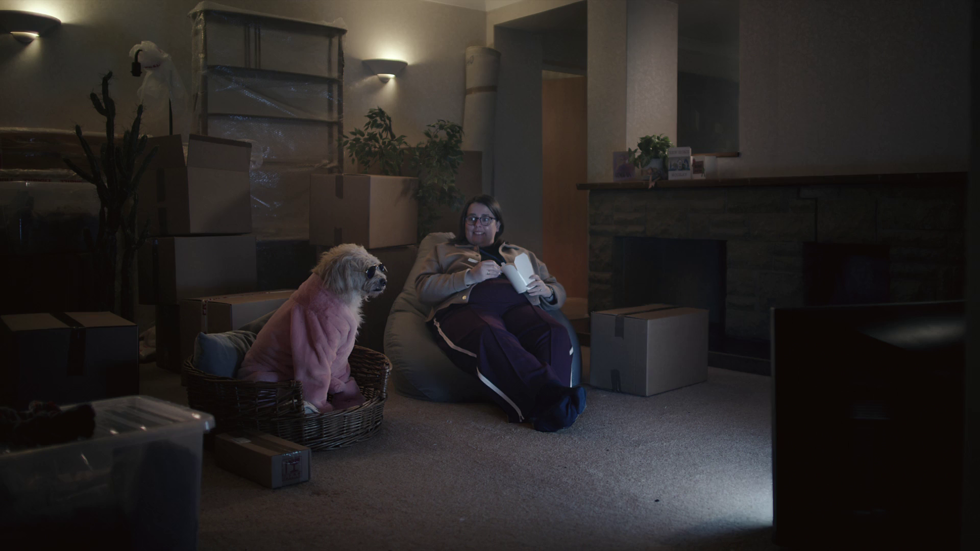

Time spent viewing
Confused.com – Emmerdale Sponsorship

Slide 2
Overall, it’s a much more stable viewing landscape
HOURS PER PERSON PER DAY (Adults)
Source: IPA TouchPoints, Adults, Barb, All devices, includes estimates for OOH viewing to TikTok, YouTube and Other online video
Notes:
Looking at the long-term trend 2023 viewing levels have flattened out and paint a picture of much more stability, with this pattern looking set to continue into 2024 – interestingly there was slight growth in total viewing levels, suggesting that the increases to TikTok and YouTube seen doesn’t all need to substitute TV viewing.

Slide 3
How we watch broadcaster TV – 16-34
Inds
16-34
2 hrs 40 mins
1 hr 5 mins
Source: 2023, Barb
Notes:
BVOD is vital to different audiences
Breaking down broadcaster TV into the different ways reveals the increasingly important role of BVOD for 16-34, now 24% of all broadcaster TV viewing.
This data uses both Barb data and includes an estimate of any unknown viewing that is thought to fall into Playback and Live viewing.

Slide 4
2023 video viewing – 16-34
ALL INDIVIDUALS
Average video time per day
All Individuals: 4 hrs, 36 mins
16-34
16-34s: 4 hrs, 6 mins
Source: 2023, Barb / ViewersLogic / IPA TouchPoints 2023 / Pornhub / UK Cinema Association
Notes:
Broadcaster TV accounts for 57.9% of video viewing for all individuals and 26.3% for 16-34s.
Methodology
The quantitative analysis of total video consumption in the UK was undertaken by Thinkbox. It combined 2023 data from Barb, ViewersLogic, Pornhub, the IPA’s TouchPoints and UK Cinema Association.
Barb data shows how much time is spent viewing broadcaster content, live or time-shifted (including BVOD) on all devices as well as Blu-Ray/DVD viewing. This chart also utilises Barb’s expanding audience reporting capabilities to provide a view of time spent viewing content on YouTube, TikTok, other video sharing services (such as Twitch) as well as SVOD/AVOD platforms. Whilst Barb reports on in-home consumption, a combination of ViewersLogic and IPA TouchPoints data was used to determine the remaining out-of-home consumption.
The combination of these sources creates a solid estimate as it utilises the robustness of Barb data (11,500 panel members, representative of the UK TV population, metered actual consumption data, analysis across a whole year) alongside ViewersLogic and IPA TouchPoints data to capture any out-of-home consumption.
Time spent viewing video at cinemas was based on total admissions data from the UK Cinema Association profiled for each audience using data from DCM.

Slide 5
Weight of viewing is a critical analysis for reach planning
All viewers of any video split into 10ths based on weight of viewing
AVERAGE TIME VIEWED
Source: Barb, Sep 23, Total-identified viewing, All devices

Slide 6
What matters is the reach opportunity in ad-supported content
TV set viewing to ad supported content
AVERAGE TIME VIEWED
Source: Barb, Sep 23, decile ranked in terms of weight of viewing to linear TV, TV set viewing

Slide 7
BVOD & SVOD ad tiers are key to reaching lighter linear viewers
AVE HRS OF TV SET VIEWING TIME PER GROUP PER DAY
Source: Barb – Sept 2023, Adults, TV set viewing, deciles ranked on weight of viewing to linear TV

Slide 8
UK original content dominates the top 30 series of 2023
Top 30 series on UK Television 2023 (All Inds 4+, TV set viewing only)
Rank | Channel | Title | Series | Ave aud (m) | Episodes
1 | BBC | Happy Valley | 3 | 12.8 | 6
2 | CH4 | The Great British Bake Off | 14 | 9.1 | 10
3 | BBC | Strictly Come Dancing | 21 | 8.5 | 25
4 | BBC | Death in Paradise | 12 | 8.5 | 8
5 | ITV | I'm a Celebrity... Get Me Out of Here! | 23 | 8.4 | 22
6 | BBC | Wild Isles | 1 | 8.4 | 5
7 | BBC | Beyond Paradise | 1 | 8.3 | 6
8 | Amazon | Clarkson's Farm | 2 | 8.2 | 8
9 | ITV | Unforgotten | 5 | 8.2 | 6
10 | BBC | Planet Earth III | 1 | 8.0 | 8
11 | BBC | Call the Midwife | 12 | 8.0 | 8
12 | BBC | Silent Witness | 26 | 7.2 | 10
13 | BBC | The Apprentice | 17 | 7.1 | 12
14 | ITV | The 1% Club | 2 | 7.0 | 8
15 | BBC | Vigil | 2 | 7.0 | 6
Top 30 series on UK Television 2023 (All Inds 4+, TV set viewing only)
Rank | Channel | Title | Series | Ave aud (m) | Episodes
16 | BBC | The Sixth Commandment | 1 | 7.0 | 4
17 | BBC | Shetland | 8 | 6.8 | 6
18 | ITV | Vera | 12 | 6.8 | 5
19 | Netflix | The Night Agent | 1 | 6.8 | 10
20 | ITV | Britain's Got Talent | 16 | 6.6 | 14
21 | ITV | Maryland | 1 | 6.6 | 3
22 | BBC | The Gold | 1 | 6.6 | 6
23 | ITV | Grace | 3 | 6.5 | 3
24 | ITV | The Hunt for Raoul Moat | 1 | 6.5 | 3
25 | ITV | Endeavour | 9 | 6.5 | 3
26 | ITV | The Long Shadow | 1 | 6.4 | 7
27 | Netflix | Beckham | 1 | 6.4 | 4
28 | ITV | The Bay | 4 | 6.4 | 6
29 | CH4 | Gogglebox | 21 | 6.4 | 16
30 | BBC | The Reckoning | 1 | 6.3 | 4
Source: Barb, 2023, Individuals. TV set viewing, Average audience per episode (excludes one-offs, kids, films and sports)
Notes:
UK original content dominates the top 30 series of 2023.

Slide 9
ALL INDIVIDUALS
Broadcasters account for over 80% of all video advertising
Average video advertising time per day
All Individuals: 17.0 mins
16-34s
16-34s: 9.8 mins
Source: 2023, Barb / Broadcaster stream data / IPA TouchPoints 2023 / UK Cinema Association / ViewersLogic to model OOH viewing time *YouTube ad time modelled at 4.1% of content time, TikTok ad time modelled at 3.4% of content time using agency and broadcaster data, Other online modelled at 4% of content time)
Notes:
Without a single source data provider on time-spent watching AV advertising, this analysis takes a jigsaw approach, using a variety of data sources to build the most accurate picture of AV viewing time possible.
The data approach used to build the estimate for each platform:
Broadcaster TV: Barb data for linear and playback advertising time and the broadcasters’ own census data for BVOD advertising viewing time.
Cinema: The UK Cinema Association provides total box office seats sold. We’ve estimated 15 minutes of advertising per seat.
YouTube: Barb data for time spent viewing content, ViewersLogic panel data to estimate out of home viewing not measured by Barb, broadcasters’ own data of ad load per hour of YouTube viewing, and agency data for average duration of ad view.
TikTok: Barb data for time spent viewing content, ViewersLogic panel data to estimate out of home viewing not measured by Barb, Thinkbox estimates for ad load per hour of TikTok viewing, and agency data for average duration of view.
Other online video: IPA TouchPoints data for % of other online video viewing relative to all video viewing, Thinkbox estimate of % ad time to content time

Slide 10
SVOD & video-sharing seasonal viewing consistent across 23
Source: Barb, 2023, Individuals
Notes:
Broadcaster viewing across 2023 highlights the impact of seasonal viewing, whilst viewing to SVOD platforms and video sharing services was broadly consistent.

Slide 11
SVOD viewing broadly consistent across 2023
Source: Barb, 2023, Online Multiple Screens Network, Individuals, All devices
Notes:
Broadcaster viewing across 2023 highlights the impact of seasonal viewing, whilst viewing to SVOD platforms was broadly consistent.

Slide 12
Viewing patterns through the day are similar across platforms
Source: Barb, Individuals, Online Multiple Screens Network, All devices, daypart by hour, 2023
Notes:
Viewing patterns are relatively similar across platforms, with peak viewing occurring in the evening for individuals.

Slide 13
For 16-34s, video-sharing platforms peak later in the day
Source: Barb, 16-34, Online Multiple Screens Network, All devices, daypart by hour, 2023
Notes:
For younger audiences, video-sharing platforms peaks later than other platforms.

Slide 14
The gradual shift of viewing from linear to VOD continues
All Adults
-6%
+5%
+12%
+23%
+23%
Source: Barb, Thinkbox video day analysis, All devices, Includes estimates for OOH viewing to TikTok and YouTube (ViewersLogic)
Notes:
Within this picture of a more stable viewing landscape, there is still a gradual shift of viewing from linear to VOD. Linear was down 6% whilst BVOD saw a very strong growth of 23%, with ITV X a key driver of this large increase.
SVOD was relatively stable, more on that in a moment. YouTube’s growth continued, as did TikToks albeit from a small base – that’s a shift of 10 mins to 12 mins per person per day.

Slide 15
Commercial broadcasters are unrivalled for scale
All Individuals – All devices
Bubble area represents total volume of daily viewing
AVERAGE DAILY REACH (000s)
Other AVOD
Other
SVOD
Twitch
Dailymotion
AVE TIME VIEWED PER VIEWER PER DAY
Source: Barb / All Individuals, all devices – 2023
Notes:
This chart breaks down viewing to the various platforms in terms of the average number of people watching per day (for at least 3 minutes) compared with the average time spent watching per viewer (i.e. only counting those who watched on that day).
Analysis across 2023 shows that the commercial broadcasters (linear and on demand) collectively reach just over 31 million viewers every day, with each of those viewers watching for an average of 3hrs, 33 mins a day. The combined portfolio of BBC channels (linear and on demand) attracts the second largest volume of viewing, with 25 million daily reach and an average view time of just over 2 hours. YouTube is next, with a daily reach of 21 million people and a view time of 1hr 49 mins (Barb only measure in-home viewing, we estimate that YouTube would be larger in viewing time if out of home viewing was included).
SVOD services such as Netflix has a daily reach of 12.3 million people and a view time of 1hr 47 mins.

Slide 16
Competition is more even amongst younger audiences
16-34s – All devices
Bubble area represents total volume of daily viewing
AVERAGE DAILY REACH (000s)
Other AVOD
Other
SVOD
Dailymotion
AVE TIME VIEWED PER VIEWER PER DAY
Source: Barb / 16-34s, all devices – 2023
Notes:
This chart breaks down viewing to the various platforms in terms of the average number of 16-34s watching per day (for at least 3 minutes) compared with the average time spent watching per viewer (i.e. only counting those who watched on that day).
Analysis across 2023 shows that the commercial broadcasters (linear and on demand) collectively reach just over 4.5 million viewers every day, with each of those viewers watching for an average of 2hrs, 19 mins a day. The combined portfolio of BBC channels (linear and on demand) has a daily reach of 2.7 million and an average view time of 1hr 32 mins. YouTube has a daily reach of 6.2 million people and a view time of 2 hours (Barb only measure in-home viewing, we estimate that YouTube would be larger in viewing time if out of home viewing was included).

Slide 17
Commercial broadcasters deliver the most scale for 16-34s on the TV set
16-34s – TV set viewing
Bubble area represents total volume of daily viewing
AVERAGE DAILY REACH (000s)
Other AVOD
Other
SVOD
Twitch
TikTok
AVE TIME VIEWED PER VIEWER PER DAY
Source: Barb / 16-34s, TV sets– 2023
Notes:
This chart breaks down viewing to the various platforms in terms of the average number of 16-34s watching per day (for at least 3 minutes) on a TV set compared with the average time spent watching per viewer (i.e. only counting those who watched on that day).
Analysis across 2023 shows that the commercial broadcasters (linear and on demand) collectively reach just over 4.3 million viewers every day, with each of those viewers watching for an average of 2hrs, 20 mins a day. The combined portfolio of BBC channels (linear and on demand) has a daily reach of 2.5 million and an average view time of 1hr 33 mins. YouTube has a daily reach of 1.9 million people and a view time of 1hr 54 mins.

Slide 18
Barb’s audience reporting capabilities provides insight into SVOD and Video-sharing audiences
Source: Barb, 2023. Individuals. Online Multiple Screens Network
Notes:
This chart looks at Barb’s audience reporting capabilities. The focal meter data provides further insight into SVOD and video-sharing platforms to provide a view on ‘total identified viewing’ which includes:
Total broadcaster viewing – represents the time spent watching linear broadcast channels and broadcaster-owned VOD services (BVOD). This includes live viewing, as well as pre- and post broadcast viewing, and viewing to archive box-sets on a BVOD service. We capture and report this viewing across four screens — TV sets, tablets, PCs and smartphones. For tagged services, this includes any streaming regardless of whether it was through the home WiFi network.
Total SVOD/AVOD viewing - includes 19 VOD services — notably Amazon Prime Video, Disney+ and Netflix. Viewing is reported on all four screens, although this only includes viewing through a home’s WiFi network.
Total video-sharing– covers use of platforms such as TikTok, Twitch and YouTube. Similarly, reporting for video-sharing platforms only includes viewing through a home WiFi network on all four screens.

Slide 19
According to Barb, TV sets account for the largest proportion of viewing for broadcaster and SVOD/AVOD content
2 hours 35 minutes
39 minutes
49 minutes
4 hours 2 minutes
Smartphones
Tablets
PCs
TV Sets
Source: Barb, 2023. Individuals. Online Multiple Screens Network
Notes:
Analysis from Barb shows that people in the UK spent an average of 4 hours, 2 minutes a day viewing content during 2023. Using Barb’s definition of ‘total identified viewing’*, this chart shows that the majority of this viewing (2 hours, 35 minutes) was spent watching broadcaster channels and VOD services.
In terms of devices, the TV set is the most popular screen for broadcaster viewing (2 hours, 32 minutes) and SVOD/AVOD viewing (33 minutes). For video-sharing services like YouTube, TV set viewing accounts for the smallest proportion (12 minutes).
* Total identified viewing includes:
Total broadcaster viewing – this represents the time spent watching linear broadcast TV channels and broadcaster-owned VOD services (BVOD). This includes live viewing, as well as pre- and post-broadcast viewing, and viewing to archive box-sets on a BVOD service. This is reported across four screens — TV sets, tablets, PCs, and smartphones — by gathering information about what is streamed through the home Wi-Fi network. For tagged services that share their own census level data with Barb, this includes any streaming regardless of whether it was through the home Wi-Fi network or not.
Total SVOD/AVOD viewing – this covers 19 VOD services, notably Amazon Prime Video, Disney+, and Netflix. Viewing is reported on all four screens, although this only includes viewing through a home’s Wi-Fi network as these services are not tagged.
Total video-sharing – this covers the use of platforms such as TikTok, Twitch, and YouTube. As with SVOD/AVOD viewing, reporting for video-sharing platforms only includes viewing through a home Wi-Fi network on all four screens.

