Slide 1


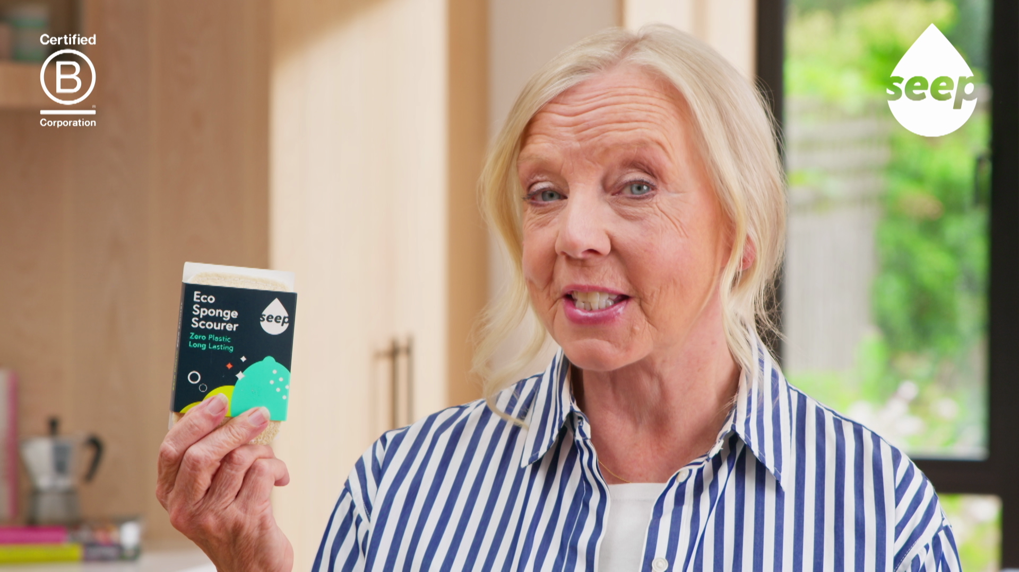
Seep: an instant impact on TV
The Challenge:
Seep were looking to reach a mainstream audience and turn fleeting TV appearances into sustained brand growth.
The Solution:
They won a share of £600,000 of airtime across Channel 4 linear channels and streaming, to launch onto TV for the first time.
The Results:
The campaign delivered a 410% increase in year-on-year revenue, grew new customers by 474% year-on-year, and delivered early-stage growth for the B Corp business.
Notes:
The Challenge
Seep is a B Corp business focused on removing microplastics from our cleaning essentials across 10 million homes in the UK. Having built momentum online since their launch in 2020 with their range of plastic-free sponges, cloths and bin liners, Seep were looking to scale. The challenge was clear: they needed to reframe sustainable cleaning as high performance in a category dominated by household names and plastic-filled competition. They wanted to reach mainstream audiences and turn their appearance on Dragon’s Den into sustained brand growth.
The TV Solution
As a B Corp business, Seep noticed that Channel 4 had partnered with B Lab UK, the business behind the B Corp certification, to launch an advertising initiative. The initiative would see 5 B Corp businesses earn a share of £600,000 of free airtime across Channel 4’s linear channels and Channel 4 Streaming to scale their purpose-led businesses. This meant they would be able to reach an eco-conscious audience in some of the biggest content across Channel 4.
The initiative is part of Channel 4’s strategy to support positive consumer behaviour change and they understand the power of TV advertising to affect change. Initially, ten businesses were shortlisted for the award. Channel 4 said “The shortlisted businesses stood out for the clarity of their ideas and how thoughtfully they’d considered the role advertising could play in their wider growth plans”. Seep was lucky to reach the next stage and be awarded free airtime.
The Plan
Armed with a TV creative starting Dragon’s Den star, Deborah Meaden, an early investor in the business, Seep made their debut on TV. Alongside the other four winners of the B Corp initiative, Seep launched as part of Channel 4’s B Corp Showcase in partnership with B Lab UK. This specially curated ad break went out in Taskmaster on 25th September.
Following the successful launch of the campaign in the break takeover, Seep continued their campaign across Channel 4 channels, combining the scale of linear with the precision of Channel 4 Streaming. Seep showed up in some of the biggest shows across Channel 4, including Gogglebox, Married at First Sight and The Inheritance; while targeting an upmarket, eco-aware light TV viewing audience across Channel 4 Streaming
Results
The first-time foray into TV from Seep showed some outstanding results. Research conducted by Sonder showed that Seep had delivered a 410% increase in year-on-year revenue growth, growing new customers by 474%. This growth clearly showed that the brand could cut through against the market saturated with cheaper, plastic-filled alternatives and deliver growth for the early-stage B Corp business.
“The Channel 4 campaign created a real halo effect for Seep- boosting brand visibility, accelerating momentum, and supporting strong sales growth at a pivotal stage for the business.”
Laura Harnett, Founder, Seep

