Slide 1
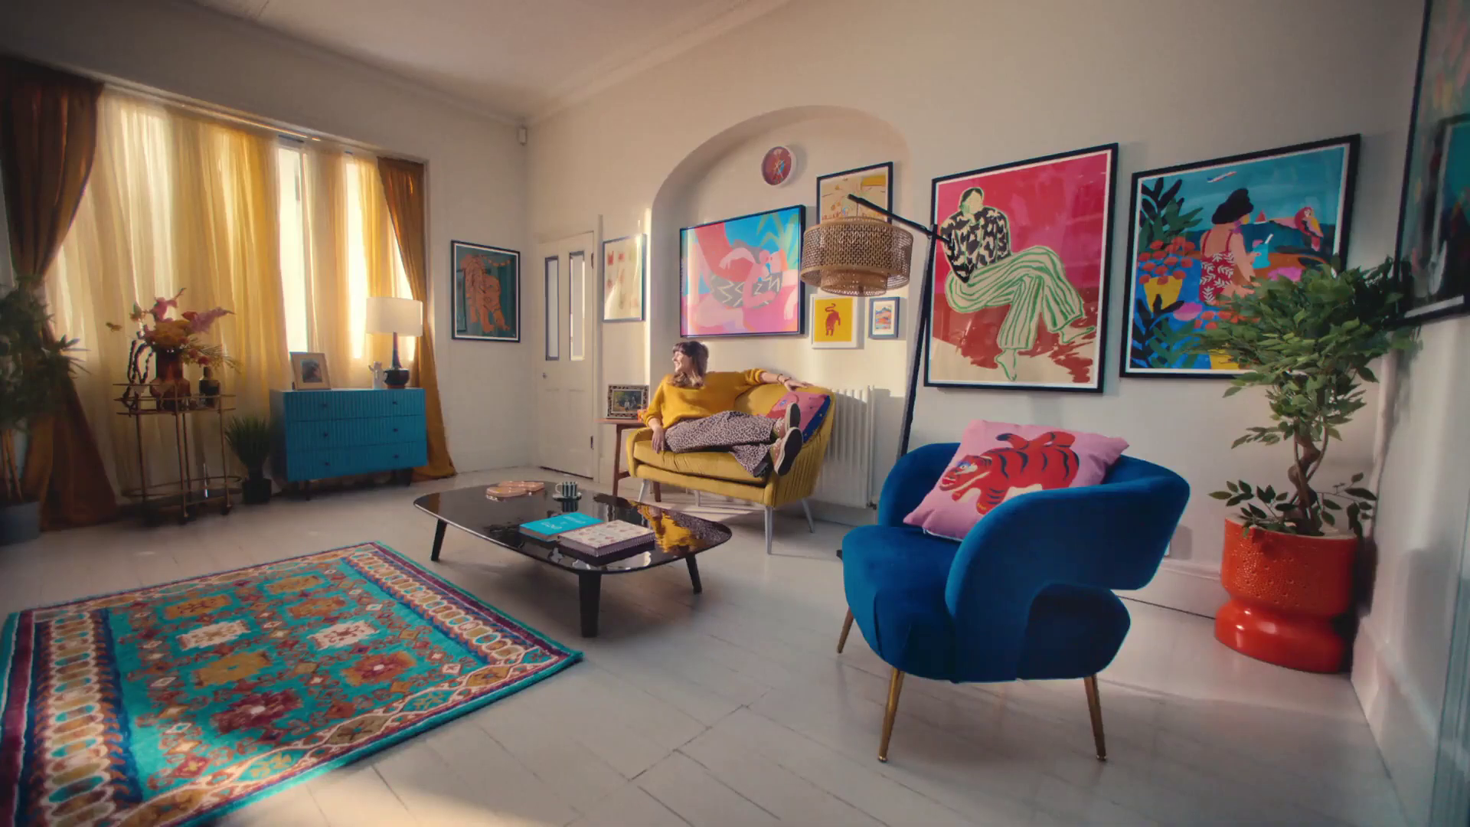
Monthly TV viewing report
January 2025
Fy!, “Less Bland More You”

Slide 2
January linear TV facts & figures
Total TV weekly reach %
Total TV viewed per day
Commercial TV viewed per day
Impacts
Individuals
77.4 | 56.1bn | 2h 25m | 1h 34m
79.8 | 54.3bn | 2h 45m | 1h 46m
79.2 | 20.9bn | 2h 11m | 1h 16m
59.5 | 3.5bn | 40m | 26m
78.3 | 24.3bn | 2h 37m | 1h 42m
81.2 | 30.0bn | 2h 51m | 1h 50m
79.1 | 4.0bn | 1h 31m | 1h 0m
Adults
ABC1 adults
16-34
Men
Women
Housepersons with children
Sources: Barb January 2025, industry standard TV viewing in-home on a TV set. Reach 3min+. 30” equivalent impacts.
Notes:
January linear TV figures for weekly reach, impacts, total TV viewing hours and commercial TV viewing hours

Slide 3
Some notable TV moments in January
On 13 January, ITV2 aired an episode of Love Island All Stars to a TV Set audience of 1.21m and a device audience of 475k.
On 15 January, Channel 4 aired new drama Patience to an average audience of 3.54m
On 26 January, Channel 5 aired The Castaways to an average audience of 2.20m.
On 23 January, Sky Atlantic aired Lockerbie: A Search For Truth to a pre-broadcast audience of 1.33m a live audience of 13k and time-shifted audience of 198k.
Source: Barb, January 2025, individuals. Average audience figures, TV set and devices viewing 1-7 days (includes pre-broadcast figures, if applicable).

Slide 4
Top 5 ITV1 programmes
Vera (1 January) 6.29 million viewers
Playing Nice (13 January) 6.27 million viewers
The Masked Singer (4 January) 4.87 million viewers
Coronation Street (6 January) 4.76 million viewers
Out There (19 January) 4.62 million viewers
“Playing Nice!”, ITV1
Source: Barb, January 2025, individuals. Average audience figures, TV set and devices viewing 1-7 days (includes pre-broadcast figures, if applicable)
Notes:
Top 5 programmes - ITV

Slide 5
Top 5 Channel 4 programmes
Patience (15 January) 3.54 million viewers
24 Hours In Police Custody (13 January) 3.00 million viewers
Gogglebox (1 January) 2.75 million viewers
The Great Pottery Throw Down (19 January) 2.60 million viewers
Celebrity Hunted (5 January) 2.14 million viewers
“Gogglebox”, Channel 4
Source: Barb, January 2025, individuals. Average audience figures, TV set and devices viewing 1-7 days (includes pre-broadcast figures, if applicable)
Notes:
Top 5 programmes – Channel 4

Slide 6
Top 5 Channel 5 programmes
The Castaways (26 January) 2.20 million viewers
The Good Ship Murder (10 January) 1.82 million viewers
World’s Strongest Man (1 January) 1.54 million viewers
Ben Fogle: New Lives in the Wild (7 January) 1.38 million viewers
Prince Andrew: Where Did All the Money Go? (25 January) 1.31 million viewers
“The Good Ship Murder”, Channel 5
Source: Barb, January 2025, individuals. Average audience figures, TV set and devices viewing 1-7 days (includes pre-broadcast figures, if applicable)
Notes:
Top 5 programmes – Channel 5

Slide 7
Top 5 commercial non-PSB* programmes (non-sport)
Love Island All Stars, ITV2 (24 January) 2.21 million viewers
Lockerbie: A Search For Truth, Sky Atlantic (23 January) 1.54 million viewers
Vera, ITV3 (21 January) 0.76 million viewers
Hollyoaks, E4 (21 January) 0.72 million viewers
Pete Wicks: For Dogs’ Sake, U&W (28 January) 0.59 million viewers
“Pete Wicks: For Dogs’ Sake”, U&W
Source: Barb, January 2025, individuals. Average audience figures, TV set and devices viewing 1-7 days (includes pre-broadcast figures, if applicable)
Notes:
Top 5 programmes – commercial non-public service broadcasting channels

Slide 8
Top 5 Netflix programmes
Harlen Coben's Missing You (1 January) 4.79 million viewers
Back in Action (17 January) 3.35 million viewers
The Night Agent (23 January) 2.94 million viewers
Bank of Dave 2: The Loan Ranger (10 January) 1.45 million viewers
American Primeval (9 January) 1.12 million viewers
“Harlen Coben's Missing You ”, Netflix
Source: Barb, January 2025, individuals. Average audience achieved during the first seven days of their availability. Only includes TV set viewing.
Notes:
Top 5 programmes – Netflix

Slide 9
Top 5 Amazon Prime Video programmes
Molly-Mae: Behind It All (17 January) 1.36 million viewers
Civil War (11 January) 0.83 million viewers
The Rig (2 January) 0.77 million viewers
Beast Game (9 January) 0.75 million viewers
UEFA Champions League (21 January) 0.59 million viewers
“Molly-Mae: Behind It All ”, Amazon Prime Video
Source: Barb, January 2025, individuals. Average audience achieved during the first seven days of their availability. Only includes TV set viewing.
Notes:
Top 5 programmes – Amazon Prime Video

Slide 10
Top 5 Disney+ programmes
Star Wars: Skeleton Crew (1 January) 0.79 million viewers
High Potential (23 January) 0.66 million viewers
Alien Romulus (15 January) 0.57 million viewers
NCIS (15 January) 0.35 million viewers
9-1-1: Lone Star (1 January) 0.30 million viewers
“Star Wards: Skeleton Crew”, Disney+
Source: Barb, January 2025, individuals. Average audience achieved during the first seven days of their availability. Only includes TV set viewing.
Notes:
Top 5 programmes – Disney+

Slide 11
Top commercial programmes with largest proportion of device viewing
Total audience
1.69m
1.43m
1.81m
6.27m
1.45m
Source: Barb, January 2025, individuals. Average audience figures, TV set and devices viewing up to 7 days post-broadcast. Based on programmes with 1 million+ total TV viewers
Notes:
Top commercial programmes with largest proportion of device viewing

Slide 12
Top commercial programmes with largest proportion of pre-broadcast boxset BVOD viewing
Total audience
1.54m
3.17m
6.27m
3.19m
3.56m
Source: Barb, January 2025, individuals. Average audience figures, TV set and devices viewing up to 7 days post-broadcast. Based on programmes with 1 million+ total TV viewers
Notes:
Top commercial programmes with largest proportion of pre-broadcast boxset BVOD viewing

Slide 13
Key new to linear TV advertisers in January
Zoe Nutrition app, Zoe, launched on TV for the first time with brand ambassador Davina McCall.
Jordan’s Cereal Jordans Cereals returned to TV screens following a decade-long hiatus.
Applied Nutrition Supplements brand, Applied Nutrition, made its TV debut on ITV with brand ambassador Coleen Rooney.
Zoe, Davina McCall
Notes:
New to TV advertisers in January.

