Slide 1
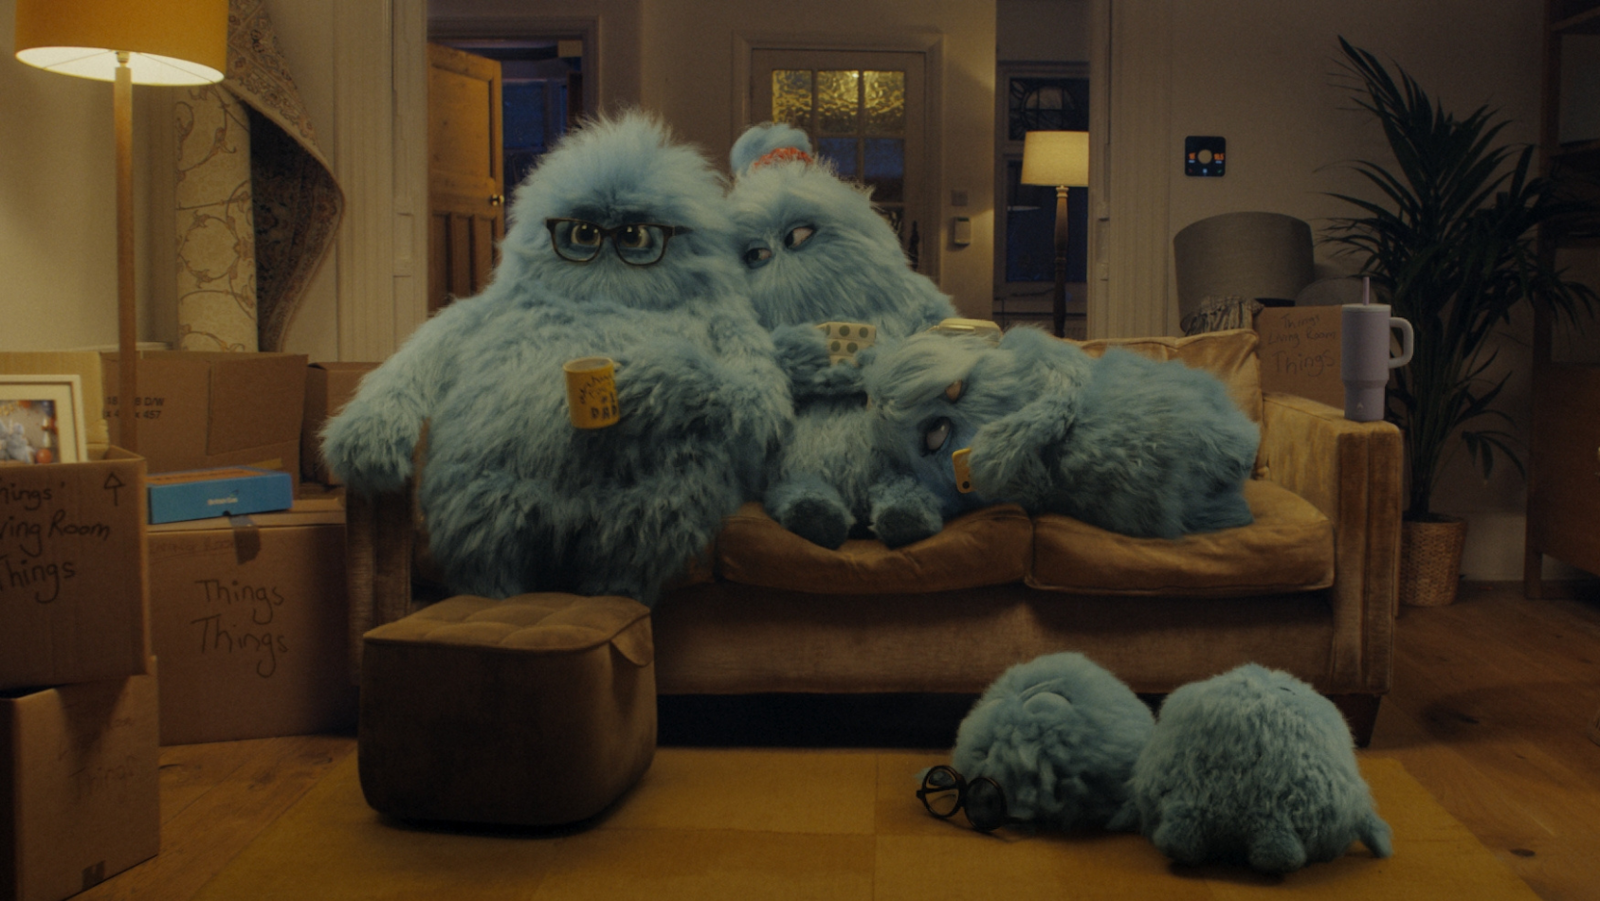

Monthly TV viewing report
July 2025
British Gas – Taking Care of Things

Slide 2
July linear TV facts & figures
Total TV weekly reach %
Total TV viewed per day
Commercial TV viewed per day
Impacts
Individuals
71.6 | 47.2bn | 2h 1m | 1h 20m
75.0 | 46.0bn | 2h 18m | 1h 31m
73.3 | 17.1bn | 1h 47m | 1h 4m
53.1 | 2.6bn | 30m | 20m
73.7 | 20.7bn | 2h 13m | 1h 28m
76.2 | 25.3bn | 2h 22m | 1h 33m
69.5 | 2.6bn | 1h 1m | 41m
Adults
ABC1 adults
16-34
Men
Women
Housepersons with children
Source: Barb, July 2025, industry standard TV viewing in-home on a TV set. Reach 3min+. 30” equivalent impacts.
Notes:
July linear TV figures for weekly reach, impacts, total TV viewing hours and commercial TV viewing hours

Slide 3

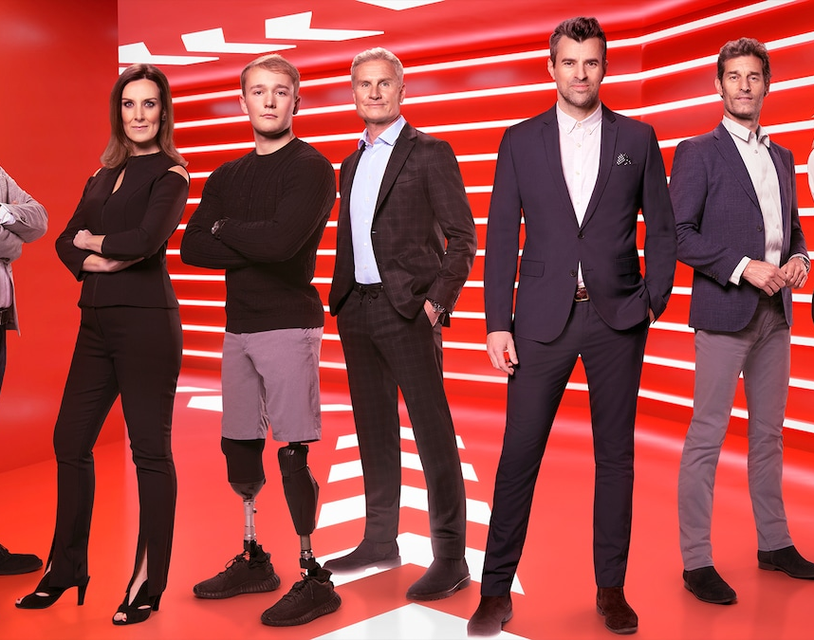
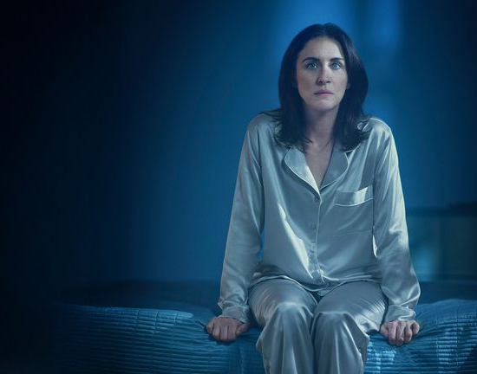

Some notable TV moments in July
On 22 July, ITV1 aired UEFA Women’s Euro 2025: England v Italy to a peak minute audience of 9.88m.
On 6 July, Channel 4 aired the Formula 1 British Grand Prix to an average audience of 2.29m.
On 6 July, Channel 5 launched new drama Insomnia to an average audience of 1.47m.
On 28 July, Sky Witness aired an episode of The Rookie to an average audience of 596k.
Source: Barb, July 2025, individuals. Average audience figures, TV set and devices viewing 1-7 days (includes pre-broadcast figures, if applicable).

Slide 4

Top 5 ITV1 programmes
UEFA Women's Euro 2025: England v Italy (22 July)
6.39 million viewers
Coronation Street (14 July)
4.26 million viewers
Emmerdale (28 July)
3.82 million viewers
Karen Pirie (20 July)
3.71 million viewers
Long Lost Family: Born Without Trace (2 July)
2.41 million viewers
Karen Pirie, ITV1
Source: Barb, July 2025, individuals. Average audience figures, TV set and devices viewing 1-7 days (includes pre-broadcast figures, if applicable)
Notes:
Top 5 programmes - ITV

Slide 5
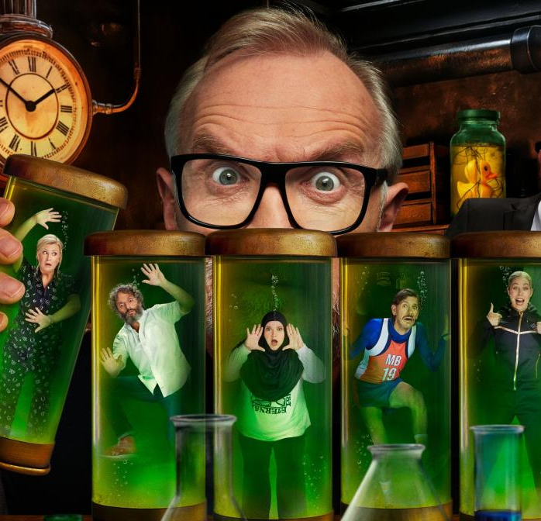
Top 5 Channel 4 programmes
24 Hours in Police Custody (7 July)
3.20 million viewers
Celebrity Gogglebox (11 July)
2.44 million viewers
Formula 1: British GP (6 July)
2.29 million viewers
Taskmaster (3 July)
2.11 million viewers
1000 Men and Me: The Bonnie Blue Story (29 July)
1.65 million viewers
Taskmater, Channel 4
Source: Barb, July 2025, individuals. Average audience figures, TV set and devices viewing 1-7 days (includes pre-broadcast figures, if applicable)
Notes:
Top 5 programmes – Channel 4

Slide 6
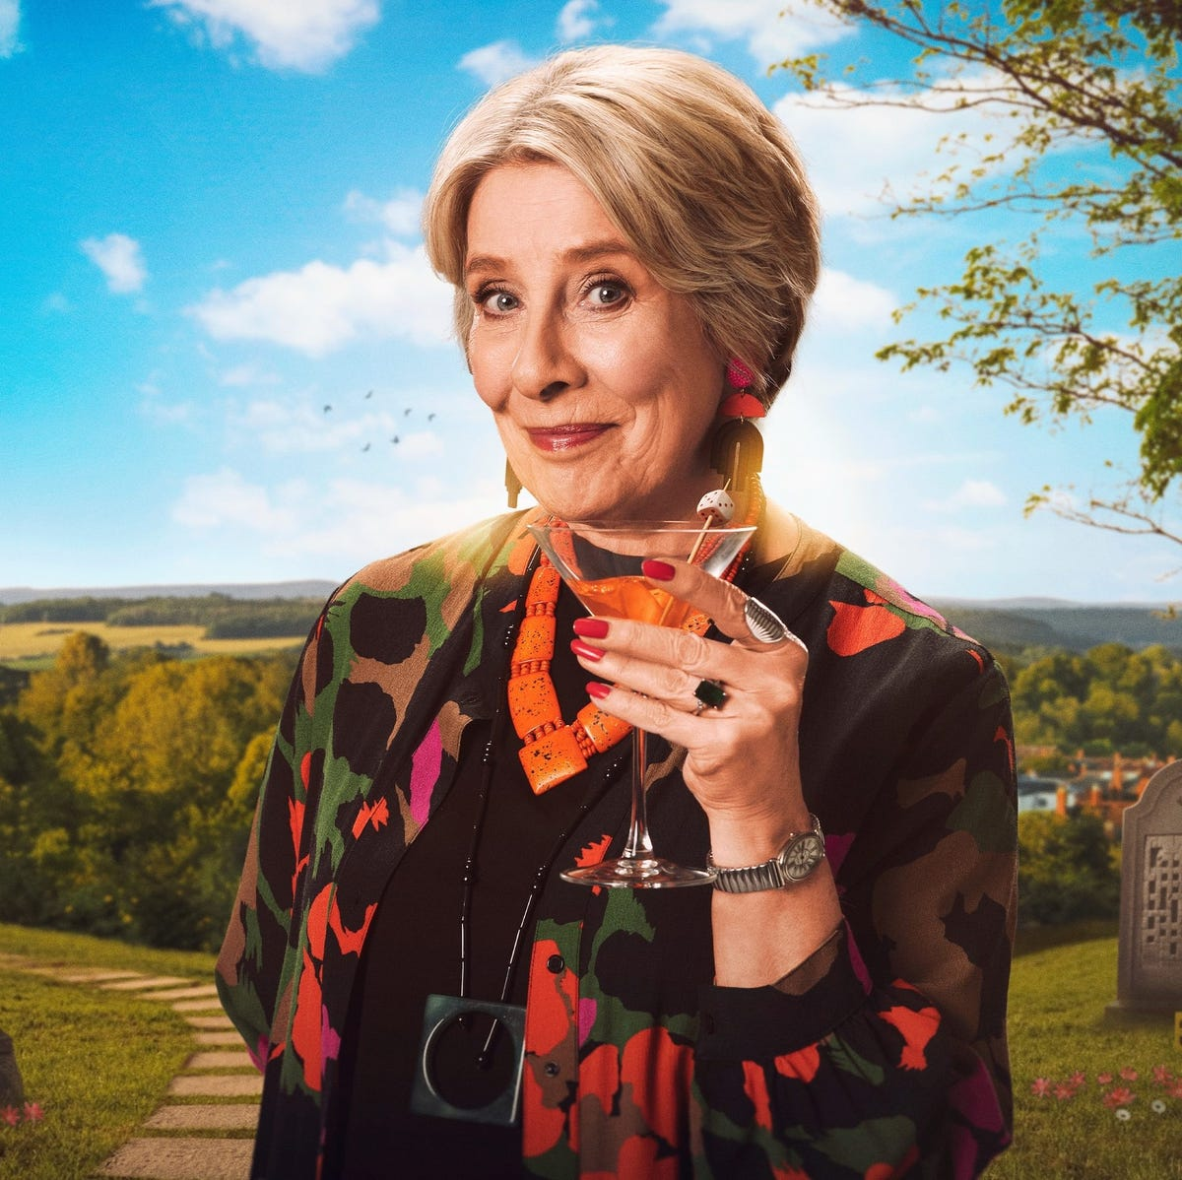
Top 5 Channel 5 programmes
Police Suspect No.1 (28 July)
1.52 million viewers
Insomnia (6 July)
1.47 million viewers
Murder Most Puzzling (3 July)
1.42 million viewers
Reuben: Life in the Dales (8 July)
1.34 million viewers
Forensics: Murder Case (21 July)
1.22 million viewers
Murder Most Puzzling, Channel 5
Source: Barb, July 2025, individuals. Average audience figures, TV set and devices viewing 1-7 days (includes pre-broadcast figures, if applicable)
Notes:
Top 5 programmes – Channel 5

Slide 7

Top 5 commercial non-PSB* programmes (non-sport)
Love Island, ITV2 (11 July)
2.72 million viewers
Bookish, U&Alibi (16 July)
1.19 million viewers
Whitstable Pearl, U&Drama (25 July)
0.81 million viewers
Outrageous, U&Drama (24 July)
0.66 million viewers
Love Island: Aftersun, ITV2 (20 July)
0.66 million viewers
Bookish, U&Alibi
Source: Barb, July 2025, individuals. Average audience figures, TV set and devices viewing 1-7 days (includes pre-broadcast figures, if applicable)
Notes:
Top 5 programmes – commercial non-public service broadcasting channels

Slide 8

Top 5 Netflix programmes
Happy Gilmore 2 (25 July)
4.22 million viewers
Untamed (17 July)
2.69 million viewers
The Old Guard 2 (2 May)
1.85 million viewers
Amy Bradley Is Missing (16 July)
1.62 million viewers
Attack on London: Hunting The 7/7 Bombers (1 July)
1.31 million viewers
Happy Gilmore 2, Netflix
Source: Barb, July 2025, individuals. Average audience achieved during the first seven days of their availability. Only includes TV set viewing.
Notes:
Top 5 programmes – Netflix

Slide 9

Top 5 Amazon Prime Video programmes
Head of State (2 July)
1.78 million viewers
The Assassin (25 July)
1.61 million viewers
Ballard (9 July)
0.77 million viewers
The Summer I Turned Pretty (16 July)
0.56 million viewers
The Flash (5 July)
0.43 million viewers
Head of State, Amazon Prime Video
Source: Barb, July 2025, individuals. Average audience achieved during the first seven days of their availability. Only includes TV set viewing.
Notes:
Top 5 programmes – Amazon Prime Video

Slide 10

Top 5 Disney+ programmes
Ironheart (2 July)
0.46 million viewers
Zombies 4: Dawn of the Vampires (11 July)
0.46 million viewers
The Amateur (17 July)
0.43 million viewers
Criminal Minds (11 July)
0.24 million viewers
Mickey Mouse Clubhouse (22 July)
0.16 million viewers
The Amateur, Disney+
Source: Barb, July 2025, individuals. Average audience achieved during the first seven days of their availability. Only includes TV set viewing.
Notes:
Top 5 programmes – Disney+

Slide 11
Top commercial programmes with largest proportion of device viewing
Total audience
2.37m
1.65m
1.08m
1.63m
1.22m
Source: Barb, July 2025, individuals. Average audience figures, TV set and devices viewing up to 7 days post-broadcast. Based on programmes with 1 million+ total TV viewers
Notes:
Top commercial programmes with largest proportion of device viewing

Slide 12
Top commercial programmes with largest proportion of pre-broadcast boxset BVOD viewing
Total audience
1.02m
1.05m
1.19m
3.68m
1.01m
Source: Barb, July 2025, individuals. Average audience figures, TV set and devices viewing up to 7 days post-broadcast. Based on programmes with 1 million+ total TV viewers
Notes:
Top commercial programmes with largest proportion of pre-broadcast boxset BVOD viewing

Slide 13
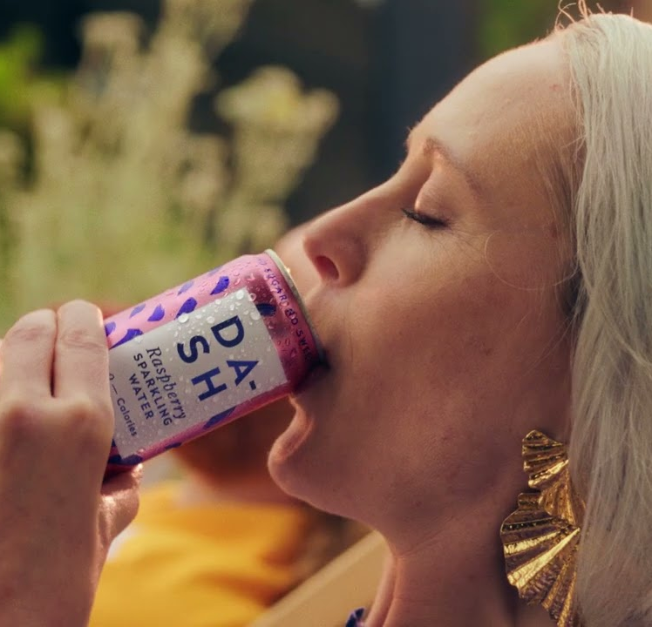
Key new to linear TV advertisers in July
DASH
Real fruit-infused drinks brand, DASH, made its TV debut on Sky’s linear channels.
Shopify
Ecommerce platform for businesses, Shopify, launched its first ever UK TV campaign in July.
Hope & Homes for Children
Charity, Hope & Homes for Children, launched its inaugural TV campaign across channels on ITV and Sky.
DASH – The Drink That Has It All
Notes:
New to TV advertisers in July.

