Slide 1
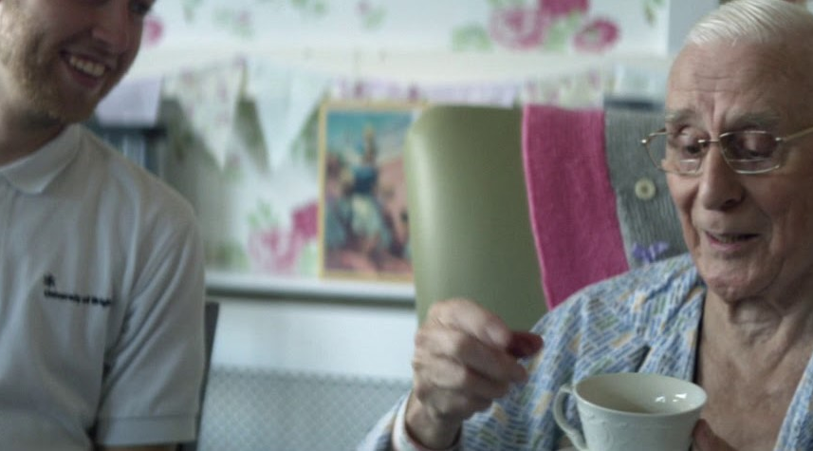
The NHS revives its workforce
Challenge
To recruit, retain and return nurses to the NHS workforce
Solution
Created national pride in the job via an emotional TV campaign at scale, showing the nurses in action - ‘We Are The NHS’
Results
Increase of 1,260 nursing applications – a 4% uplift
19 percentage point increase in those considering returning to the NHS
Notes:
The Challenge
The NHS is the most recognised brand in the UK above Manchester United Football Club. Additionally, despite research showing that the public’s personal experiences with the NHS were largely positive, this conflicted with public opinion and the media’s portrayal of the NHS being an institution in constant crisis.
The NHS had not focused a campaign on workforce for a number of years. In fact, their last recruitment campaign was in 2005. Over time, this resulted in an attrition of the NHS workforce. Whilst the NHS had been focussing instead on system change and service delivery, they had lost track of the importance of maintaining and recruiting to the NHS workforce. There was an 89% decrease of nurses joining the register - one of the main reasons for this being the discontinuation of the nursing bursary.
However, not attracting employees wasn’t the only problem the NHS faced. They were also struggling to maintain their workforce, with an increase of 67% of EU nurses leaving the register. To make matters even worse, the NHS were confronted with a tough recruitment climate with the UK employment being extremely high. With all these factors combined, there was a predicted supply gap of nurses of 22,000 by 2020/21.
The NHS tasked MullenLowe with promoting the NHS as an attractive career option with a media approach described as a ‘perpetual winter’. The challenge was to reach a broad section of society and to reposition the role of a nurse from being not just someone with care and compassion but someone with a broader skillset. They wanted to attract staff who were more academically accomplished, with a variety of skills (including IT for example) and for the NHS to be seen as progressive, positive and more modern. So it was important that the ad showed off the technicality of the job and also demonstrated that a key benefit of working at the NHS was working in a team as research showed that teamwork was an important factor when young people are looking for jobs.
The TV Solution
As one of the NHS’s key performance indicators was staff retention and the NHS England’s workforce was 1.2m at the time of briefing, MullenLowe understood that broadcast communications were necessary. Furthermore, in order to build scale and reach as quickly and powerfully as required, TV was the obvious solution. With TV’s reach being so high, it made it possible to communicate with a variety of different audiences, which was important as the NHS workforce is very diverse.
The brief identified four audiences for MullenLowe to appeal to: retain, recruit, return and an additional influencer audience which was made up of friends and family of nurses who acted as supporters.
In order to appeal to this crucial fourth audience, the NHS needed to create pride at a societal level. The only way to do this was to take a step back and evaluate the service the NHS provides and the true value of the work the nurses do. MullenLowe knew that TV is the best medium to evoke emotion and would enable them to resonate with viewers at a national level.
The strapline ‘We Are The NHS’ was designed as a call to arms, with the purpose of activating pride and driving a response from the four identified audiences. Another benefit of TV is that it drove rapid response in the short term, which will carry on delivering for years after. Given the ubiquity of multi-screening, the campaign’s direct response call to action ‘search nursing careers’ was acted upon immediately.
The Plan
MullenLowe created a highly impactful and emotional TV ad that showed the NHS nurses in action. The first TV ad aired immediately after the England v Columbia World Cup match on ITV. This was a perfect kick off spot as it not only delivered a huge audience but was the ideal environment to remind people about the heroes of the UK – nurses.
The 30 second TV campaign ran across July and August 2018, mostly on ITV. One of the striking elements of the ad was the unprecedented access inside hospitals. It even featured a birth for the first time in a TV ad.
The campaign was led by TV for emotion and scale but was amplified across OOH in strong OOH transport areas to compel searches and career research.
Following the incredibly strong response at launch, this was followed by social media activity that showed individual nursing roles within the NHS to demonstrate the true breadth of opportunities. In order to drive response, CRM comms then retargeted those who had engaged with the campaign during the final month before course deadlines closed. They offered films with more info into becoming a nursing student to try and nudge people over the line
Results
The campaign was voted Adwatch’s ‘the most liked’ Ad of the Year, with a 57% likeability score - the highest since records began.
In the first week of the campaign, Google searches for ‘nursing careers’ reached their highest level since 2005.
From campaign launch until the UCAS deadline, the campaign drove over 410k visits to the website – up 604% year on year
There was a +19 ppt increase in those considering returning to the NHS and a +13 ppt increase in those agreeing that ‘Making a difference in people’s lives makes me consider returning to the NHS.’ Half said they had taken action as a direct result of the campaign.
This led to a threefold increase in the number of visits to the ‘Return to Nursing’ page, from 3,639 in 2017, to over 10,290 across the course of the campaign - an uplift of over 6,000.
The campaign made current NHS staff more likely to see their job in a positive light with a 10 ppt decrease in ‘I would get greater job satisfaction working somewhere other than the NHS.
Against a backdrop of the first-ever decline in UCAS applications overall, and a 13% decline in 2018, there was an increase of 1,260 nursing UCAS applications - a 4% uplift.
“It’s obvious that TV and creativity played a huge role, but we need to recognise that success depends on a fully integrated campaign... There is a time and a place for targeting through the obvious channels, digital and CRM, but there is also a time to talk to the nation and this campaign did it brilliantly and successfully. We had an unflinching commitment to authenticity and achieved this through bravery and goodwill from within the NHS. Building emotion is not in conflict with prompting action, certainly in government advertising. The trick is to trust and empower your agencies, to get a great set of agencies to support you and give them the space to do it.”
Ian Hampton, Senior Campaigns Manager NHS England

