Slide 1


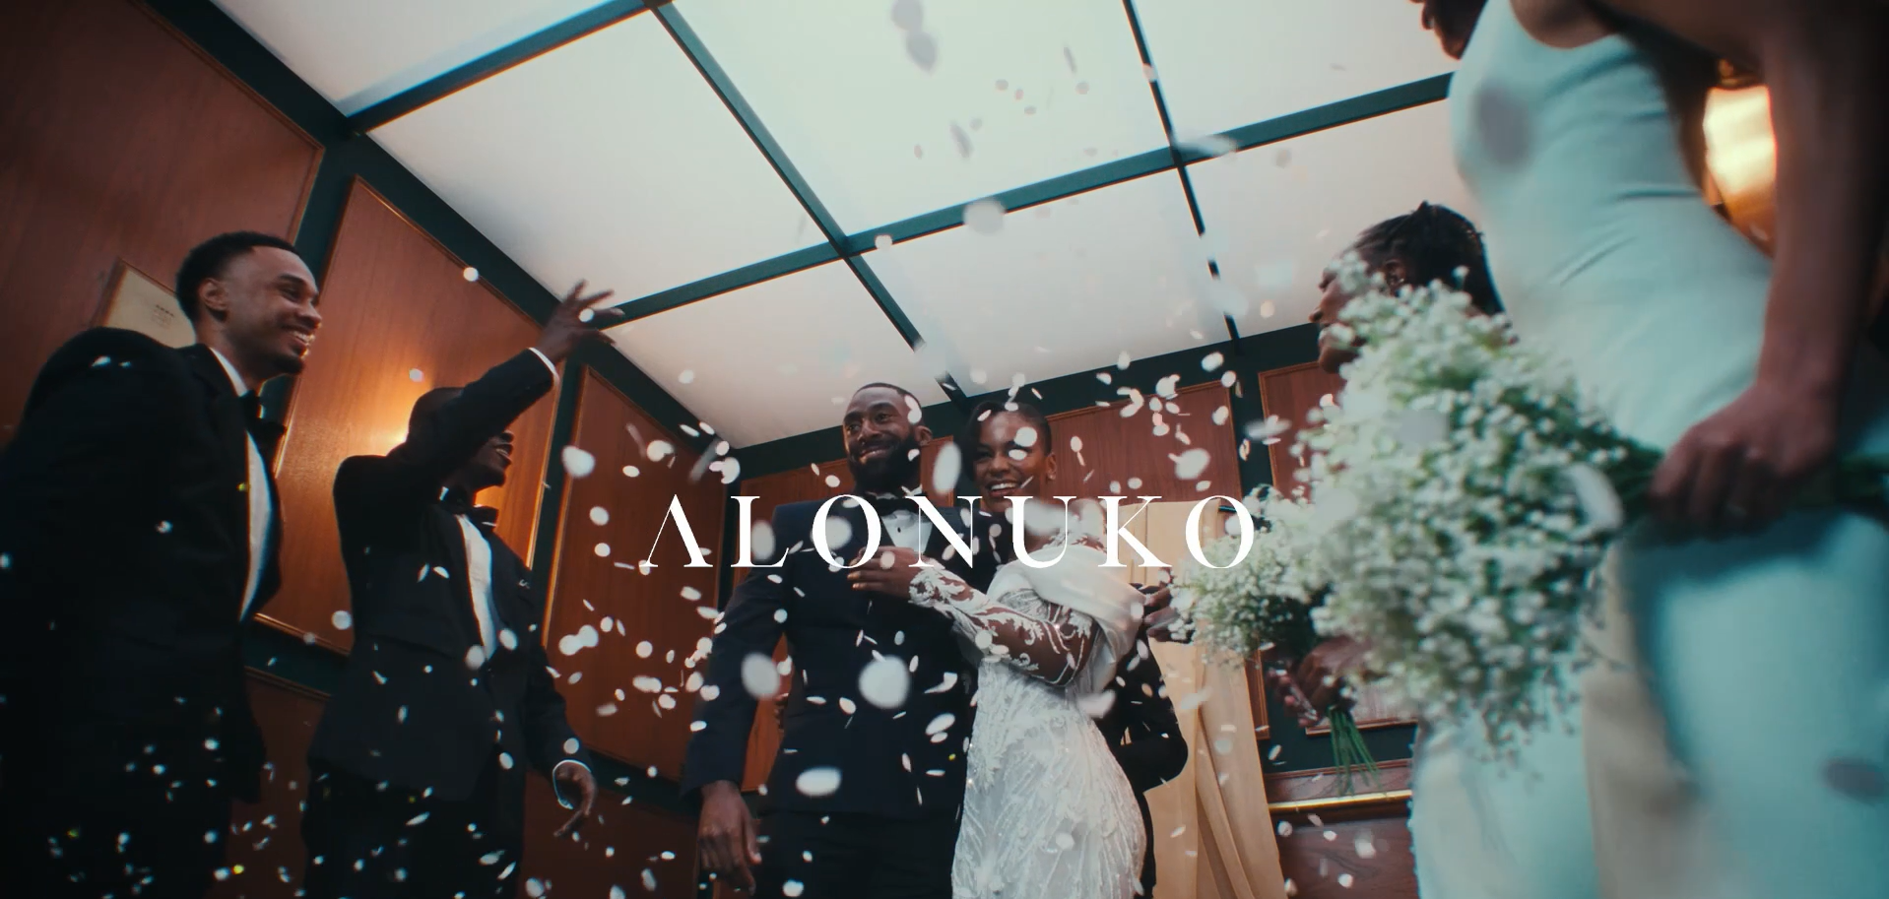
Alonuko: TV for the first time with Channel 4 and Lloyds’ ‘Black in Business’ Initiative
The Challenge:
Founded in 2012, Alonuko designs and produces bridal wear for women of colour. The internationally renowned brand were looking to increase brand awareness, drive revenue and double their number of brides in the UK.
The Solution:
As one of four Beneficiaries of Channel 4 and Lloyds’ ‘Black in Business’ Initiative, Alonuko were gifted £150,000 of airtime to help launch the brand.
The Results:
Delivered high levels of awareness, increases in consideration and brand reappraisal from key audiences, setting new benchmark for Channel 4’s PL4Yback studies.
Notes:
The Challenge
Founded in 2012 by Gbemi Okunlola, Alonuko design and produce bridal wear for both brides and their parties, either bespoke or from the shop. Their clothing is all hand-designed, and tailored for women of colour, a group often underrepresented in bridal suites across the world.
Despite being an internationally renowned and recognised brand, having been featured in Vogue and The Huffington Post, Alonuko were looking to grow.
Their key objectives were to drive brand awareness, increase revenue and double their number of brides in the UK in 2025.
The TV Solution
With an ambition to grow their brand, Alonuko had previously used trade and trunk shows and pop ups to reach their audience alongside social media activity. However, after hearing about Channel 4 and Lloyd’s Black in Business Initiative, they jumped at the chance to enter the scheme.
Now in its second iteration, the ‘Black in Business’ Initiative from Channel 4 and Lloyds was designed to highlight the difficulty that black business owners face when trying to get their businesses funded, with research highlighting that only 0.24% of venture capitalist funding is invested into black owned businesses and 54% of black owned businesses only receive funding once the business is already established.
To combat this, Channel 4 and Lloyds partnered to launch the initiative, which would gift 4 lucky winners £150,000 of free airtime along with 6 months of mentoring from experts from both Channel 4 and Lloyds. Entering alongside 200 other applicants, Alonuko were announced as one of the beneficiaries in 2025. Given its ability to reach millions of people at the right moment, with the right messaging, TV was the perfect channel to introduce the brand to the nation.
The Plan
Armed with a creative from Quiet Storm, and a plan drawn up by Channel 4’s commercial sales team, Alonuko were ready to launch on TV for the first time. This activity kicked off with a premier break alongside the 3 other beneficiaries on 1st July, on Channel 4’s biggest show that day, Bake Off: The Professionals, reaching 1.4 million people in one hit.
Following on from the launch, Alonuko’s activity kicked off in earnest, covering Channel 4, E4, More4, Film4 and Channel 4’s partner sales channels in UKTV and Warner Brothers Discovery.
Programming was analysed and sought for the female audience, which saw the brand showing up in Handmaids Tale, First Dates, Grand Designs and Educating Yorkshire on Channel 4.
The focus on programming was extended to E4 with the launch of the perfect show for the bridal brand - Married at First Sight UK. With spots throughout the show, the association started with a second in break placement in the launch episode of the latest series, delivering instant reach with a bullseye audience for Alonuko. This focus also reached Channel 4 Streaming, with buys against both the top 10 programming and reality content. This saw Alonuko’s creative show up in both Married at First Sight UK and Australia, First Dates, Made in Chelsea and Celeb Googlebox - extending reach of the linear campaign and ensuring Alonuko reached those who weren’t heavy viewers of Linear TV. To support the campaign, Alonuko ran a social campaign to capture those who were likely exposed to the TV campaign and likely in market for Bridal and bridesmaid clothing.
Results
Regarding the aim of lifting brand awareness for the brand, the campaign was a success. The brand saw movements against their competitor set delivering higher levels of awareness compared to Channel 4’s micro brand norms. Brand awareness spiked when the brand was present in Married at First Sight across both linear and BVOD, correlating with higher levels of TV exposure those weeks.
Alongside this, Alonuko were able to shift brand perceptions around the brand being ‘Up and Coming’, ‘Purpose driven’ and ‘For people like me’, closing the gap on key competitors. This brand awareness also in turn led to increases in consideration. These lifts in consideration again lined up with activity in Married in First Sight UK, delivering the biggest improvement in consideration for the brand. Finally, the campaign has successfully led to a complete reappraisal of the brand, delivering scores that set a new benchmark for micro brands among Channel 4’s PL4Yback benchmarks.

