Slide 1


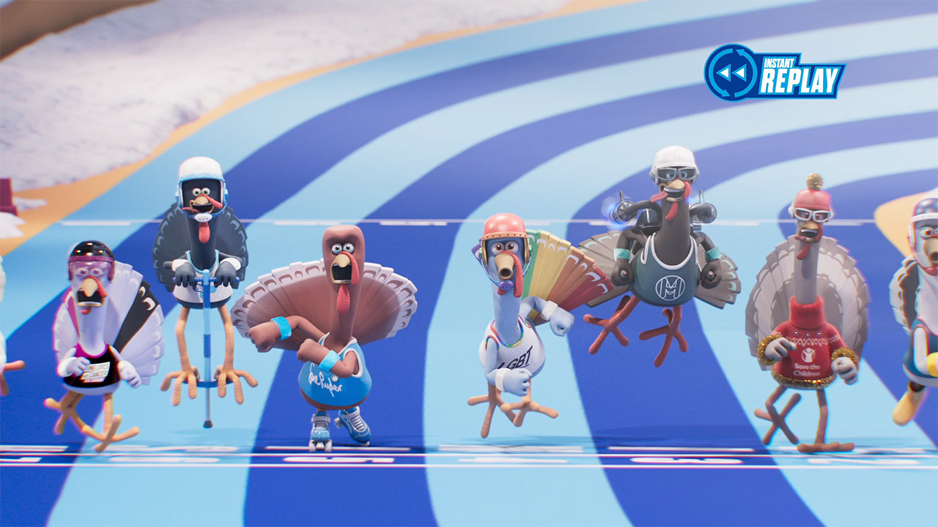
PayPal’s Turkey Dash helps raise money at Christmas
Challenge
PayPal wanted raise awareness of their PayPal Giving Fund and to champion donating. The primary audience was 18-34s.
Solution
A three week campaign centred around a Turkey dash, where each turkey represented a charity
TV, social media and online display used to build awareness
The campaign culminated in a two-minute broadcast in peak airtime
Results
Turkey Dash connected to 76% of 18-34s, an average seven times
£177,000 was raised for the charities, which represented an increase year on year of 978%
Notes:
The Challenge
PayPal, the secure online payment service, have always tried to support charities through their ‘Donate’ button and the PayPal Giving Fund (PPGF). The PPGF is an independently-registered charity set up by PayPal which enables 100% of donations to go straight to the good causes.
However, their charitable services have not been getting noticed. In 2017, their objective was to raise awareness and comprehension of the fund and to champion donating with PayPal. Their primary audience was 18 to 34s, as this is the group who use cash the least. In 2017, only 46% of transactions were made using cash and this figure is even lower amongst 18 to 34s.
The challenge for PayPal was to create a moment that charities and donors could connect to through using the donate button.
The TV Solution
Crispin Porter + Bogusky, PayPal’s creative agency came up with an innovative idea to address the challenge and they worked with Havas, PayPal’s media agency to make it happen. It was decided that Christmas was the best time of year, as people tend to be more charitable at that time. They found the perfect day to launch the campaign in Giving Tuesday. This is the day after Cyber Monday and is a day that is all about giving to charity. Havas felt that using TV was the best route because it meant they could connect with the positivity surrounding Christmas telly. Focussing on TV meant that they could reach people in the right environment with an empathetic giving mindset. In addition, the viewers were quite likely to be watching with their phone (and so also the donate button) in their hand.
In order to engage 18 to 34s, they needed something that offered participation and fun. They wanted to create a cultural media event that charities could get behind, to inspire the British public to get involved. They worked with Aardman Animations to create Turkey Dash – a race involving eight animated turkeys, each one representing a charity, powered by donations. The more that cash was donated, the faster the turkeys would dash.
The Plan
Havas managed to secure a two-minute long ‘live’ broadcast in peak airtime on Channel 4 just before Christmas. They launched the campaign three weeks out, setting the turkeys loose across TV, social media and online display, with an animated Scarlett Moffatt training the turkeys and encouraging viewers to get involved.
They chose a wide range of causes to maximise the breadth of appeal. The eight partner charities were: Blue Cross, RNLI, CLIC Sargent, LGBT Foundation, Sue Ryder, Royal British Legion, Save the Children and Mental Health Foundation. All the charities got involved and helped to promote the event via their own channels, which magnified the impact of the campaign.
The donations that started to come in enabled the turkeys to be ‘trained’ and PayPal showed their progress with ‘Bootcamp’ spots across Channel 4 and social media. The campaign culminated in the ‘live’ race which went out in Jamie and Jimmy’s Friday Night Feast. Donations were valid right up to the event, giving the turkeys a final boost before the big race. The ad was fronted by Steve Jones (Channel 4’s F1 presenter) and voiced by Steve Cram. Viewers tuned in to see Captain McStuffing – RNLI’s turkey – win by a close margin in an exciting finish.
Results
Rooted in entertainment and giving, Crispin Porter + Bogusky and Havas created a completely new moment in the gifting calendar, with an event that celebrated UK charities and at the same time raised awareness of PayPal and their donate button.
Turkey Dash allowed PayPal to establish itself as the new, better way to give to charity:
Awareness of the donate button - up 7 percentage points post campaign
Perception that PayPal ‘offers something different’ – up 4 percentage points
PayPal fits with my values – up 9 percentage points
PayPal is a brand people like – up 8 percentage points
Turkey Dash connected to 76% of 18-34s, an average seven times
12% of people exposed to the campaign chose to support their chosen Turkey with an additional 35% planning to
£177,000 was raised for the charities, which represented an increase year on year of 978%
Campaign was shortlisted in Best Use of TV Innovation in TV Planning Awards
To read the full case study and access the creative visit: https://www.thinkbox.tv/Case-studies/PayPal

