Slide 1
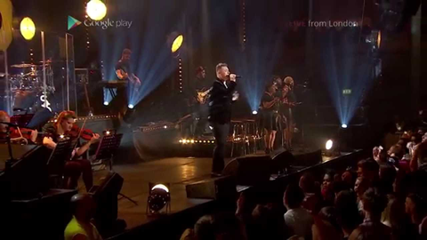
Sam Smith sings live during Channel 4 ad break
Challenge
An ambitious sales target of 100,000 set for Sam Smith’s album
Solution
Needed scale to achieve sales target
Universal Music worked with Mediacom and Channel 4 to deliver the world’s first live music performance in an ad break
Results
In The Lonely Hour was the fastest selling debut album of 2014
There were 101,000 sales of the album in week one
1.5m people saw the live ad on Channel 4
Notes:
Challenge:
Sam Smith is one of the UK’s biggest breakthrough artists of the last 18 months. He rose to stardom as the lead vocal on “Latch” by Disclosure and also “La La La” by Naughty Boy - which became a number one single in 2013 – but the public didn’t really know him as an artist in his own right.
In 2014, Sam won the BBC Sound of 2014 and BRITS Critics Choice Awards which generated a huge amount of interest in him. As a result, Universal Music and Sam’s record label, Capitol Records, had high expectations for his debut album In The Lonely Hour with an ambitious sales target of 100,000 records in week one.
Solution:
The live experience has always been the most powerful advertising for an authentic artist, as an audience can experience the genuine talent of a singer as well as witness their connection with a crowd. The challenge was how to take this experience of a gig to a wider audience. If the live experience could be delivered with innovation and excitement in a medium that reached a lot of people, they felt they could achieve both the scale they needed to hit the sales target whilst maintaining the credibility that was essential for long term success.
Working with their media agency, Mediacom, they came up with the idea of a live performance in a TV ad break. They collaborated with Channel 4, The Outfit production company and Google Play to deliver the world’s first live music performance in an ad break.
After teasing the event with trailers in the week prior, they took over the whole of the last ad break in Alan Carr’s Chatty Man which cut to Sam’s biggest gig to date at The Roundhouse in Camden, London. Live on air, Sam performed his latest No. 1 single Stay With Me to both the adoring crowd present as well as audiences around the country. With the crowd singing along with every word and an emotional Sam in tears by the end of the song, the nation got to see that Sam is a true star.
In addition, by doing the live performance in the ad break, it enabled Universal Music to showcase Sam Smith’s new single within Chatty Man, as he was unable to appear live on the show on account of him performing on the Graham Norton show on BBC1.
In order to provide viewers with the opportunity to consume more content once the three minutes were up, the ad directed viewers to GooglePlay, who hosted the live gig footage exclusively. In addition, the footage was hosted in various ad units including the YouTube masthead. .
Results:
In The Lonely Hour was the fastest selling debut album of 2014
There were 101,000 sales of the album in week one
1.5m saw the live ad on Channel 4, with 100,000 tuning in especially at 22.45 for the ad takeover
There were 680,000 views of the live stream via the Google Network
Superb reception on social media with a Twitter trending topic
Fantastic PR coverage in the UK
For the full case study and to view the ad campaigns visit: https://www.thinkbox.tv/Case-studies/Universal-Music-Sam-Smith

