Slide 1
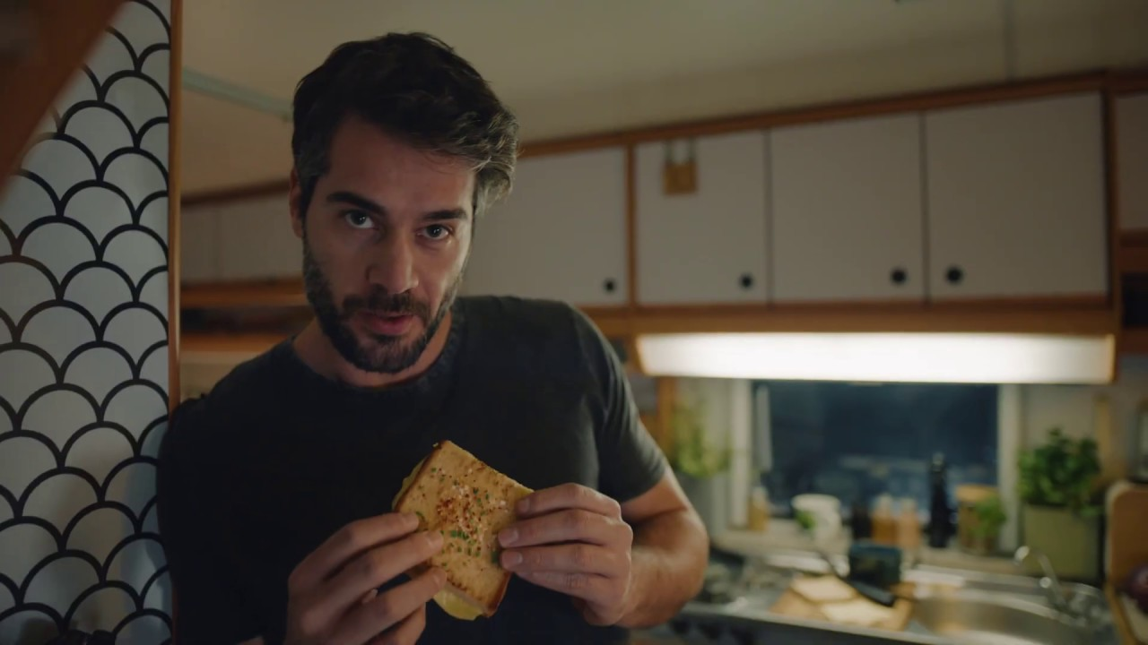
Violife: moving beyond the dairy-free aisle
Challenge
Violife are a well-known in the vegan, vegetarian and flexitarian market, but needed to change the perception of dairy-free cheese in order to become a competitor for all cheese.
Solution
Although the vegan revolution was still relatively new, cheese eaters overall represented a large proportion of the UK population, so reach was key. VCCP knew that there was only one channel that could ensure this mass reach – TV.
Results
Violife saw a 39% increase YoY in unit sales in 2019, with TV credited as the ‘hero channel’.
Their campaign has also benefitted the whole category, which has grown 28% between Q1 & Q4 in 2019.
TV spend has increased 150% YoY as a result of the campaign.
Notes:
The Challenge
John Lewis advertising is recognised as signalling the start of Christmas and each year is hotly anticipated. The John Lewis Christmas ad makes national news and captures consumers’ attention and eyeballs. This cultural moment creates a unique environment, blurring the lines between advertising and entertainment with people actively seeking out advertising, commenting and sharing it.
In the past 12 months, retailers have increased their media spending at Christmas by 20% to over £185m. John Lewis’s share of voice is only 4% so they are operating in a highly competitive market. They tasked their media agency Manning Gottlieb OMD to bring freshness to the John Lewis Christmas campaign for 2016.
The Solution:
MGOMD knew that the storytelling style of the Christmases ad would fit well on TV. In addition, they knew that the TV screen is the best for driving an emotional connection with the brand and also that viewers were watching more content on demand these days. So, working with Sky, they created the first ever ‘on-demand’ launch where viewers could watch the new ad whenever and wherever they wanted, as many times as they liked across any device.
There were two key phases:
Phase 1: The Binge View - a perfectly synced moment across all devices
Phase 2: Catch-up – opportunities to watch additional, behind the scenes content
Sky felt like the right broadcast partner because the John Lewis shopper and the Sky subscriber are aligned and because of Sky’s penetration of VoD services.
Alongside the ad, additional content was also available in the form of a behind the scenes making of the ad and a mini programme hosted by Sky talent Patrick Aryee looking at the urban living patterns of the animals featured in the ad.
Results
John Lewis achieved a 4.9% increase in sales, totalling £998m – their biggest Christmas ever
It was the biggest single day download ever with nearly 900,000 downloads
John Lewis content was over ten times bigger than the next biggest programme on launch day
679% increase year on year Facebook views, 117% increase year on year Twitter views and 25% increase year on year YouTube views
Over 22,000 Buster the Boxer soft toys sold in the first two hours
Winner of ‘Best Use of TV Innovation’ in TV Planning Awards
To read the full case study and access the creative visit: https://www.thinkbox.tv/Case-studies/John-Lewis-innovate-with-on-demand-advertising

