Slide 1
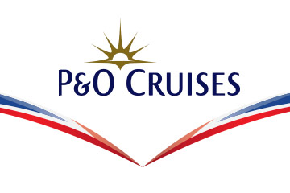

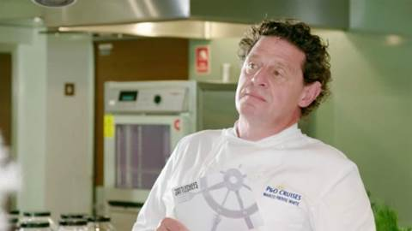
P&O Cruises and Battlechefs
Challenge
P&O Cruises wanted to build brand awareness and consideration using the style and class of its newest ship, Britannia, to promote the benefits of a P&O Cruise holiday
Solution
AFP ‘Battlechefs’ with UKTV channel W.
10 episodes in the series, promotional trailers on W, social and digital platforms
8 sponsorship idents per episode
Results
Spontaneous awareness of P&O Cruises was 73% for viewers compared to 53% for non-viewers – an uplift of 38%
One of the major take outs of the sponsorship was that ‘P&O Cruises have good food’
Notes:
The Challenge
P&O Cruises has eight ships in its fleet, each offering exceptional service and attention to detail, as well as speciality dining options and quality entertainment. In 2015, they wanted to build further brand awareness and also drive brand consideration.
To do this, they needed to show potential customers their points of difference to other cruise companies. P&O Cruises works with a number of top chefs, their Food Heroes, one of which is renowned chef Marco Pierre White and they also have a state of the art cookery school on the new ship, Britannia, which was launched by HM The Queen in March 2015.
Britannia is the largest of their ships, that combines the excitement of cruising with the sophistication of a five star hotel and it is specifically aimed at the British market. The challenge was how to use the style and class of Britannia to promote the benefits of a P&O Cruises holiday.
The TV Solution
P&O Cruises felt that by funding a TV programme, they could incorporate the most visible and distinctive elements of the guest experience in an entertaining, aspirational and highly relevant way. As such, ‘Battlechefs’ was developed as a celebrity-led cookery competition, combining the on board experience with the colour, vitality and speciality dishes in Mediterranean ports of call.
Two teams of celebrities competed to be the top Battlechef. They had to cook a three course dinner that reflected that day’s destination for the Captain and his VIP guests, under the guidance of Marco Pierre White.
The celebrities, who included Alex James, Jenny Eclair, Greg Rutherford, Jason Gardiner, John Partridge, Sam Bailey and Susannah Constantine, were on Mediterranean cruises where they met chefs and artisan cooks and learned about local delicacies. Each day, Marco nominated one celebrity to be head chef and decide on the menu for that evening.
Product placement was included as part of the deal. This meant that the series was filmed on board Britannia. The series was able to showcase the extensive guest spaces on board and in particular, the cookery school and the various bars, restaurants and deck space.
The Plan
Their broadcast partner was W – one of the UKTV family channels. The series launched on 4th April 2016, was stripped over two weeks and included branded promotional trailers and support on W’s social and digital platforms.
The programme was one hour long and there were ten episodes in total. The main show went out weekdays at 1900. There were repeats during the day adding up to a total of 40 transmissions. Each programme had three centre breaks so P&O Cruises had 8 sponsorship idents per episode.
Results
Spontaneous awareness of P&O Cruises was 73% for viewers compared to 53% for non-viewers – an uplift of 38%
Spontaneous + prompted awareness was 97% for viewers compared to 87% for non-viewers – an uplift of 11%
One of the major take outs of the sponsorship was that ‘P&O Cruises have good food’
Viewers recognised the association as a good fit, with high levels of enjoyment and persuasion
Partnership meant an uplift across all image statements, particularly for ‘P&O Cruises provides a broad choice of dining options’ which went from 42% amongst non-viewers to 72% amongst viewers aware of the sponsorship – an uplift of 71%
P&O Cruises moved ahead of Royal Caribbean on the metric ‘Offers cruises tailored to British tastes’
Likeability increased from 54% amongst non-viewers to 74% amongst viewers aware of the sponsorship – an uplift of 37%
Consideration also increased with 39% of viewers aware of the sponsorship saying they would seriously consider booking a cruise with P&O Cruises compared with 16% of non-viewers
To read the full case study and access the creative visit: https://www.thinkbox.tv/Case-studies/P-and-O-cruises

