Slide 1


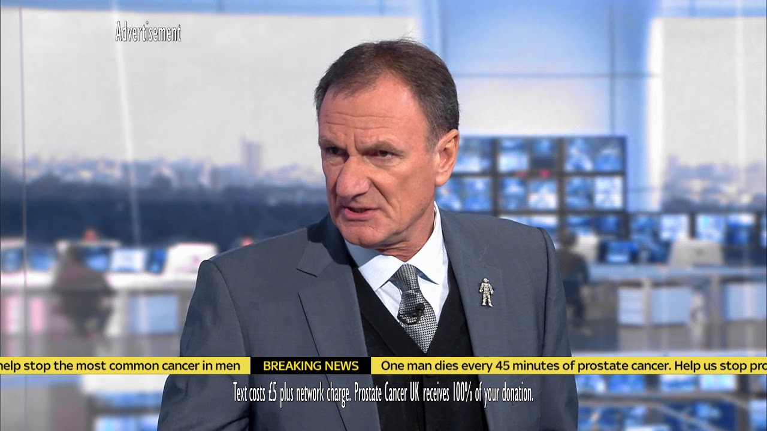
Prostate Cancer UK’s bid to change the game for men
Challenge
Prostate Cancer needed the public to know what they did and what a lapel badge known as their “Man of Men” was all about
Solution
They used Sky Sports’ Soccer Saturday team, led by Jeff Stelling, to talk about the badge, what it represents and why it is important
The unscripted ad had a ‘behind the scenes’ feel and went out in football matches to reach 45+ men whilst watching with their friends & family
Results
Sold 15,000 “Man of Men” badges, alongside significant spikes in donations and sign ups
Notes:
Challenge
Prostate cancer has now overtaken breast cancer, making it the third biggest killing cancer in the UK. Today, one man dies every 45 minutes of prostate cancer in the UK and after decades of underfunding, Prostate Cancer UK wanted to raise build trust and knowledge of their cause with the public to raise money to fund research. Despite famous faces in football sporting the charity’s man-shaped badge and making it highly recognisable, research told them not enough people understood the significance or associations the badge had with Prostate Cancer UK.
Prostate Cancer UK’s media agency - the7stars needed to create a solution to inform football fans about the purpose of the badge as well as creating the motivation and pride to wear it themselves. Subsequently, this would encourage further engagement with Prostate Cancer UK and drive donations. The audience needed to know that the ‘Man of Men’ badges represented everyone in the fight against prostate cancer and how they could purchase one.
The Solution
The campaign needed to give the target audience of 45+ men a sense of authenticity on the topic that would allow them to feel like it’s a big issue – something that’s relevant to them and a team they want to be a part of.
Sky Sports indexes highly amongst 45+ men and the Sky Sports Soccer Saturday team, particularly Jeff Stelling, had a number of reasons to show their support and raise money. As this group were respected and listened to by the male audience, the7stars believed they were best placed to deliver the message about what the badge represents and why it was important. It was decided that football pundit and supporter of the cause Jeff Stelling was the ideal face to lead the campaign.
To encourage conversation, it was crucial that the creative was viewed with family and friends and not when they were alone. For this reason, Boxing Day was chosen as the optimal time to launch the campaign, as traditionally on this day, families come together and tune in to the football. This unique day offered the perfect opportunity to kickstart conversations about men’s health. In addition, advertising on TV would allow this engagement to happen simultaneously in many homes right across the country.
With direct access to the nation’s favourite Sky Sports pundits, Prostate Cancer UK was able to hijack the half time breaks on Boxing Day for both Tottenham vs. Southampton & Liverpool vs Swansea that season. These cherry-picked spots provided the perfect opportunity to reach 45+ Men whilst they were surrounded by loved ones and less likely to be alone.
The7stars used a 60” creative designed with a ‘behind the scenes’ look, where Jeff candidly starts talking with his co-hosts about what the badge means to him. By mentioning how one man dies every 45 minutes from prostate cancer, it created a relatable time frame for the issue as there are 45 minutes in a football half. The unscripted conversation put authenticity behind their words which made the emotional reactions feel genuine. This took the film beyond advertising and garnered an element of respect from the target audience.
Results
The launch day created so much interest that Prostate Cancer UK’s site crashed
Each subsequent day saw immediate increases in web traffic and over the Prostate Cancer UK site, there was a 17% increase in page views
By the end of January, 15,000 badges had been sold, alongside significant spikes in donations and event sign ups
To read the full case study and access the creative visit: https://www.thinkbox.tv/Case-studies

