Slide 1

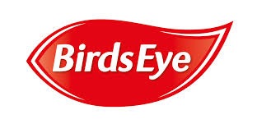
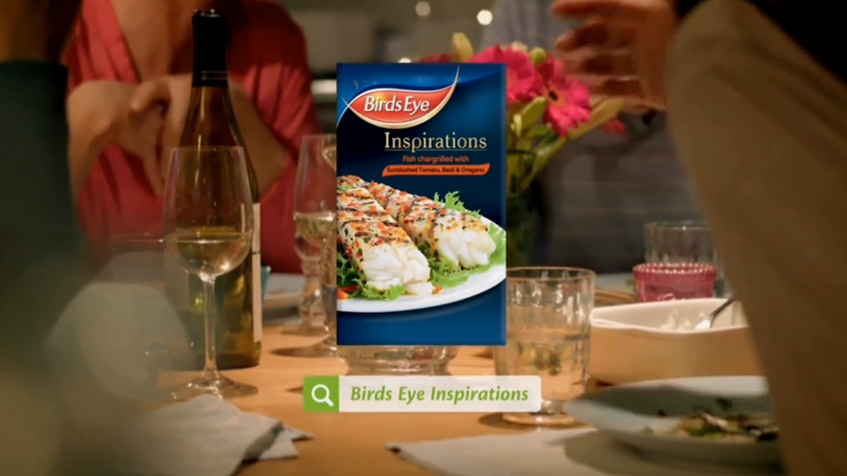
Birds Eye Inspirations - most successful food & drink launch of 2014
Challenge
Birds Eye set themselves the challenge to double their business by 2020 and promote a more modern image, starting with the launch of their new premium Inspirations range
Solution
Devised the strategy – ‘Refreshing Modern British Mealtimes’
Widened the target audience from family shoppers to include couples and individuals
Produced three creative treatments - one for each audience segment
Results
£46m worth of Inspirations brand sales
Most successful food/drink launch of 2014
Notes:
Challenge
Everybody knows Birds Eye. It is one of those enduring, intrinsically British brands. This is down to the fact that we have all grown up with it in our freezers. Moreover, Birds Eye have a rich heritage of classic TV ads – from a very young Patsy Kensit popping her cheek for peas, to good old Captain Birdseye, to the polar bear Clarence hiding in your freezer.
The challenge that Birds Eye set themselves was to double their business by 2020. In order to achieve this, they needed to ensure that consumers see them as a modern food brand offering convenient, delicious meal solutions that fit in with the time pressures of 21st Century life. Their advertising agency, Havas Worldwide, came up with a creative look and feel called “The Food of Life” which reflected the brand’s future as much as its past and would set them on the path towards realising their ambition.
Birds Eye’s media agency, Havas Media, were tasked with launching Birds Eye Inspirations – a premium range of chicken and fish dishes. It is vitally important for a launch to be successful in the FMCG market as there is so much competition for space with retail partners. Also, you need to drive enough customers to purchase the product in the first 14 weeks of a product’s life cycle to justify retailer’s continuing to list the product.
So the two key objectives were to drive reach and awareness for the Inspirations range and to deliver big sales in order to get retailers to continue to list it.
Solution
One of the key audiences they wanted to target was family main shoppers, as they had done in previous campaigns. However, they decided to widen the target to include couples and individuals either side of the family life-stage. This meant time-poor young professionals plus empty nesters. Both audiences want quick and convenient food, but without compromising on taste. For these consumers, meal decision moments are likely to be closer to the meal occasion, as there is a lower level of meal planning. Also, they take a more ad hoc approach to their grocery shopping, fitting it in whenever they can in their busy lives.
There were two key insights that informed the planning process. One was that often shoppers don’t even go in to the frozen food aisle due to the popularity of chilled foods. The second was that if they did visit the frozen food aisle, they did not linger there as it was so cold. So the advertising campaign needed to prime customers to be aware of Inspirations and interested in the range, to give them a reason to go to the freezer section and look for the products.
The strategy devised by Havas was “Refreshing Modern British Mealtimes”.
Refreshing – priming customers by driving awareness of the new product and refreshing pre-existing opinions about the Birds Eye brand
Modern – demonstrating the brand’s understanding of modern British food and meal requirements, engaging and educating consumers about Inspirations, driving trial and consequently sales
Meal Times – ensuring presence was strongest in meal time related moments, when people were thinking about meals and making choice decisions
Television was central to activating the strategy. This is because it could cover all audiences and drive awareness such that the launch was unmissable.
Plan
Havas Worldwide created three TV ads that allowed communication with the different facets of the audience; family execution, friends and couples. The creative was rotated according to which one was the best fit with the programme.
Each product had a TV campaign that started with a four week initial burst to build 80% 1+ cover, followed by a two week break, then back on for a two week pulse strategy. It was run at heavy weights because previous econometric learnings had told them this was necessary for a new product launch.
In terms of programming, they bought shows with high ratings and universal appeal such as Coronation Street, Britain’s Got Talent, Gogglebox and the British Soap Awards. To target the non-family segment, they opted for programmes such as How I Met Your Mother, Celebrity Juice and 24 Hours in A&E.
Across the 14 weeks of the launch period, they bought over 1600 ratings.
The TV campaign was supported by VoD on ITV Player and 4oD. They ran an Ad Elect campaign on 4oD that allowed users to choose whether they wanted to see the Fish or Chicken creative. This delivered higher completion rates and three times higher CTR than standard pre-rolls.
There was also activity on social media, online display, OOH and mobile.
Results
On TV, the campaign reached 90% of viewers with frequencies of 9.6 OTS for Fish ad and 10.8 OTS for Chicken
VoD delivered 129,000 clicks to site – well above target
There were £46m worth of Inspirations brand sales in 2014
According to the Kantar World panel, the Birds Eye Inspirations launch was the most successful food and drink launch of 2014
There was a halo effect on sales of some other Birds Eye products whilst the Inspirations campaign was live
To read the full case study and access the creative visit: https://www.thinkbox.tv/Case-studies/Birds-Eye

