Slide 1
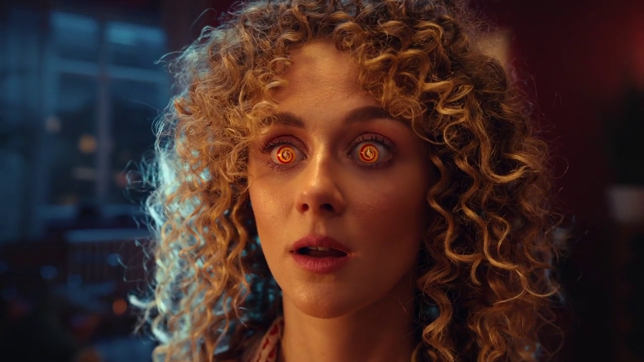
Monthly TV viewing report
October 2024
Cheez It, “Couple”

Slide 2
October linear TV facts & figures
Total TV weekly reach %
Total TV viewed per day
Commercial TV viewed per day
Impacts
Individuals
76.1 | 52.6bn | 2h 12m | 1h 29m
79.0 | 51.0bn | 2h 31m | 1h 42m
78.7 | 19.5bn | 1h 58m | 1h 13m
57.7 | 3.3bn | 36m | 26m
77.6 | 22.6bn | 2h 23m | 1h 37m
80.4 | 28.4bn | 2h 38m | 1h 46m
76.2 | 3.6bn | 1h 18m | 55m
Adults
ABC1 adults
16-34
Men
Women
Housepersons with children
Sources: Barb October 2024, industry standard TV viewing in-home on a TV set. Reach 3min+. 30” equivalent impacts.
Notes:
October linear TV figures for weekly reach, impacts, total TV viewing hours and commercial TV viewing hours

Slide 3
Some notable TV moments in October
On 14 October, ITV1 aired new drama Joan to a live audience of 1.28m, time-shifted audience of 1.26m, and a pre-broadcast audience of 1.65m.
On 30 October, E4 aired Married at First Sight UK to an average audience of 2.04m on TV Set and 324k on device.
On 10 October, Channel 5 aired new All Creatures Great and Small to an average audience of 3.46m.
On 24 October, Sky Showcase aired new drama Sweatpea to an average audience of 990k.
Source: Barb, October 2024, individuals. Average audience figures, TV set and devices viewing 1-7 days (includes pre-broadcast figures, if applicable).

Slide 4
Top 5 ITV1 programmes
Coronation Street (14 October) 4.62 million viewers
Joan (13 October) 4.30 million viewers
DI Ray (20 October) 4.15 million viewers
Emmerdale (15 October) 4.13 million viewers
UEFA Nations League: England v Greece (10 October) 3.69 million viewers
“DI Ray”, ITV1
Source: Barb, October 2024, individuals. Average audience figures, TV set and devices viewing 1-7 days (includes pre-broadcast figures, if applicable)
Notes:
Top 5 programmes - ITV

Slide 5
Top 5 Channel 4 programmes
The Great British Bake Off (1 October) 6.52 million viewers
Gogglebox (4 October) 3.45 million viewers
Grand Designs (2 October) 1.73 million viewers
Taskmaster (3 October) 1.67 million viewers
Celebrity SAS: Who Dares Wins (13 October) 1.58 million viewers
“Gogglebox”, Channel 4
Source: Barb, October 2024, individuals. Average audience figures, TV set and devices viewing 1-7 days (includes pre-broadcast figures, if applicable)
Notes:
Top 5 programmes – Channel 4

Slide 6
Top 5 Channel 5 programmes
All Creatures Great and Small (10 October) 3.46 million viewers
The Hardacres (7 October) 2.77 million viewers
Ellis (31 October) 2.39 million viewers
Phillip Schofield Cast Away (1 October) 1.90 million viewers
Police Interceptors (28 October) 1.31 million viewers
“The Hardacres”, Channel 5
Source: Barb, October 2024, individuals. Average audience figures, TV set and devices viewing 1-7 days (includes pre-broadcast figures, if applicable)
Notes:
Top 5 programmes – Channel 5

Slide 7
Top 5 commercial non-PSB* programmes (non-sport)
Married at First Sight UK, E4 (24 October) 2.75 million viewers
Big Brother, ITV2 (6 October) 1.40 million viewers
The Chelsea Detective, U&Drama (30 October) 1.05 million viewers
Sweetpea, Sky Showcase (24 October) 0.99 million viewers
Our Farm Next Door: Amanda, Clive and Kids, More4 (14 October) 0.97 million viewers
“Big Brother”, ITV2
Source: Barb, October 2024, individuals. Average audience figures, TV set and devices viewing 1-7 days (includes pre-broadcast figures, if applicable)
Notes:
Top 5 programmes – commercial non-public service broadcasting channels

Slide 8
Top 5 Netflix programmes
Sing: Thriller (16 October) 2.48 million viewers
Woman of the Hour (18 October) 1.78 million viewers
A Man Called Otto (13 October) 1.55 million viewers
Sweet Bobby: My Catfish Nightmare (16 October) 1.51 million viewers
The Menendez Brothers (7 October) 1.50 million viewers
“Sing: Thriller”, Netflix
Source: Barb, October 2024, individuals. Average audience achieved during the first seven days of their availability. Only includes TV set viewing.
Notes:
Top 5 programmes – Netflix

Slide 9
Top 5 Disney+ programmes
Rivals (18 October) 1.06 million viewers
Agatha All Along (3 October) 0.97 million viewers
Only Murders on the Building (15 October) 0.92 million viewers
Grey's Anatomy (10 October) 0.47 million viewers
9-1-1 (17 October) 0.42 million viewers
“Rivals”, Disney+
Source: Barb, October 2024, individuals. Average audience achieved during the first seven days of their availability. Only includes TV set viewing.
Notes:
Top 5 programmes – Disney+

Slide 10
Top 5 Amazon Prime Video programmes
The Lord of the Rings: The Rings of Power (3 October) 1.40 million viewers
Nautilus (25 October) 0.89 million viewers
Canary Black (24 October) 0.61 million viewers
UEFA Champions League (1 October) 0.58 million viewers
The Devil's Hour (18 October) 0.29 million viewers
“Canary Black”, Amazon Prime Video
Source: Barb, October 2024, individuals. Average audience achieved during the first seven days of their availability. Only includes TV set viewing.
Notes:
Top 5 programmes – Amazon Prime Video

Slide 11
Top commercial programmes with largest proportion of device viewing
Total audience
2.37m
1.07m
1.02m
4.18m
1.02m
Source: Barb, October 2024, individuals. Average audience figures, TV set and devices viewing up to 7 days post-broadcast. Based on programmes with 1 million+ total TV viewers
Notes:
Top commercial programmes with largest proportion of device viewing

Slide 12
Top commercial programmes with largest proportion of pre-broadcast boxset BVOD viewing
Total audience
4.18m
1.04m
3.90m
3.77m
2.04m
Source: Barb, October 2024, individuals. Average audience figures, TV set and devices viewing up to 7 days post-broadcast. Based on programmes with 1 million+ total TV viewers
Notes:
Top commercial programmes with largest proportion of pre-broadcast boxset BVOD viewing

Slide 13
Key new to linear TV advertisers in October
Pet Health Club Pet care provider, Pet Health Club, aired its first ever TV ad showcasing its subscription service.
Isuzu Car manufacturer, Isuzu, launched a 30-second mental health advert to normalise mental health discussions among men aged 35+.
MoneyPlus Debt management plan provider, MoneyPlus, launched its first ever TV campaign.
Isuzu, “Let’s talk about mental health”
Notes:
New to TV advertisers in October.

