Slide 1
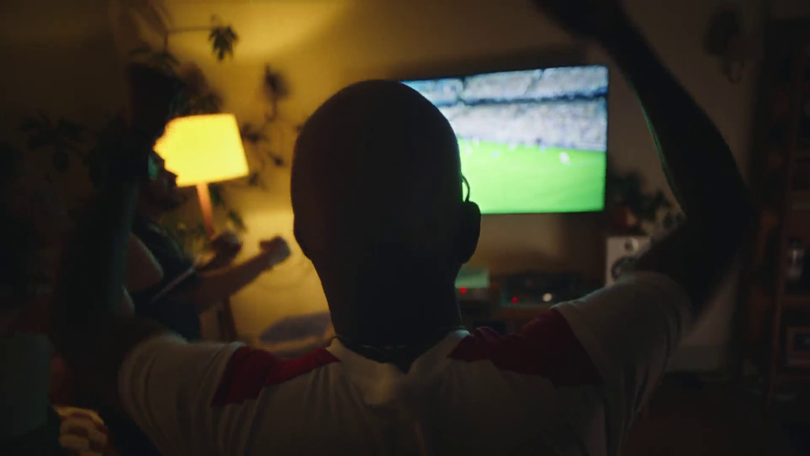

The power of trust
Open AI – Chat Football

Slide 2
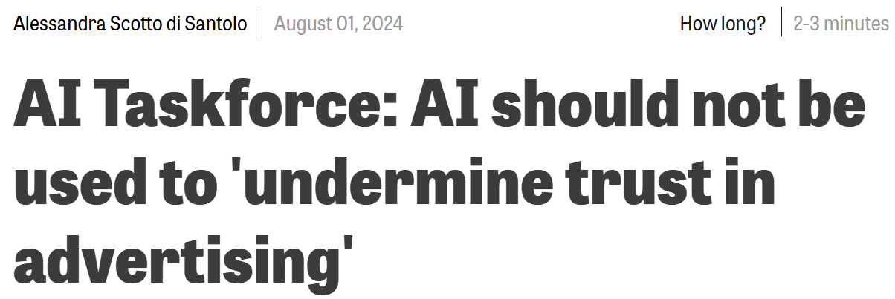
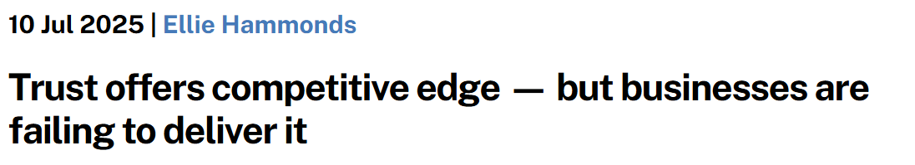
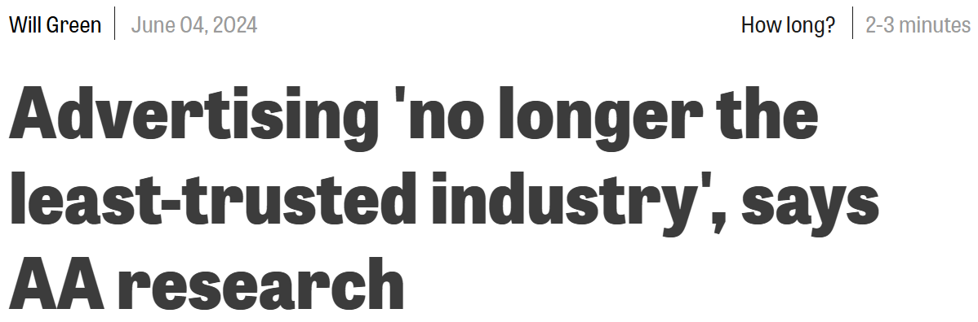
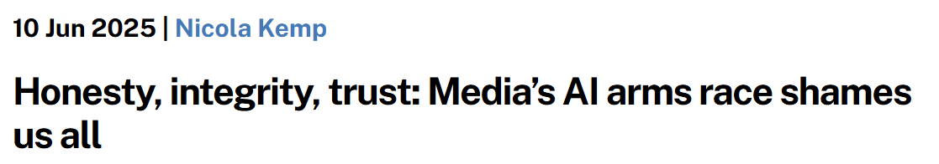
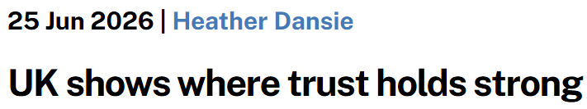
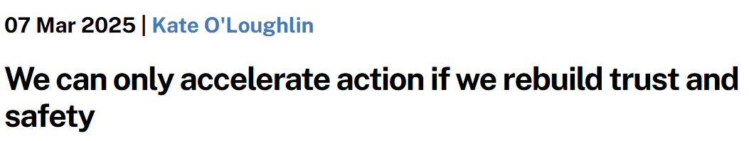
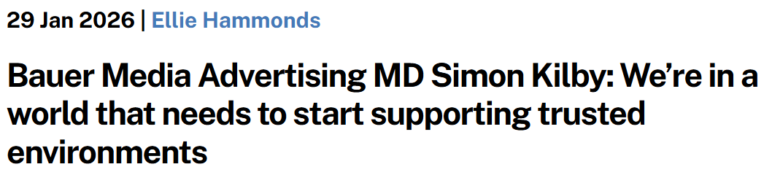
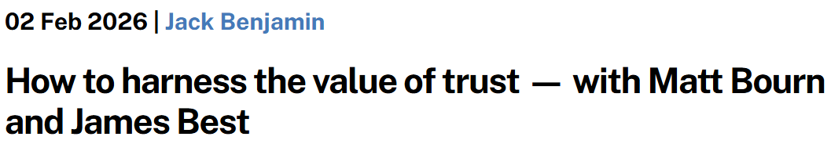
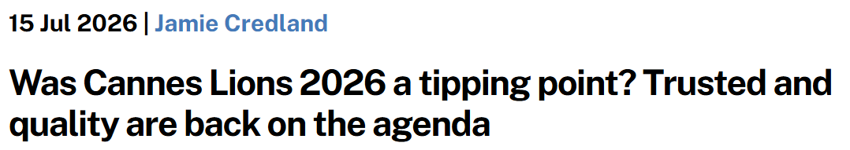
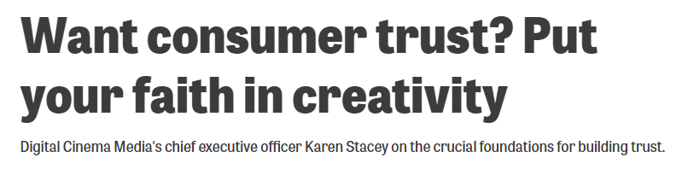
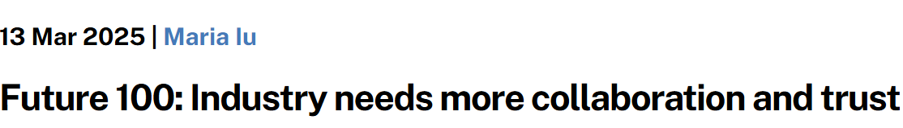
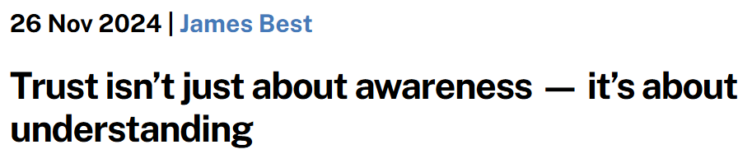
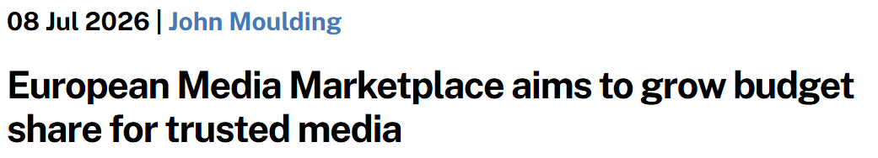
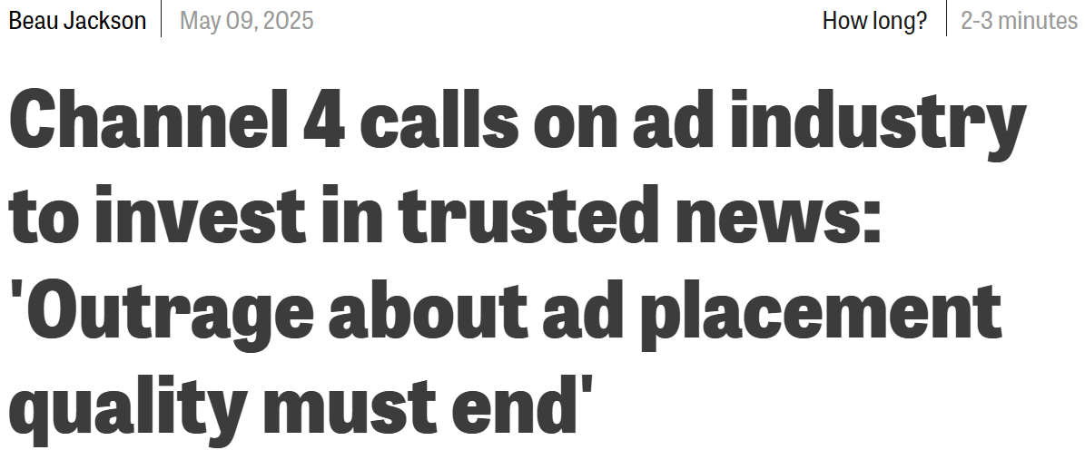
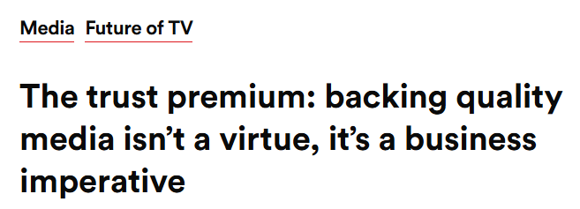
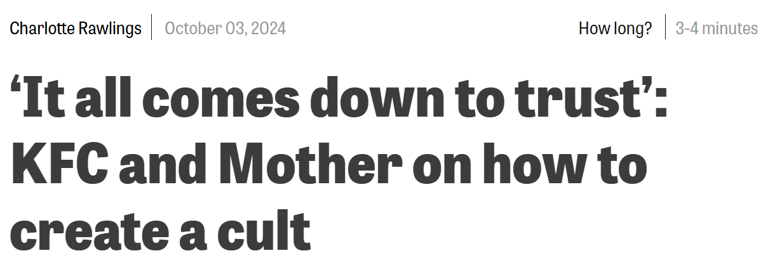
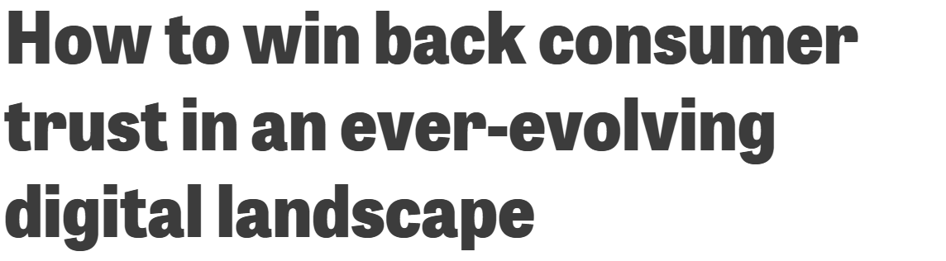
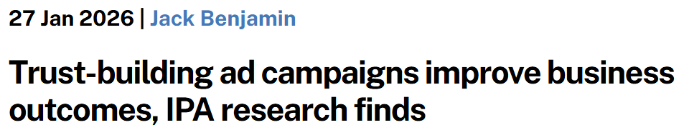
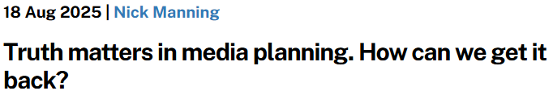

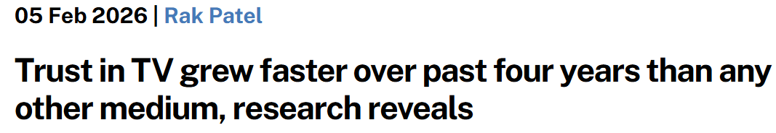
Everyone seems to want to talk about trust
Source: The Media Leader, Campaign, Videoweek, The Drum
Notes:
Trust has become one of advertising’s most written-about ideas. The trade press is full of it – articles, reports and opinions pieces exploring it’s role in building brands and shaping behaviour.

Slide 3

“Ad effectiveness and purchase intent were significantly higher when the ad was displayed on a platform that the audience trusted”
Source: Kristin Stewart (California State University/San Marcos) & Isabella Cunningham
(University of Texas/Austin), Journal of Advertising Research, 2017
Toyota - Imagine the Possibilities
Notes:
The Journal of Advertising Research also states that ‘ad effectiveness and purchase intent were significantly higher when the ad was displayed on a platform that the audience trusted.’

Slide 4


Trust is linked to profit growth
Source: IPA Databank 2004-2022 for profit cases reporting very large trust improvements. NB: insufficient data prior to 2008.
Notes:
Analysis from the IPA shows that over the last 20 years the relationship between building trust in a brand and achieving greater profit has strengthened considerably. Twenty years ago, trust was the least important of the seven brand mental availability metrics that the IPA monitors, today it is the second most important, bested only by the perceived quality of the brand.
Read more here: https://www.thinkbox.tv/research/reports/tv-is-at-the-heart-of-effectiveness-whitepaper-by-peter-field

Slide 5
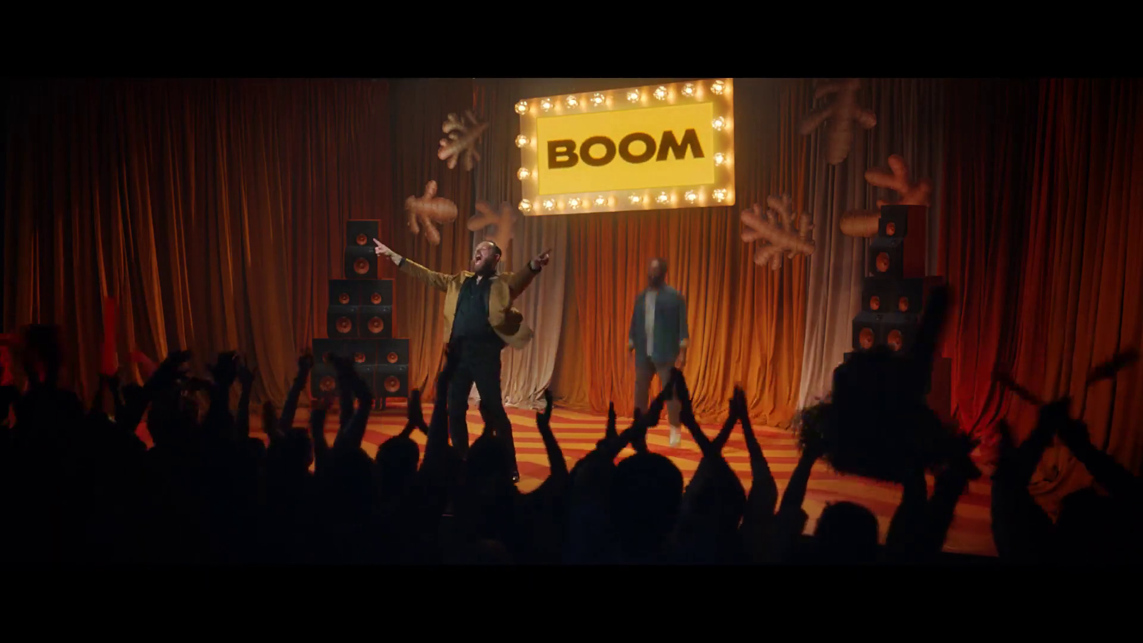
Trust now ranks as the No. 2 metric linked to driving business effects
Source: IPA Effectiveness Databank 2016 - 2024
Moju - Game Show
Notes:
Analysis from the IPA shows that over the last 20 years the relationship between building trust in a brand and achieving greater profit has strengthened considerably. Twenty years ago, trust was the least important of the seven brand mental availability metrics that the IPA monitors, today it is the second most important, bested only by the perceived quality of the brand.
Read more here: https://www.thinkbox.tv/research/reports/tv-is-at-the-heart-of-effectiveness-whitepaper-by-peter-field

Slide 6
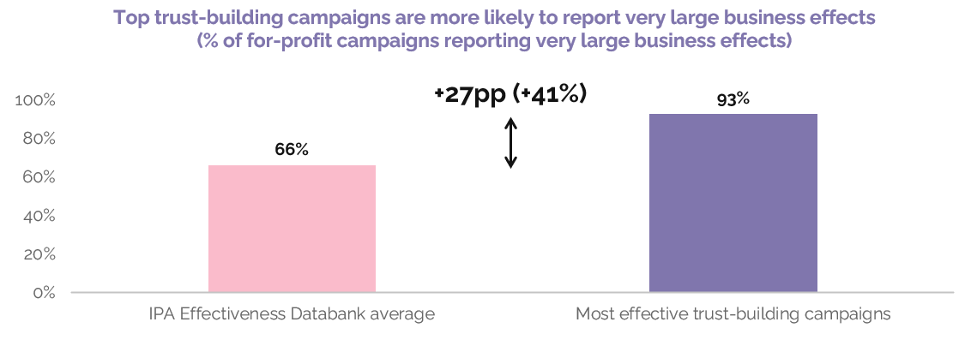
Trust is important because it’s linked to business effects
Source: Trust-building advertising works, IPA, 2026. N=812 for-profit IPA Effectiveness Databank campaigns 1998 to 2024.
Notes:
Data from the IPA shows that the most effective for-profit trust-building campaigns are more likely to record very large business effects.
93% of for-profit campaigns reporting very large trust effects also record very large business effects (e.g. a very large rise in market share, profit, or other commercial metrics). They are +27pp (+41%) more likely to report very large business effects than the IPA Effectiveness Databank for-profit average.
Read more here: https://ipa.co.uk/knowledge/documents/trust-building-advertising-works

Slide 7
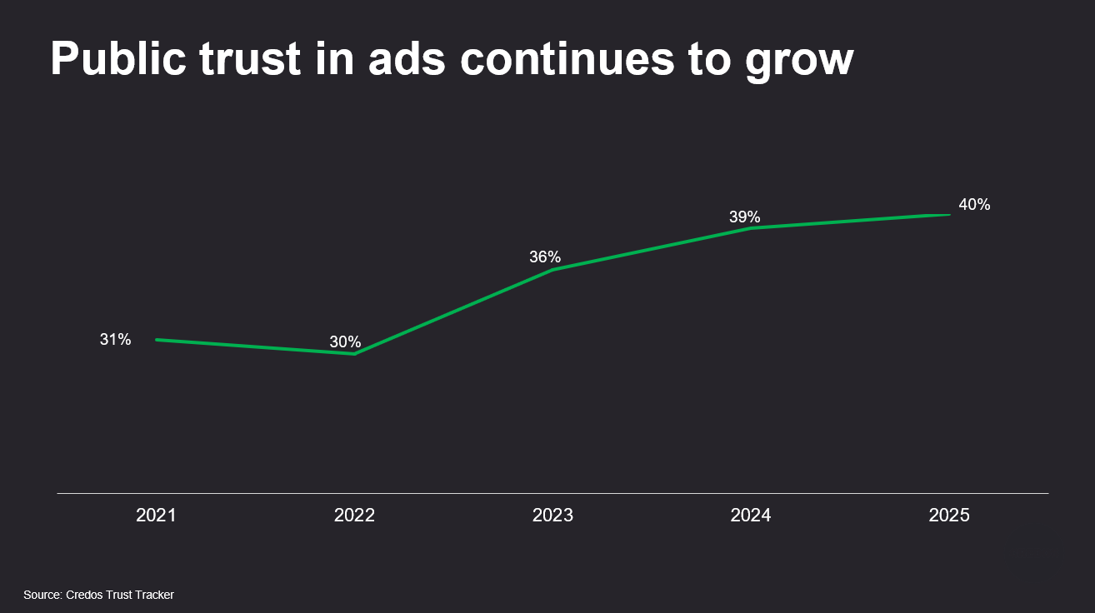
Advertising’s reputation is recovering
Source: Public Trust in Advertising, Advertising Association, Credos. 2026.
Notes:
In terms of trust in ads and the advertising industry, research from the Advertising Association and Credos shows how public trust is rising (however it’s starting from a low base).
It’s reached the highest level recorded over the past 5 years in 2025. 40% of people now trust ads they come across.

Slide 8
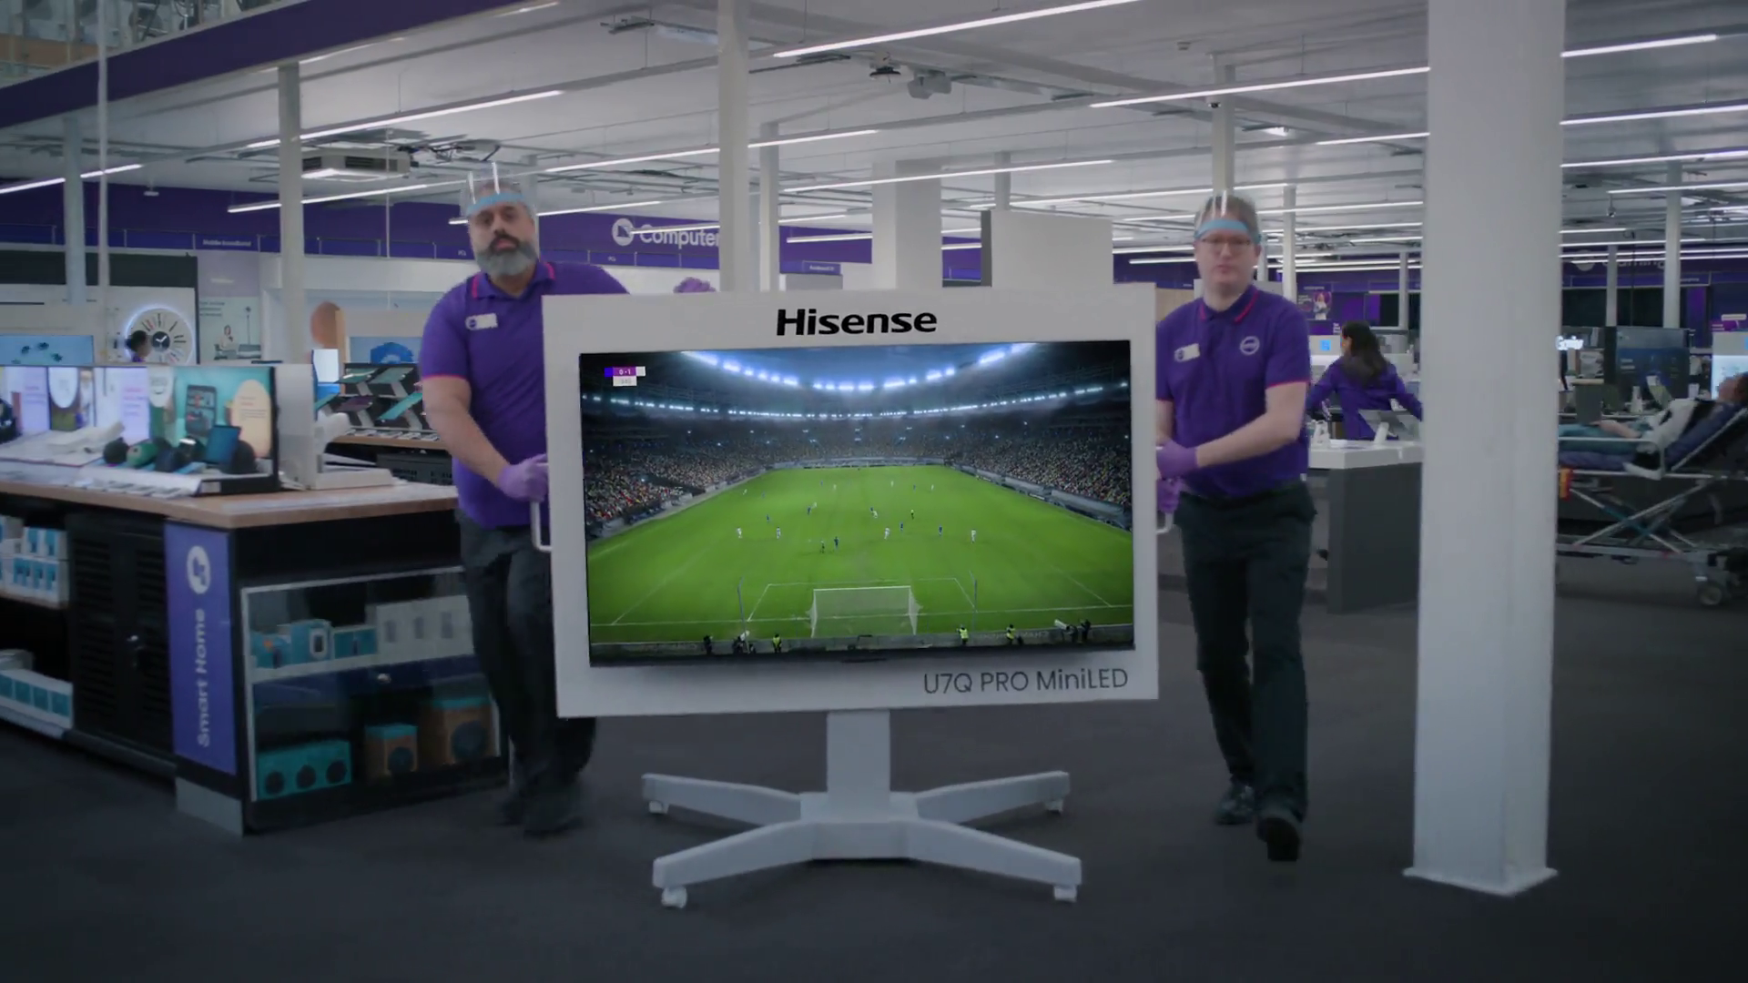
+44%
More likely to trust advertising seen within professional content
+15%
Currys - Analysis Paralysis
Higher brand trust when watched with others
Source: Context Effects, Map The Territory & Tapestry Research, 2024. Staying Power, Tapestry Research, 2025.
Notes:
Context Effects (Thinkbox, 2024) used ethnography and SEM to analyse in-home video viewing. It found that ads shown within professionally produced content were seen as 44% more trustworthy than those in user-generated or unregulated environments.
TV’s in-home, shared, high-attention setting creates the ideal conditions for trust to flourish.
Similarly, in Staying Power (Thinkbox, 2025), analysis shows that TV’s strength is amplified in shared viewing contexts, when people watch TV with others, brand trust grows 15%.
Read more about Context Effects here: https://www.thinkbox.tv/research/thinkbox-research/context-effects
Read more about Staying Power here: https://www.thinkbox.tv/research/thinkbox-research/staying-power-the-longevity-of-advertising

Slide 9
Perceived cost signals trust
TRUST SIGNAL
Source: Signalling Success, 2020, house51/Thinkbox. Base: all adults (3,654)
Notes:
In Signalling Success (2020), analysis found a very obvious linear relationship between perceived cost of an advertising channel, and key brand metrics, such as brand quality & brand trust.
As perception of advertising cost increases, so do trust & quality scores of brands advertising on those channels. There’s a direct relationship between the perceived cost of an advertising channel and how trusted and high-quality its brands are seen to be. The more people believe a medium costs, the more credibility its advertisers gain. TV’s perceived expense, even though it’s fantastic value, boosts brand stature.
Read more here: https://www.thinkbox.tv/research/thinkbox-research/signalling-success

Slide 10
There’s a clear relationship between perceived reach and trust signals
TRUST SIGNAL
Source: Signalling Success, 2020, house51/Thinkbox. Base: all adults (3,654)
Notes:
In Signalling Success (2020), there was a very obvious linear relationship between perceived reach of an advertising channel, and key brand metrics such as brand trust.
As perception of advertising reach increases, so do trust & quality scores of brands advertising on those channels.
Read more here: https://www.thinkbox.tv/research/thinkbox-research/signalling-success

Slide 11
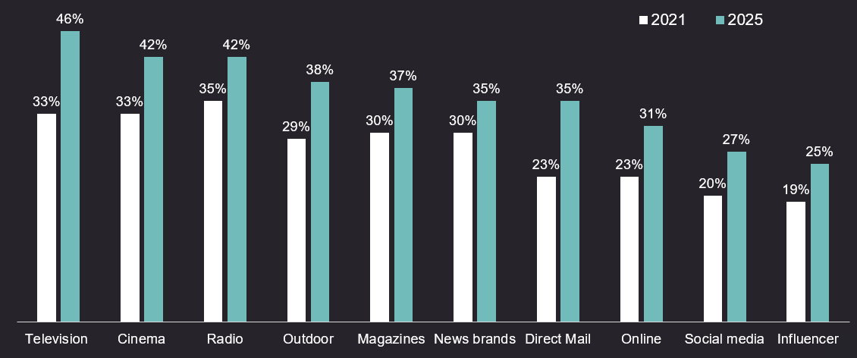
TV advertising is the most trusted medium
Source: Credos Trust Tracker (Advertising Association).
Q. To what extent, if at all, do you trust each of the following types of advertising in relation to products and services? (very trusting / fairly trusting), Kantar, 2025, n= 2,534
Notes:
One factor is becoming a clear differentiator in advertising: trust. As uncertainty grows and consumer confidence declines, it’s playing an increasingly critical role in shaping brand preference and driving profitability.
This chart highlights data presented at LEAD 2026 from the 2025 Credos Trust Tracker revealing a key trend: trust in advertising has increased across every media channel since 2021.
One channel stands out. TV is the most trusted advertising environment. Between 2021–2025, trust in TV grew faster than any other medium, reaching 46%, outperforming online ads (31%), social media (27%) and Influencer content (25%).
To dive deeper into why trust matters for brands and why TV continues to lead, read more here: https://www.thinkbox.tv/why-tv/unrivalled-trust

Slide 12
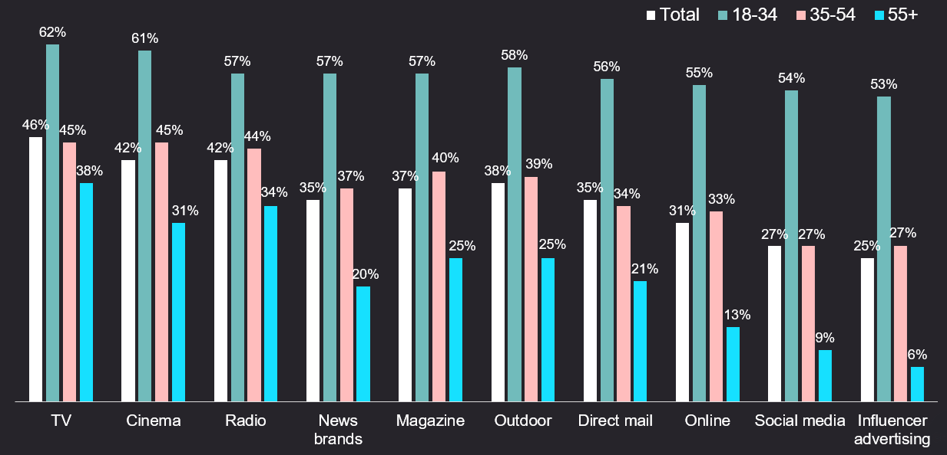
A generational trust difference
Source: Credos Trust Tracker (Advertising Association).
Q. To what extent, if at all, do you trust each of the following types of advertising in relation to products and services? (very trusting / fairly trusting), Kantar, 2025, n= 2,534
Notes:
Data presented at LEAD 2026 from the 2025 Credos Trust Tracker revealed a generational trend in perception of trust, with younger audiences more trusting than older audiences.

Slide 13
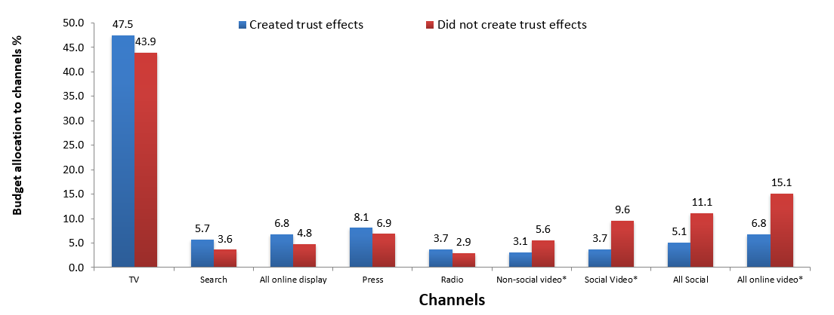
TV is a trusted medium
Source: IPA Databank 2014-2022 for profit cases *data available from 2016
Notes:
Recent years have seen a strengthening relationship between advertising trust and advertising driven profit. Comparing IPA survey data from 2014-2022 with data from 2000-2012, trust jumped from the seventh-highest brand metric linked to profit to the second-highest, just below quality.
Trust is often correlated with quality and has become increasingly important. Consumers are continuously forming assessments of the quality of the brands they may buy, based on whether they trust the brand (and its advertising).
Data showcased by effectiveness expert Peter Field at The Future of TV Advertising Global 2023 suggests that there seems to be a relationship between campaigns that created trust effects and their budget allocation to different media. Field’s work shows that campaigns using TV, search, online display, press, and radio achieved enhanced trust effects; whilst social media, social video, and online video were much less likely to deliver positive trust effects.
Additionally, many previous research studies have emphasised the importance of trust – not least Thinkbox’s ‘Adnormal Behaviour’ (conducted by Ipsos), which revealed how TV outperformed all other media as the leading source of advertising that people trust.

Slide 14
People trust brands on TV more than any other channel
% of people that trust brands that advertise on…
Source: Tapestry Research, 2025, ADS1a. Thinking about different places in which you see advertising, please tell us how you feel [TRUSTED] about brands that advertise [INSERT TYPE OF AD]. Social media e.g. Facebook, Instagram and TikTok.
Notes:
Trust in advertising is more important than ever. Amid growing uncertainty and declining consumer confidence, trust has become a key driver of business outcomes like brand preference and profitability.
Analysis from Tapestry Research highlights where consumers place their trust when it comes to advertising platforms. We asked people about the different places they see advertising and how they felt about brands that advertised on those channels.
Analysis reveals that people are most likely to describe brands advertising on TV as trusted (24%), with newspapers and magazines coming in second at 20%. People are least likely to describe brands advertising on YouTube (12%) and social media (9%) as trusted.
To dive deeper into why trust matters and why TV continues to lead, read more here: https://www.thinkbox.tv/why-tv/unrivalled-trust

Slide 15
Brand trust rises across channels as age drops
Source: Tapestry Research, 2025, ADS1a. Thinking about different places in which you see advertising, please tell us how you feel about brands that advertise [INSERT TYPE OF AD]. Social media e.g. Facebook, Instagram, TikTok.
Notes:
When Tapestry Research analysed the percentage of people who trust brands that advertise across different media channels, segmented by age group, the results showed that brand trust generally increases as age decreases. Younger audiences consistently reported higher levels of trust in brands across all media channels than older age cohorts.

Slide 16



TV advertising is seen as most trustworthy
Newspapers
Radio
Magazines
Search
Cinema
TV
Social Media
Outdoor
Direct Mail
YouTube
Websites
Source: Adnormal Behaviour, 2022, Ipsos / Thinkbox. Q.TN3: In which, if any, of the following places are you most likely to find advertising that...you trust
Base: ‘normal’ people (1,158)
Notes:
Thinkbox’s ‘Adnormal Behaviour’ work showed that TV ads were see as the most trusted form of advertising.
For more information on this study, see the full write up on the Thinkbox website:
https://www.thinkbox.tv/research/thinkbox-research/adnormal-behaviour/

Slide 17
TV, magazines & radio deliver strongest trust signal
Trust to deliver on promises made
Average trust signal
TRUST SIGNAL (% POSITIVELY SCORING)
Source: Signalling Success, 2020, house51/Thinkbox. Base: all adults (3,654)
Notes:
‘Signalling Success’ is the first-known UK research dedicated to the behavioural science principle of ‘signalling’, which has been widely discussed by academics and behavioural scientists. The theory suggests that the perceived cost and scale of an advertising campaign translates to improved brand attributes.
In addition to capturing an explicit measure of brand trust, ‘Signalling Success’ also used implicit research techniques to uncover the ‘emotional trust’ signals delivered by different types of advertising.
The ‘Signalling Success’ study found that TV advertising drives the strongest ‘fitness’, ‘social’ and ‘trust’ signals.
Statements asked within the study were split into three groups based on the type of signal communicated:
‘Fitness’ signals cover the perceived brand quality, financial strength of the company and the company’s confidence in their brand.
‘Social’ signals cover the brand’s perceived fame, popularity and success.
‘Trust’ covers the perceived degree to which the brand will deliver against the promises it makes within its advertising.
The above chart demonstrates:
Brands advertising on TV, magazines and radio are perceived as most trusted to deliver on promises made.
30% rated brands advertising on TV as trusted to deliver on promises made, making TV the most trustworthy medium, just ahead of magazines (29%) and radio (28%).
Advertising on video sharing sites was least likely to deliver brand trust at 19%.
The full study can be found here: https://www.thinkbox.tv/research/thinkbox-research/signalling-success/

Slide 18


The trust for TV and radio is deeply embedded
TRUST
High, more effort
High & Automatic
% Agree
100%
Rational Trust
Emotional Trust
SLOW
FAST!
0%
Low, more effort
Avg RT
Low & Automatic
Reaction time
Source: Signalling Success, 2020, house51/Thinkbox. Base: all adults (3,654). Please see notes for detail on implicit trust calculation.
Notes:
‘Signalling Success’ is the first-known UK research dedicated to the behavioural science principle of ‘signalling’, which has been widely discussed by academics and behavioural scientists. The theory suggests that the perceived cost and scale of an advertising campaign translates to improved brand attributes.
In addition to capturing an explicit measure of brand trust, Signalling Success also used implicit research techniques to uncover the ‘emotional trust’ signals delivered by different types of advertising.
Research respondents were shown a series of words in relation to the fictional brand being tested. The explicit agreement/disagreement with the words shown was timed, and the speed of response was used as a measure of implicit brand association. This research technique is commonly used to give a ‘true’ reflection of deeper brand perception.
house51 used a score of four brand associations (see below for detail) to establish the ‘emotional trust’ signals delivered by media channel. This chart demonstrates that the trust in TV and radio was significantly stronger and more automatic than the trust in social media and video sharing sites. This is important for brands as emotional trust is deeper, and therefore more resilient, than trust based on rational thoughts. Whilst rational trust can disappear after just one bad brand experience, emotional trust generally weathers the storm. It’s based on an understanding that even though the experience fell short of expectation, brands with high levels of emotional trust will effectively be given a ‘second-chance’ - the negative experience is seen as more of a blip than a dip.
NB. Trust is a composite of implicit reaction to popular, competent, honest, not cheap, not risky, not unreliable.
The full study can be found here: https://www.thinkbox.tv/research/thinkbox-research/signalling-success/

Slide 19
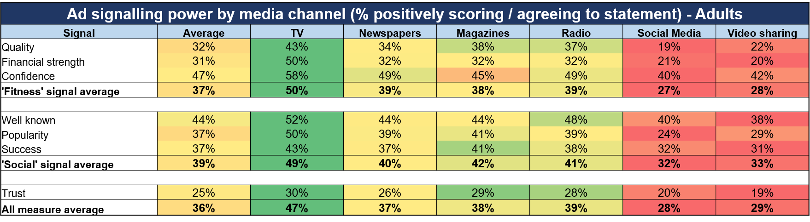
Across the board, TV drive the strongest signals
Source: Signalling Success, 2020, house51/Thinkbox. Base: all adults (3,654)
Notes:
‘Signalling Success’ is the first-known UK research dedicated to the behavioural science principle of ‘signalling’, which has been widely discussed by academics and behavioural scientists. The theory suggests that the perceived cost and scale of an advertising campaign translates to improved brand attributes.
In addition to capturing an explicit measure of brand trust, ‘Signalling Success’ also used implicit research techniques to uncover the ‘emotional trust’ signals delivered by different types of advertising.
The ‘Signalling Success’ study found that TV advertising drives the strongest ‘fitness’, ‘social’ and ‘trust’ signals.
Statements asked within the study were split into three groups based on the type of signal communicated:
‘Fitness’ signals cover the perceived brand quality, financial strength of the company and the company’s confidence in their brand.
‘Social’ signals cover the brand’s perceived fame, popularity and success.
‘Trust’ covers the perceived degree to which the brand will deliver against the promises it makes within its advertising.
The full study can be found here: https://www.thinkbox.tv/research/thinkbox-research/signalling-success/

Slide 20
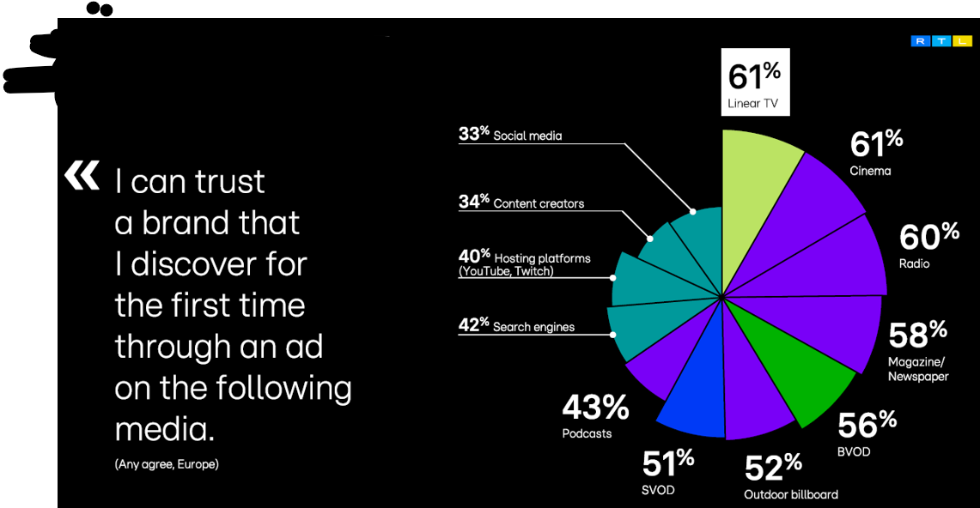
TV and Cinema drive the highest level of trust
Source: The New Life of the Living Room by RTL AdAlliance. Online field from 25 Jan. to 7 Feb. 2025. 12,297+ respondents aged 18-64.
Europe 14: Austria, Belgium, Denmark, Finland, France, Germany, Italy, the Netherlands, Norway, Poland, Spain, Sweden, Switzerland, the UK.
Notes:
Research conducted by RTL shows that Linear TV remains a trusted environment for many viewers in Europe, with 61% expressing confidence in the brands they encounter.
Radio follows closely (60%) and magazines and newspapers are at 58%. BVOD performs strongly too, with 56% of viewers expressing trust in the brands they see there.
By contrast, trust drops when people move to more open ecosystems such as YouTube (40%) and social media (33%).

