Slide 1


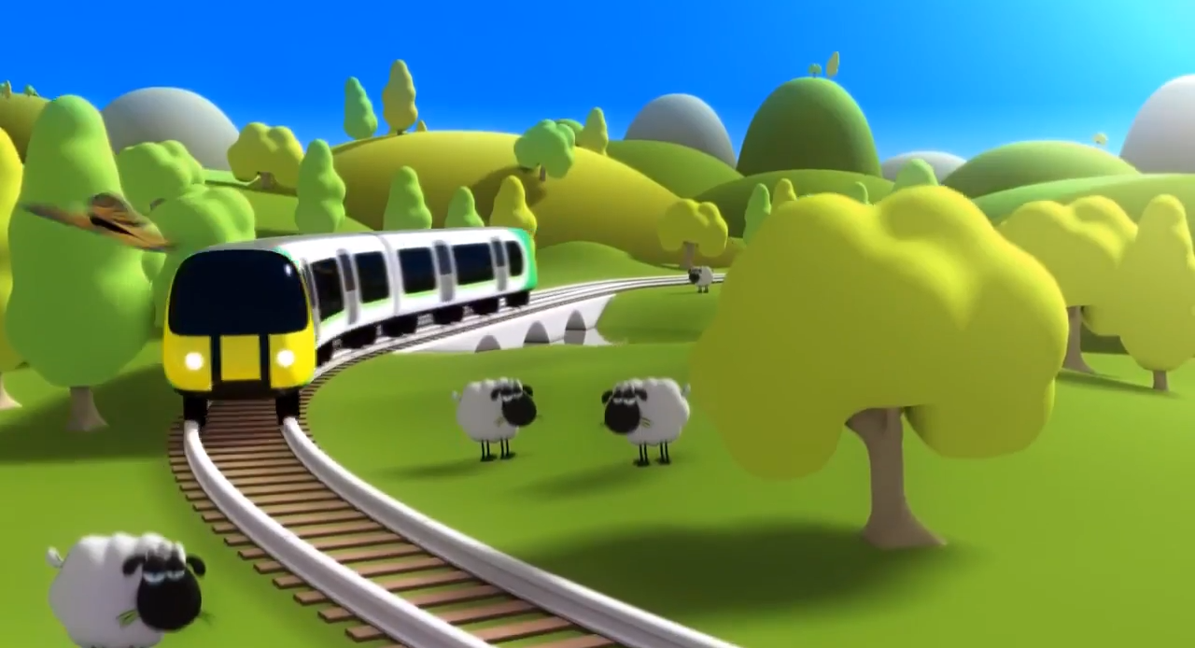
London Midland gets back on track by using TV for the first time
Challenge
London Midland wanted to boost their short term sales whilst establishing the brand as THE local rail operator
Solution
Opted to use ITV due to the micro regional flexibility that could deliver the campaign to the Central West region only
Able to purchase almost 500 adult ratings over four weeks which established London Midland as a big brand
Results
New registrations increased by 85%
Reached 65% of adults in their key region
Notes:
The Challenge
London Midland operates a railway franchise in the midlands. In a difficult recessionary period, they needed to increase short term sales and to establish themselves as THE local rail operator.
Their objectives were to
Increase propensity to take a leisure trip
Drive switching from a competitor train operator
Encourage switching from a coach operator along the same route
Achieving these objectives was made more difficult by the tight geographical nature of their business and a limited budget of less than £200,000.
The challenge was to deliver London Midland’s core “cheaper” message to a narrow geographical audience across a business-crucial time period.
In the past, they had used local messages at each train station and local media options. They had never before considered driving a wider, more broadly targeted message but felt that it was the right time to do this as the brand was struggling.
The Solution
London Midland had never used TV before but their agency, OMD, felt that now was the right time to utilise what TV can offer. TV is proven to drive awareness quickly and has the power to change the fortunes of a brand. In addition, ITV have the micro regional flexibility to deliver the tight geographical footprint required. So they opted for the micro region Central West which offers an adult reach of over 4million.
They created a fun ad using animated characters that helped tell the viewers who London Midland are and gave them a feeling of where to go. It also provided them with an offer and drove them online to buy tickets.
With their budget, they were able to buy nearly 500 adult ratings which were spread over a period of 4 weeks. This is a heavy weight of advertising and so meant that, to viewers in this region, London Midland felt like a big brand.
Results
There was an 85% increase in new registrations to their online booking system
The return on investment was extremely positive with an uplift of 38% versus the 3 previous years
They reached 65% of adults in their key region
They were shortlisted in Thinkbox’s TV Planning Awards in the ‘Best Newcomer to TV’ category
To read the full case study and access the creative visit: https://www.thinkbox.tv/Case-studies/London-Midland

