Slide 1


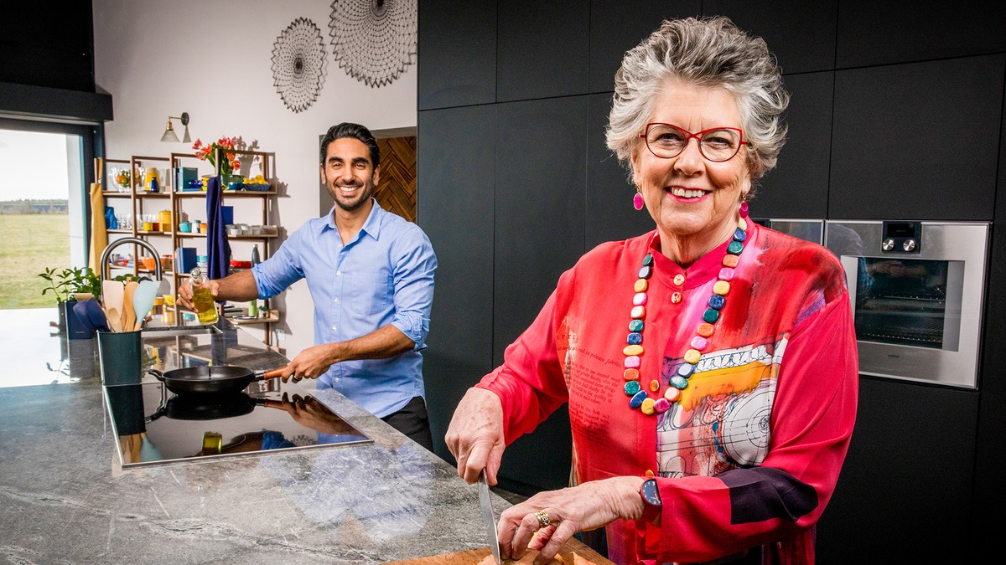
Hellmann’s shows us how to cook clever and waste less
Challenge
Hellmann’s wanted to encourage a reduction in food waste and promote their product as the perfect ingredient to improve a leftovers meal
Solution
They created a 4-part prime time TV series, ‘Cook Clever, Waste Less’ that ran on Channel 4
The programme, starring Prue Leith, gave practical tips and money-saving advice
Results
Traffic to Hellmann’s website increased by 500%
Viewers saved 3.1m kg of food waste, saving 5.9m kg of CO2 emissions
Notes:
The Challenge
If food waste was a country, it would be the third largest emitter of greenhouse gases in the world. However, mass awareness of the impact of food waste on global warming was still lacking compared to other, more widely accepted, contributors.
Hellmann’s is on a mission to help people say no to waste and yes to taste. As Hellmann’s is the perfect ingredient to turn leftovers into a delicious meal, the challenge was about how to raise awareness of the fact that UK households are major contributors to the food waste issue.
Simply highlighting the food waste problem was not enough. Helmann’s needed to demonstrate their passion for taste over waste, establish credibility for their purpose and make a genuine difference. They needed to convince the UK public to start saving meals from the bin and in the process, save tonnes of carbon.
The TV Solution
Mindshare’s research around sustainable behaviours uncovered an important and powerful insight – in recent years it has been broadcast programmes that have been the catalyst for environmental behaviour change. For example, 88% of Blue Planet 2 viewers changed their plastic lifestyle. This type of hard-hitting, long-form content creates impact and builds an emotional connection that makes the issue matter more, which in turn inspires change.
To make Hellmann’s the beacon for food waste and to trigger behaviour change, Mindshare used this insight and created a prime-time TV programme, ‘Cook Clever, Waste Less’, that put the issue front and centre, engaging the audience to affect change.
They enlisted top UK cook and self-proclaimed Queen of Leftovers, Prue Leith, along with NHS GP and food expert, Dr. Rupy Aujla, to turn four British families from food wasters to waste warriors, showing them the impact of their food waste and inspiring them to change their cooking and eating behaviours for good. The programme gave practical tips and money-saving advice such as the benefits of meal planning, batch cooking and re-using leftovers.
The Plan
The series consisted of four 30-minute episodes that aired in peak on Channel 4 and on All 4, with the usual sponsorship idents around the show. To complement the series, they created a TV ad with Dr. Rupy Aujla that set out Hellmann’s commitment to food waste. These spots ran first-in-break in each episode as well as across the C4 network.
Alongside the TV activity, they created a host of digital assets for social media and online video that ran throughout the campaign period. In addition, they produced a downloadable recipe book that sat on Hellmann’s website and meant that people had a useful resource to help combat their waste at home.
Results
15% uplift in people agreeing with the statement “Hellmann’s helps use food that would otherwise go to waste”
Traffic to Hellmann’s website increased by 500%
Over 40,000 recipe books were downloaded
3.4m people tuned in to watch ‘Cook Clever, Waste Less’
32% of viewers said they would start using leftovers from their meals after watching the show
Viewers saved 3.1m kg of food waste from landfill, saving 5.9m kg of CO2 emissions which is equivalent to a full year of electricity for 1,450 British households

